Slide 1


Louisiana Networks of Excellence for Tomorrow
(LA-NEXT)
NSF EPSCoR OIA - 2437963

Slide 2

EPSCoR Collaborations for Optimizing Research Ecosystems (E-CORE)
The E-CORE RII Program aims to support EPSCoR-eligible jurisdictions to:
Address challenges and opportunities in research infrastructure specific to the current and evolving needs of a jurisdiction's science and technology research ecosystem;
Build capacity for jurisdiction-wide investigator expertise into critical masses for sustained, effective, research and education partnerships and funding; and
Develop pathways to broaden the participation of institutions and individuals in the jurisdiction's research ecosystem.

Slide 3


FIRST Louisiana 2030
Louisiana’s S&T Roadmap
Target Industry
Sectors
Clean and Renewable Energy
Advanced Manufacturing
Healthcare
Bioengineering
Resilient Infrastructure
Advanced Manufacturing
Structural Integrity Assurance
Clean Energy
Coastal Restoration
Resilience & Disaster Recovery
Cyber-Physical Systems
Biomedical & Healthcare Solutions
Agriculture & Forestry Products
Innovation &
Incubation
Materials and Manufacturing
Bioscience and Biotechnology
Energy Solutions
Environmental Solutions
Cross-cutting: Data, Computational Science, and Cybersecurity
Networks of
Excellence
Shared Experimental R&D Infrastructure
Shared Computing and Data Infrastructure
Shared Data and Research Libraries
Building Blocks
Foundations
STEM Disciplines
Computer and Information Sciences
Social, Behavioral, and Economic Sciences

Slide 4
Louisiana Networks of Excellence for Tomorrow (LA-NEXT)
Vision
Coordinate, build, and sustain strong networks of collaboration, communication, and partnership among Louisiana’s various institutions to transform the STEM R&D enterprise of the State.
Mission
LA-NEXT will drive a transformation of the R&D ecosystem through coordination, facilitation, and capacity building in strategic areas identified by the FIRST Louisiana 2030 plan.

Slide 5
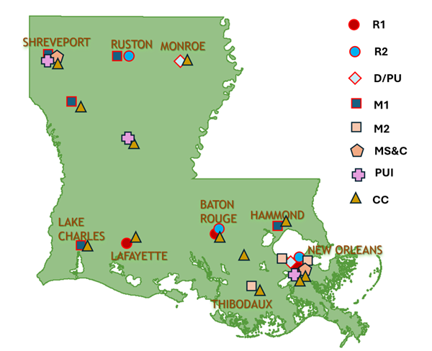
State’s Higher Education Enterprise
3 Carnegie R1 institutions (LSU, Tulane, and ULL)
3 R2 institutions (Louisiana Tech, Southern, and UNO)
2 Doctoral/professional (D/PU) universities
8 Masters institutions (5 M1 and 3 M2)
2 Medical Schools and Centers (MS&C)
3 Primarily undergraduate institutions (PUI)
12 community colleges (CC) that belong to the Louisiana Community and Technical College System.

Slide 6
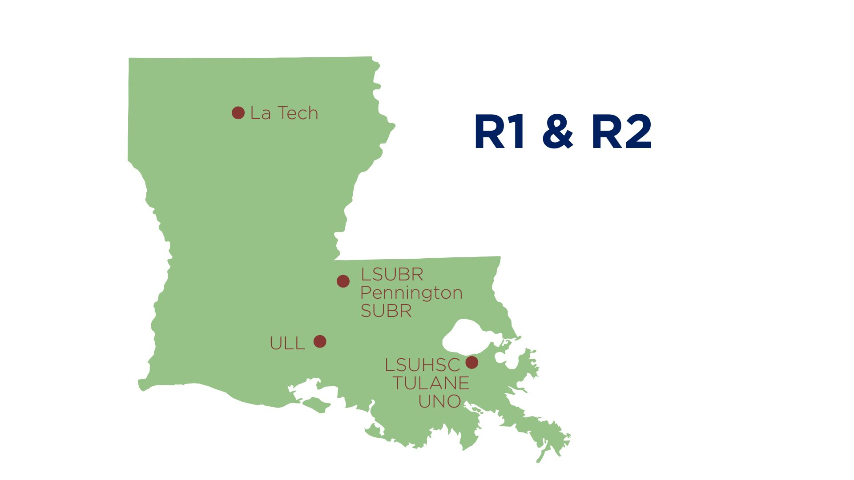

Louisiana EPSCoR
Eligibility (Mentor Institutions)

Slide 7
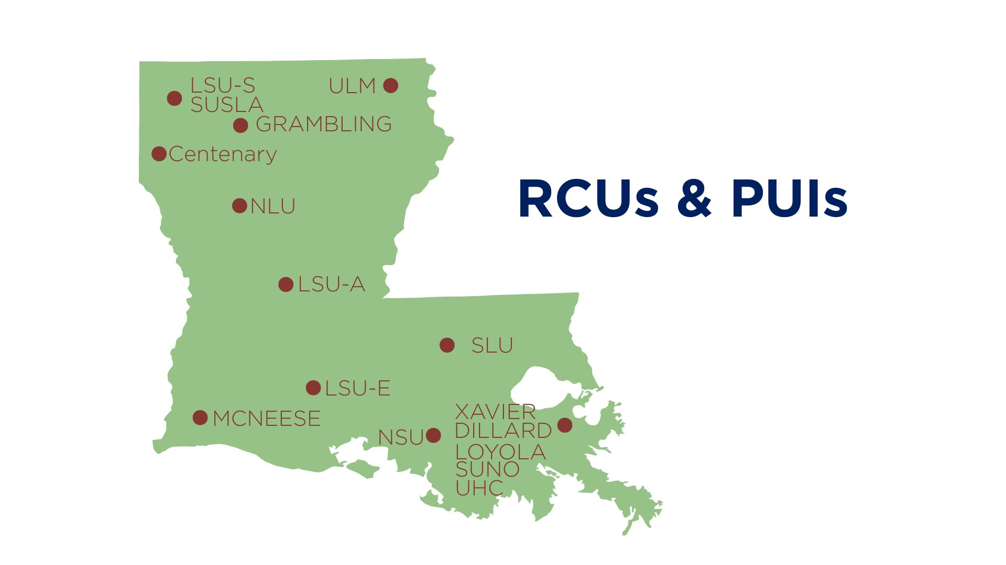
Louisiana EPSCoR
Eligibility (Mentee institutions)

Slide 8
Louisiana EPSCoR
Initiating Growth through Networks and
Interdisciplinary Teamwork (IGNITE)
GOALS
Increase the involvement of Research Colleges and Universities (RCU) and Primarily Undergraduate Institutions (PUI) faculty in STEM research
Establish research collaboration networks between RCUs and PUIs with R1 and R2 institutions in the State
Continued collaborations that lead to external funding and products
Increased access to shared research instrumentation and facilities in Louisiana

Slide 9
Louisiana EPSCoR
Initiating Growth through Networks and
Interdisciplinary Teamwork (IGNITE)
STRATEGY
Strengthen the mentoring mechanisms for new faculty at all types of institutions.
Establish mechanisms to integrate D/PU, M1, M2, and PUI faculty into the R&D enterprise.

Slide 10
Louisiana EPSCoR
Eligibility
MENTEE (Principal Investigator)
Must be a faculty member at an institution classified as a Carnegie Research College and University (RCU) or Primarily Undergraduate Institution (PUI)
Award up to $10,000
MENTOR
Must be tenured or tenure-track
Award up to $5,000

Slide 11
Louisiana EPSCoR
Eligible Disciplines
STATE SCIENCE & TECHNOLOGY PRIORITY AREAS
Advanced Manufacturing
Agriculture & Forestry
Biomedical
Cybersecurity
Coastal Restoration
Energy
Resilience & Disaster Recovery
Structural Integrity Assurance
https://rsi.laregents.edu/program-evaluations-2/state-st-plan/

Slide 12
Louisiana EPSCoR
Allowable Expenses
MENTEE (Principal Investigator from: RCU and PUI institutions)
Salary
Student support
Materials and Supplies
Travel
Publication costs
MENTOR (R1 and R2 institutions)
Materials and Supplies
Travel

Slide 13
Louisiana EPSCoR
Next Steps…
LA-NEXT COLLABORATION ENHANCEMENT (LANCE)
Available in year 2 of LA-NEXT
Intended to strengthen existing collaborations, such as those built through IGNITE
Awards anticipated to be in the $30-40K range

Slide 14
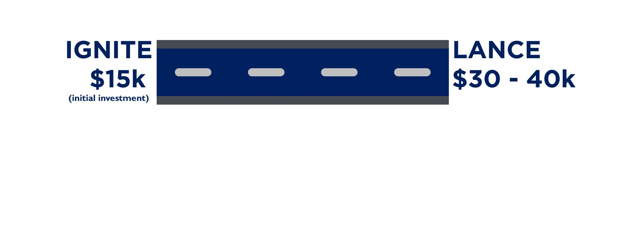
Louisiana EPSCoR
Roadmap from IGNITE to LANCE
IGNITE proposals are due on October 27, 2025, by 4:30 pm Central Time
https://rsi.laregents.edu/la-epscor-2/epscor-programs/la-next-funding-opportunties/

