Slide 1
PRESENTATION TO THE MEDIFUND BOARD MAY 14, 2014 SPONSORED PROGRAMS: COMPETITIVE REVIEW PROCESS
Kerry Davidson
Deputy Commissioner for Sponsored Programs
Louisiana Board of Regents

Slide 2
MEDIFUND LAW
(Act 320 of the 2013 regular session)
“MediFund Program shall be administered by the Board of Regents through its Sponsored Programs Unit”
“All grant application review and grant selection processes shall follow the competitive request for proposals process and external review process as may be utilized by the Sponsored Programs Unit, including published criteria, so as to ensure impartial and merit-based grant selection.”

Slide 3
Constitutional Amendment: 1986
Louisiana Education Quality Trust Fund (LEQTF)
$540M
$1.2B
$660M
$540M
Oil & Gas Settlement
Corpus has grown to $1.2B
25% of interest earnings added back annually until reaches $2B
Louisiana Education Quality Support Fund (LEQSF)
75% of interest earnings from Trust Fund received annually
Divided evenly between BESE and BoR

Slide 4
SUPPORT FUND TIMELINE: ADVISORY PROCESS TO AWARDING OF GRANTS BY BOARD OF REGENTS FY 2013-14
Oct.-Dec. 2012:
BoRSF Advisory Process
Dec. 2012:
BoR Approval of Plan & Budget
Jan.-June 2013:
Legislative/
Gubernatorial Review & Approval
July 2013:
Dissemination of RFPs
Sept.-Nov. 2013:
Consultants Engaged
October 2012 – April 2014
April 23, 2014:
Action of BoR on FY 2013-14 Awardees
April 1-21, 2014:
Campus Reviews
April 1, 2014:
Completion of Reports
November 2013-
March 2014:
Consultants Conduct Reviews

Slide 5































Board of regents support fund april 23, 2014
180 Awards Across 32 Campuses

Slide 6
I.
Endowed Chairs
II.
Enhancement
III.
Superior
Graduate Fellows
IV.
Research & Development
THIRTEEN Subprograms
Sponsored Programs Staff: RFPs to Recommended Grants
Medifund Board/ Regents: Budgets – Programs –
Eligible Grantees – Biosciences
– RFPs
 | Proposals Recommended/Awarded | Funds Recommended/Awarded
11 Competitive Subprograms | 114 | $12,916,087
2 Non-Competitive Subprograms | 66 | $ 2,620,000
TOTALS | 180 | $15,536,087

Slide 7
BOARD OF REGENTS SUPPORT FUND PROGRAMS
FY 2013-14 PRIOR AND NEW COMMITMENTS
FY 2013-14 Budget: $23,000,000
Prior Commitments: $10,577,500
New Commitments: $10,953,762

Slide 8
Board of Regents Support Fund programs
Fy 2013-14 Commitments from Future Budgets
FYs 2014-15 through 2018-19 : $4,582,325

Slide 9
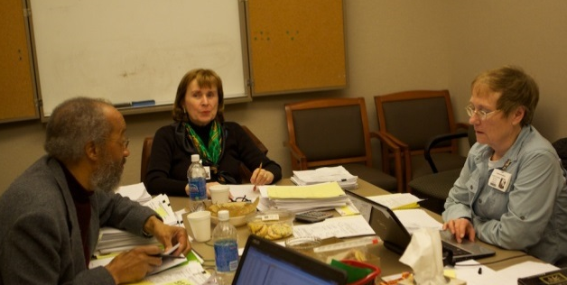
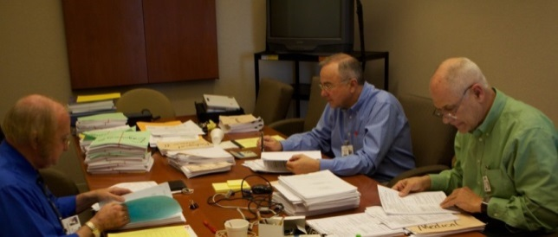
GOALS
Competitive & merit-driven process
Allocate Dollars Consistent with Constitutional Goals and Regents’ Priorities
Insure Both Appearance and Substance of Objectivity and Fairness
Undergraduate Enhancement Panel Reviewing Proposals
Prepare Faculty and Departments for Federal Grants Competition:
Comparable Reviewers to NSF/NIH
Proposal Feedback
Provide Regents with Basis for Evaluation and Accountability
Research Competitiveness Subprogram Panel Reviewing Proposals

Slide 10
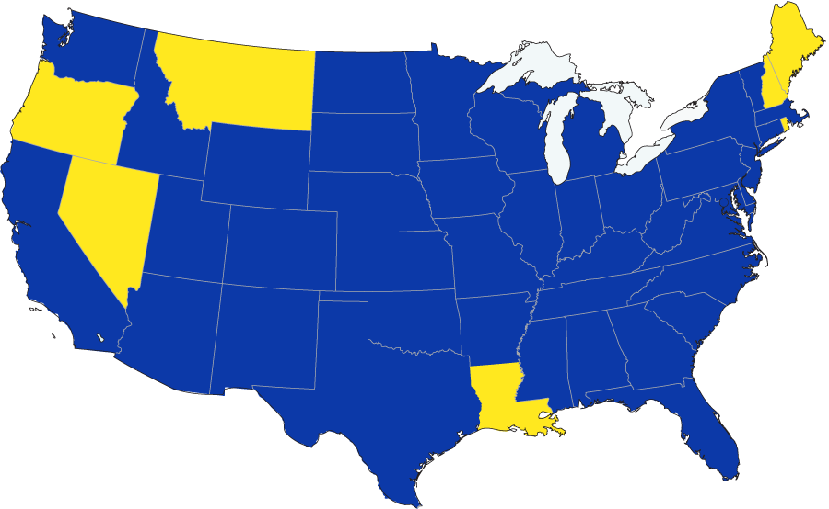

FY 2013-14 CONSULTANTS:
294 Consultants Engaged
States/ Consultants
Not Engaged
STATES & CAMPUSES OF ORIGIN
Fisher College
U of Washington
Hampton U
Washington State
UNC Chapel Hill
UCLA
Duke
Arizona State
U. of Dayton
Georgetown
Boise State
U of Kansas
Vanderbilt
Rutgers
Colorado State
U of Wisconsin Milwaukee
Georgia Perimeter
NYU
Lamar U.
Northwestern U
U of Florida
Princeton
UT Austin
Purdue
Penn State U
Harvard
10

Slide 11
The competitive and merit-based process ELEVEN COMPETITIVE SUBPROGRAMS FY 2013-14
PROPOSALS SUBMITTED | TOTAL FUNDS REQUESTED | PROPOSALS AWARDED | SUCCESS RATE
401 | $57,064,285 | 114 | 28%
FIRST-YEAR/MULTI-YEAR FUNDS AWARDED
$12,916,087

Slide 12
Board of Regents Support Fund Programs 13 CURRENT SUBPROGRAMS
Endowed Chairs for Eminent Scholars
1. Endowed Chairs (1986-87)
Enhancement
Traditional Enhancement (1986-87)
Federal Matching (1986-87)
Undergraduate Enhancement (1990-91)
Enhancement Program for Two-Year Institutions (2001-02)
Endowed Professorships (1990-91)
Endowed First-Generation Undergraduate Scholarships (2007-08)
Research & Development
Research Competitiveness Subprogram (RCS) (1986-87)
Industrial Ties Research Subprogram (ITRS) (1986-87)
Awards to Louisiana Artists and Scholars Subprogram (ATLAS) (2004-05)
Recruitment of Superior Graduate Fellows
Traditional Graduate Fellows (1986-87)
Graduate Fellowships for Teachers (1993-94)
BoR/SREB Graduate Fellowships to Promote Diversity (2007-08)

Slide 13
Research Competitiveness Subprogram
Only STEM Disciplines Eligible
Some Annually
Some on a Two-Years-On, Two-Years-Off Cycle
Eligible Every Year | Eligible in FY 2013-14, 2016-17, 2017-18, etc. | Eligible in FY 2014-15, 2015-16, 2018-19, etc.
Biological Sciences Computer & Information Sciences Earth & Environmental Sciences | Chemistry Engineering B Health & Medical Sciences | Agricultural Sciences Engineering A Mathematics Physics & Astronomy Social Sciences

Slide 14
7 RCS ELIGIBLE DISCIPLINES FY 2013-14
Cell/Molecular Biology
Biochemistry
Microbiology
Biological Sciences I
Biological Sciences II
Chemistry
Computer & Information Sciences
Earth & Environmental Sciences
Engineering B
Health & Medical
Ecology
Nutrition
Natural Biology
Toxicology
Pharmacology
Neurosciences
Anatomy
Genetics
“BIOSCIENCES”
Allied Health
Audiology
Chiropractic
Dental Sciences
Environmental Health
Epidemiology
Health Science Administration
Immunology
Medical Sciences
Nursing
Optometry
Osteopathic Medicine
Pharmaceutical Sciences
Podiatry
Public Health
Veterinary Science

Slide 15
RESEARCH COMPETITIVENESS SUBPROGRAM
THREE-STAGE 2013-14 REVIEW PROCESS: STRUCTURE/CONSULTANTS/COSTS
Stage I: Electronic Mail Review
Specialists: Applicants Nominate Six or More Potential Reviewers with Appropriate Expertise and “Without Conflicts of Interest”
Staff Select Two Out-of-State Reviewers per Proposal
112 Proposals
224 consultants - $11,200
Stage II: Electronic Disciplinary Review
A Review Panel for Each Eligible Discipline
Each Panel Identifies “Priority I Prospects” Based on Both Examination of Proposals and Stage I Mail Reviews
19 consultants - $45,050
7 Disciplinary Panels
Stage III: Three-Member Final Panel Visits the State
Specialists/Administrators: Review original proposals and “Priority I Prospects” Identified by the 7 Stage II Disciplinary Teams
Recommends Most Meritorious of “Priority I Prospects” Identified by the Disciplinary Teams
$16,814

Slide 16
RESEARCH COMPETITIVENESS SUBPROGRAM THREE-STAGE 2013-14 REVIEW PROCESS: PROCESS and Outcomes
Stage II: 7 Disciplinary Panels: Comparative Quality
Stage I: Specialists – Intrinsic Scientific Quality
7 Eligible Disciplines Proposals Mail Reviews
Biological I: 13 26
Biological II: 24 48
Chemistry: 18 36
Computer & Information: 13 26
Earth & Environmental: 10 20
Engineering B: 16 32
Health & Medical: 18 36
TOTALS: 112 224
“Priority I Prospects”
Biological I: 2
Biological II: 9
Chemistry: 6
Computer & Information: 5
Earth & Environmental: 3
Engineering B: 4
Health & Medical : 4
TOTAL: 33
Stage III: Final Panel: Comparative Quality – “33 Priority I Prospects”
Final Panel
Specialists/Administrators: Considered 33 “Priority I Prospects” which the Disciplinary Panels Identified
Recommended 22 for Funding in Rank Order Based on Highest Merit
Regents Awarded Grants to 14 Top-Ranked Projects

Slide 17
The competitive and merit-based process RESEARCH COMPETITIVENESS SUBPROGRAM: FY 2013-14 SUMMARY
PROPOSALS SUBMITTED | TOTAL FUNDS REQUESTED | PROPOSALS AWARDED | SUCCESS RATE
112 | $17,137,724 | 14 | 13%
FIRST-YEAR/MULTI-YEAR FUNDS AWARDED
$1,851,819
TOTAL COST OF FY 2013-14 RCS REVIEW: $73,064

Slide 18
RESEARCH COMPETITIVENESS SUBPROGRAM
Post-review information dissemination
FY 2013-14
Final Report Disseminated Statewide on April 1 (website):
33 Priority I Proposals Ranked Based on Merit
Grants (Stipulations) Recommended for Proposals Ranked 1-22
Regents Funded Proposals Ranked 1-14 (April 23)
112 Applicants Receive, Respectively, Stage I Mail Reviews and Stage II Subject-Area Critiques of Proposal

Slide 19
COMMON SUPPORT FUND/MEDIFUND ATTRIBUTES
Dedicated Funds
Competitive RFP Process
Formal Advisory/Planning Process:
Support Fund: Single Statewide Committee with Multiple Advisory Functions
Medifund: Single or Multiple Advisory Bodies?
Contracts/Evaluation/Administrative Procedures Act
Reporting to Legislature/Regents/Medifund Board

Slide 20
UNCOMMON SUPPORT FUND/MEDIFUND ATTRIBUTES
Provision of Program and Budgetary Advice to Regents
BoRSF Planning Committee: Established
Through Policy (1986-87)
Annually Reviews and Recommends Comprehensive Budgets
Recommends for Each Subprogram:
RFP
Continuation/Revisions
Discontinuation
Additions
Recommends Project and Program Evaluation
Medifund Board: Established Through Law
(Spectrum of Responsibilities Includes All of the Above)
Clarity Needed Regarding Eligible Grantees and Disciplines
May 30 Agenda

Slide 21
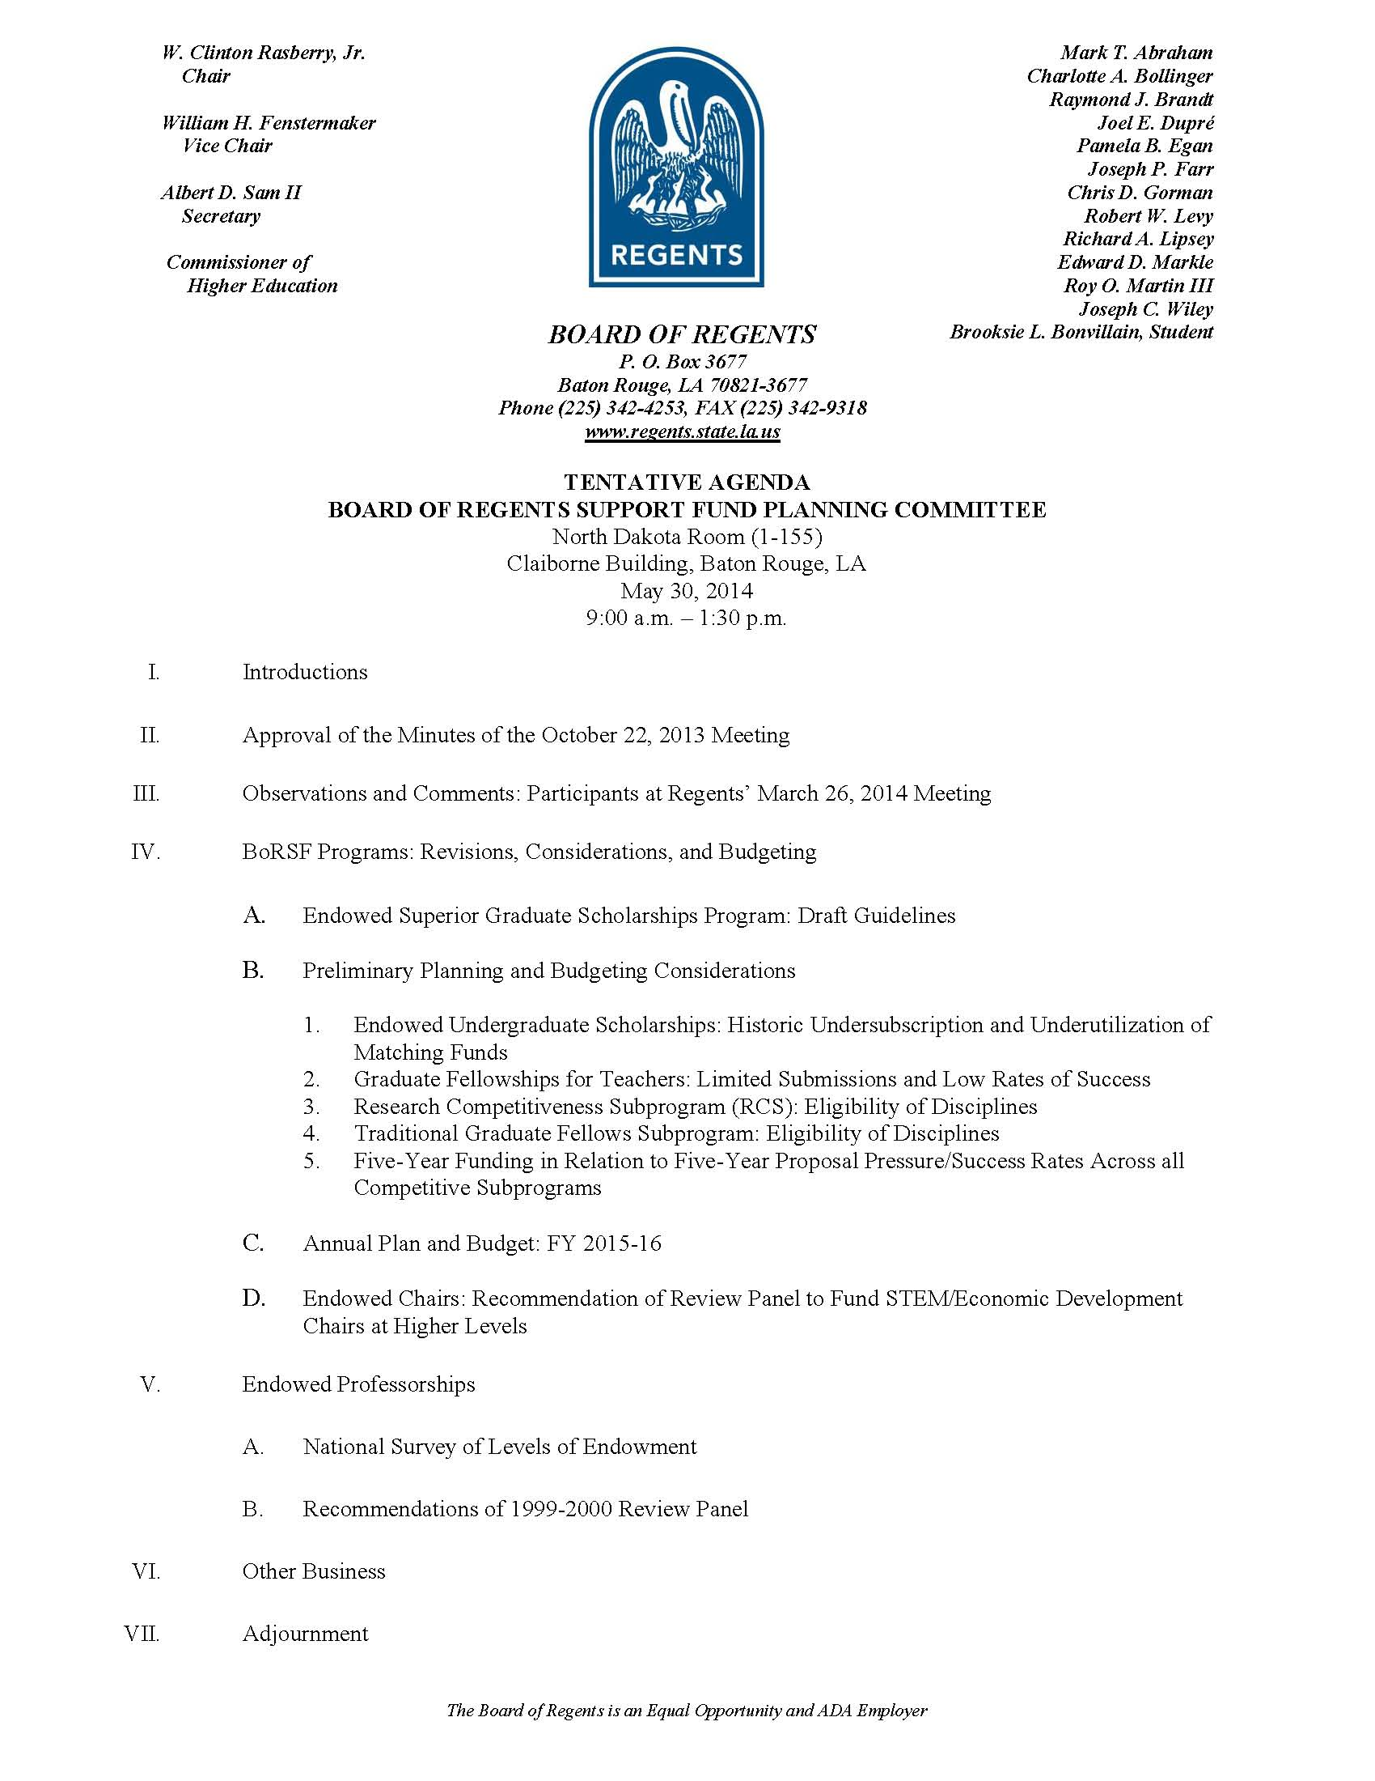

Slide 23
UNCOMMON SUPPORT FUND/MEDIFUND ATTRIBUTES
Provision of Program and Budgetary Advice to Regents
BoRSF Planning Committee: Established
Through Policy (1986-87)
Annually Reviews and Recommends Comprehensive Budgets
Recommends for Each Subprogram:
RFP
Continuation/Revisions
Discontinuation
Additions
Recommends Project and Program Evaluation
Medifund Board: Established Through Law
(Spectrum of Responsibilities Includes All of the Above)
Clarity Needed Regarding Eligible Grantees and Disciplines
May 30 Agenda

