Slide 1
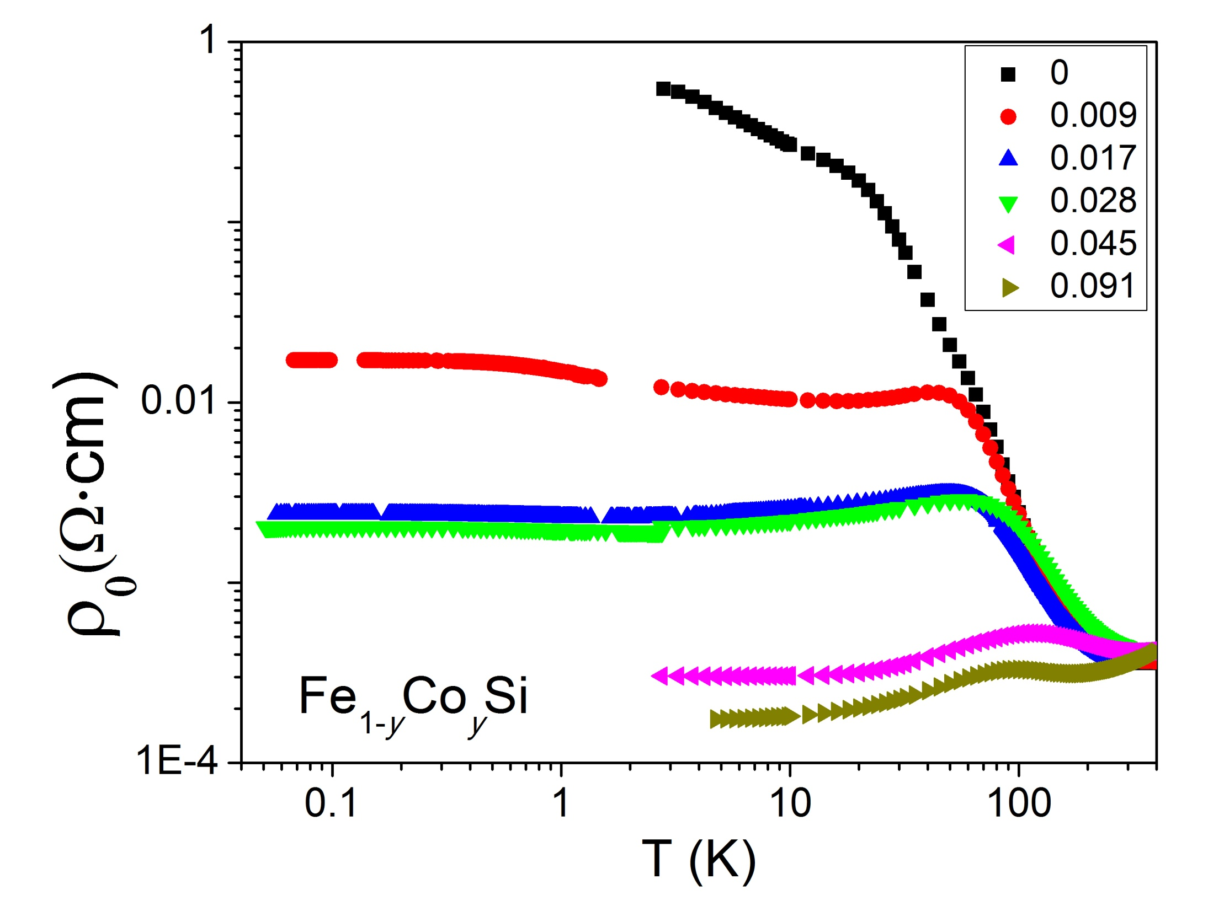
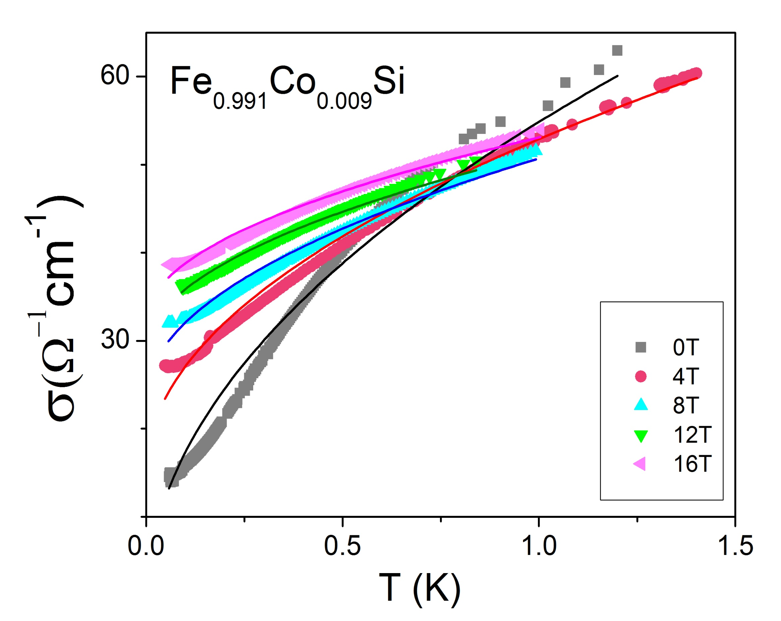
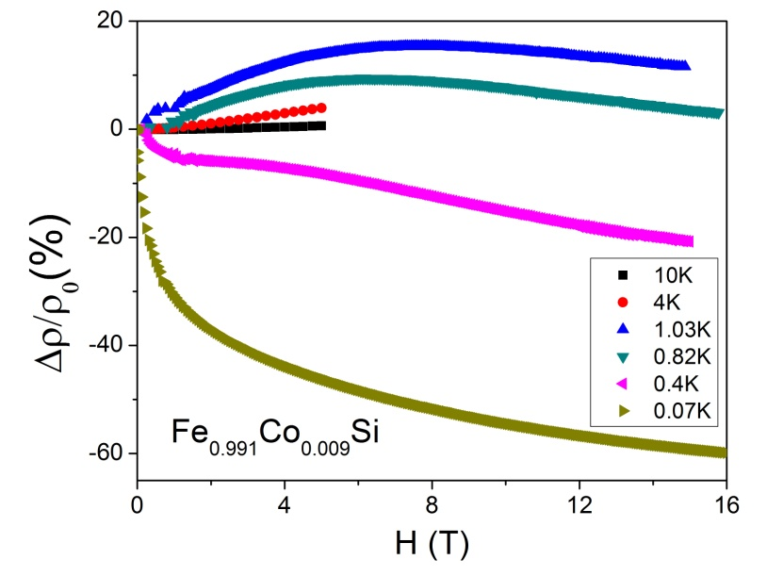
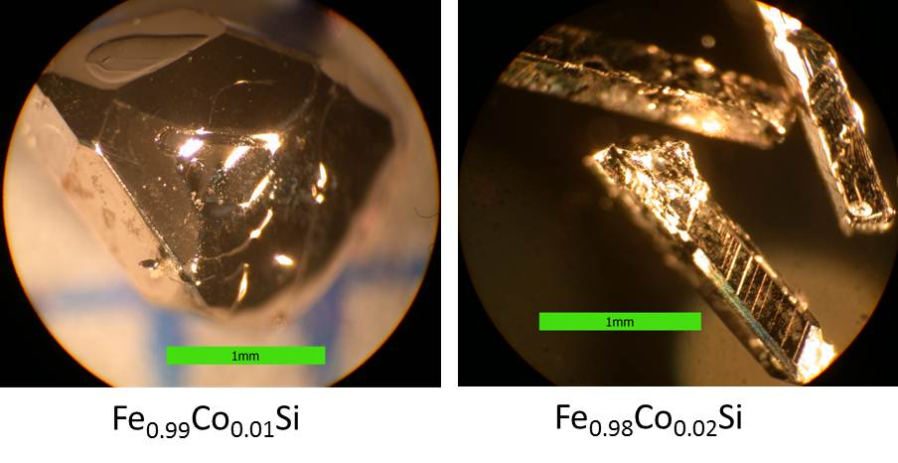
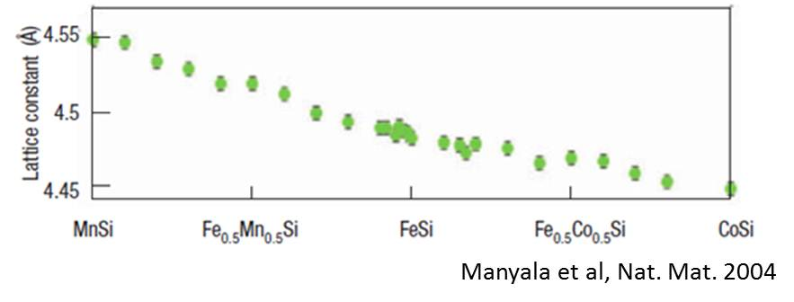
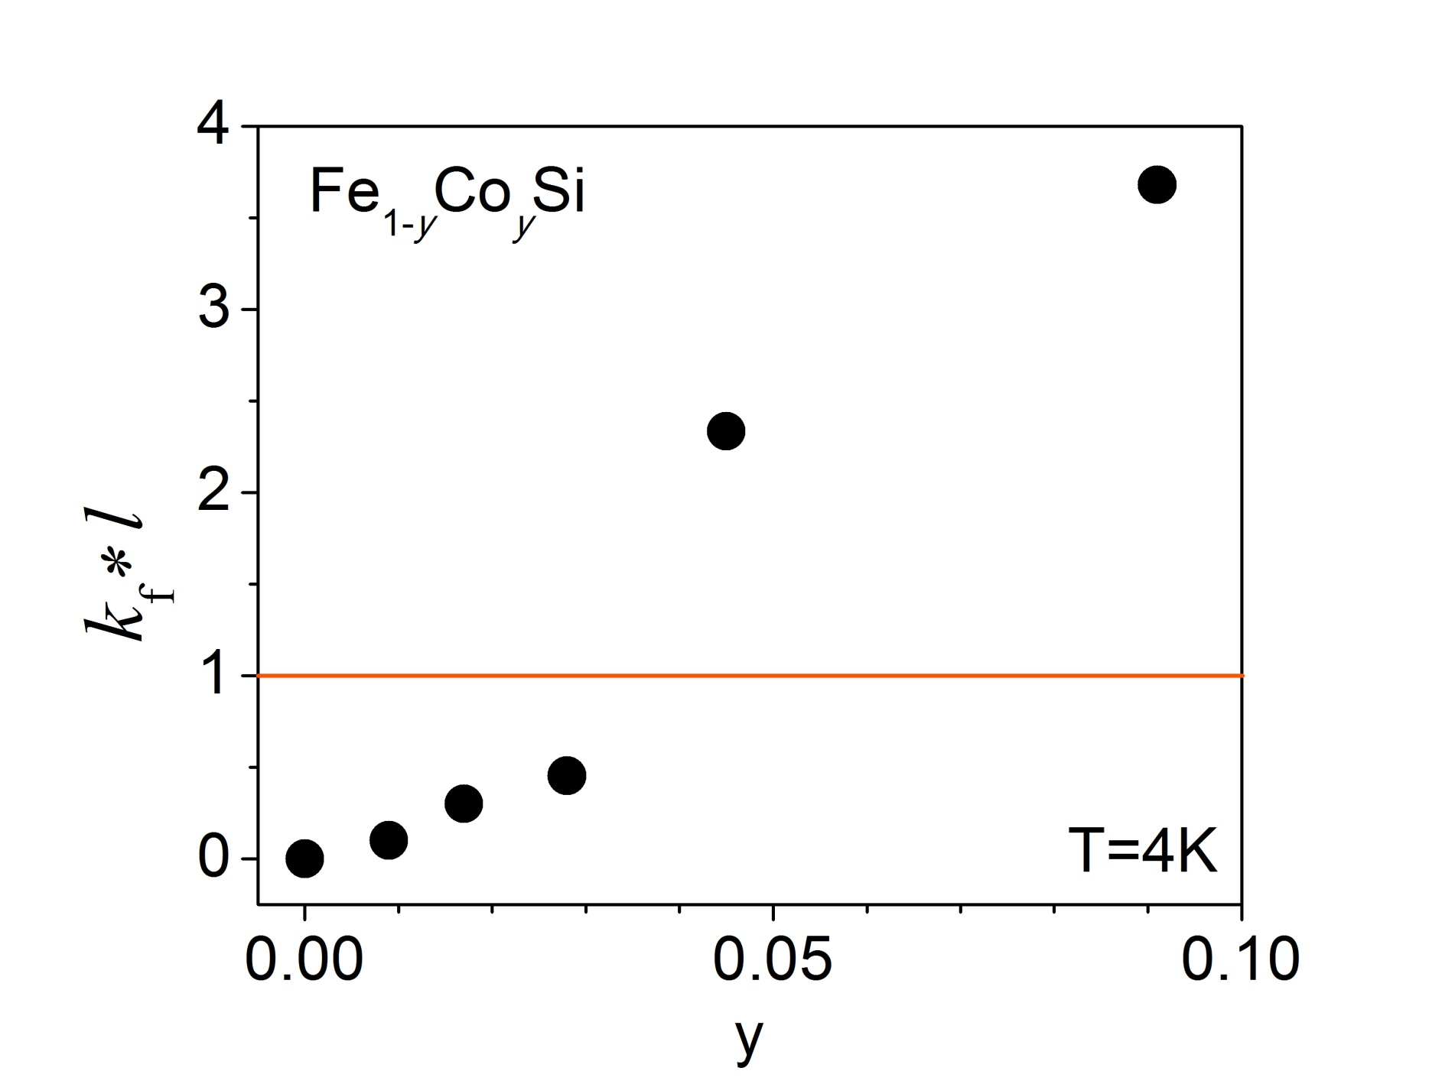
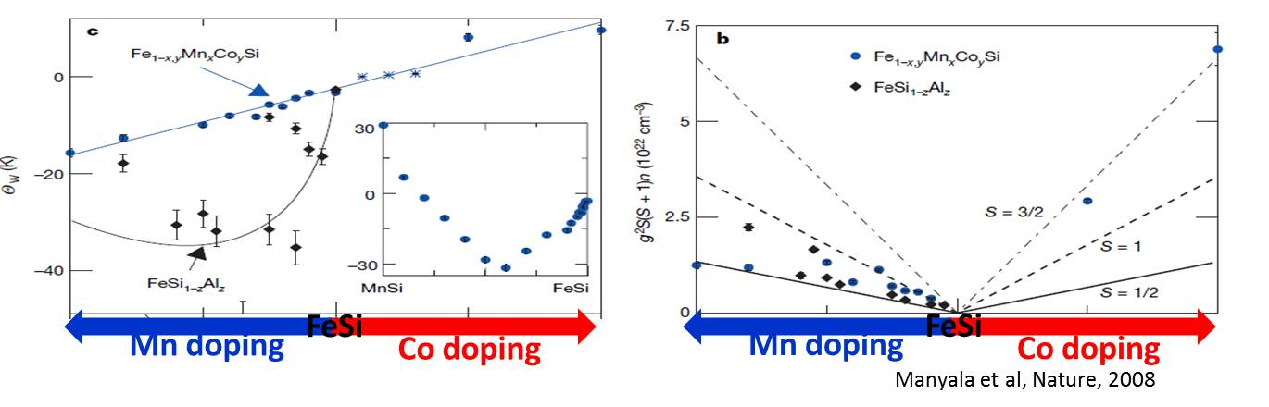
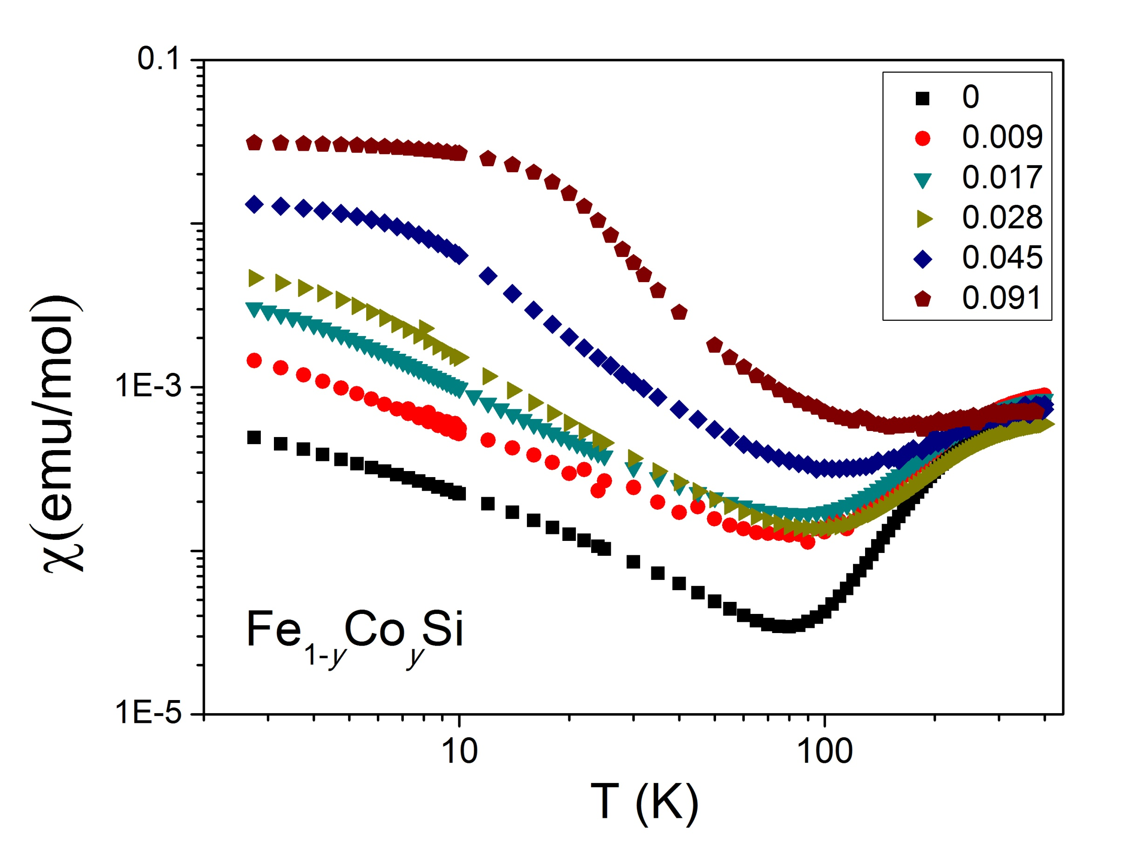
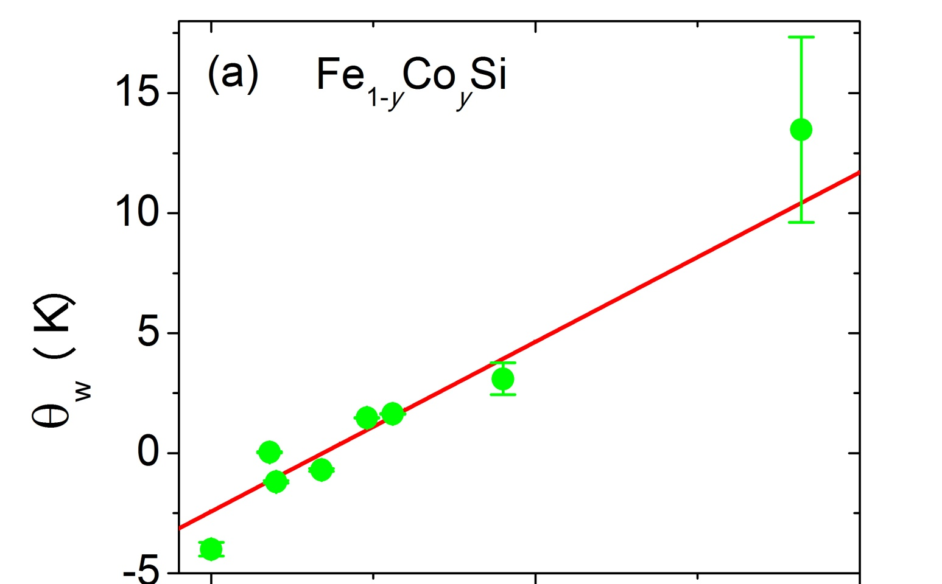
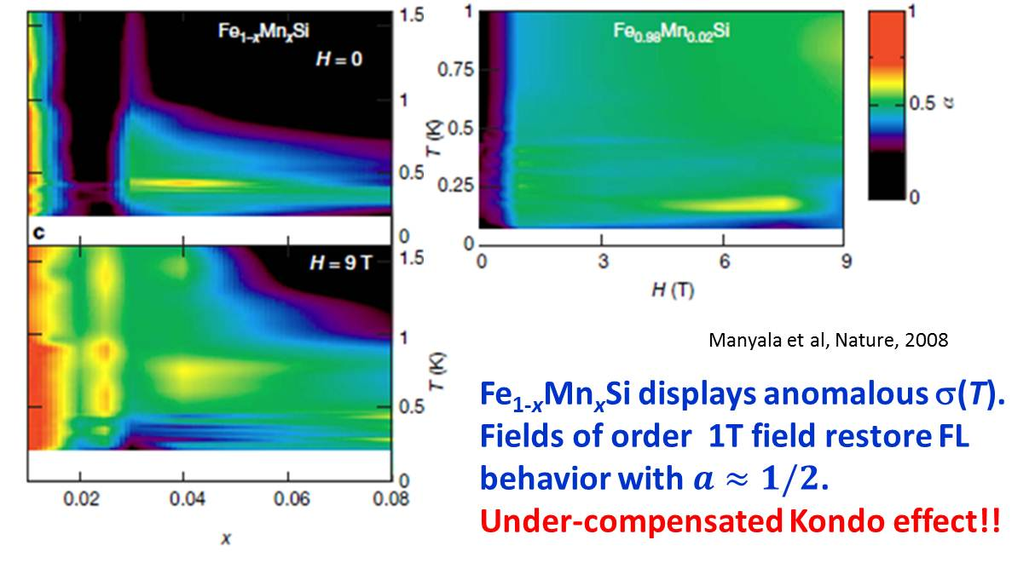
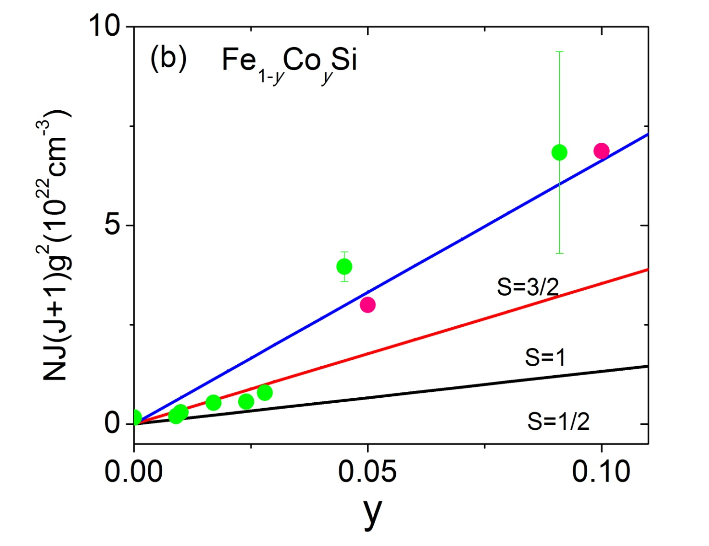

Magnetic and transport properties of Fe_{1-y}Co_{y}Si near insulator-to-metal transition Yan Wu¹, John DiTusa¹ ¹ Department of Physics and Astronomy, Louisiana State University
Abstract
Carrier doping of the fascinating nonmagnetic narrow gap insulator-FeSi, by way of either Mn or Co substitution results in
interesting physical properties. A previous study revealed that Mn doping of FeSi, Fe_{1-x}Mn_{x}Si, exhibits an intriguing field-
sensitive non-Fermi-Liquid behavior near the insulator-metal-transition (IMT) due to the underscreening of the S=1 doping
induced magnetic moments by the added holes. Here, we describe a set of experiments to probe the IMT with low Co
substitution, Fe_{1-y}Co_{y}Si, to search for equally as interesting effects and to compare directly with the hole-doped data. Our
magnetic susceptibility and magnetization measurements indicate an underlying competition between screening of the
magnetic moments by the doped electrons at low y (y≤0.03) and a tendency toward ferromagnetic ordering at higher Co
concentrations. Transport studies suggest that IMT occurs very close to y≈0.01. For temperatures above 2 K, we find in
agreement with previous work for y≥0.1, a temperature and field dependent resistivity dominated by e-e interactions.
However, similar to what was observed in Fe_{1-x}Mn_{x}Si below T=1 K, at lower temperatures and small doping we find that
application of a magnetic field significantly enhances charge carrier mobility.
Fe_{1-x,y}Mn_{x}Co_{y}Si
Fe_{1-y}Co_{y}Si
The low temperature resistivity of Fe_{1-y}Co_{y}Si decreases systematically with y.
The pure FeSi is an insulator, the doped samples with y>0.01 behave more metallic(extrapolations of the conductivity to zero temperature being non-zero.)
FeSi: B20 structure, no center inversion symmetry.
Mn doping: hole doping
Co substitution: electrons doping.
Field drives system into metallic state, indicating an enhancing effect on the charge carries mobility.
For y<0.01 at T<1 K, a negative MR contribution dominates, similar to prototypical semiconducting materials on the insulating side of the IMT.
While the temperature or doping level is increased, a positive MR dominates in the form that expected for e-e interactions.
The two higher doped samples are clearly metallic.
The samples with 0.01<y<0.03 have around ½, likely to be weakly localized.
The pure FeSi sample is clearly in the well localized regime as is the y=0.009 sample.
Single crystals of Fe_{1-y}Co_{y}Si samples.
Structure and stoichiometry verified by X-ray diffraction and WDS.
Magnetic properties measured using SQUID, PPMS and He³-He⁴ dilution refrigerator.
Fe_{1-x}Mn_{x}Si
Reference
[1] N. Manyala, J. F. DiTusa, G. Aeppli, and A. P. Ramirez, Nature 454, 976
(2008).
[2] A. Bauer, A. Neubauer, C. Franz, W. Münzer, M. Garst, and C. Pfleiderer,
Physical Review B 82, 064404 (2010).
[3] M. K. Forthaus, G. R. Hearne, N. Manyala, O. Heyer, R. A. Brand, D. I.
Khomskii, T. Lorenz, and M. M. Abd-Elmeguid, Physical Review B 83, 085101
(2011).
[4] N. Manyala, Y. Sidis, J. F. DiTusa, G. Aeppli, D. P. Young, and Z. Fisk, Nature
404, 581 (2000).
[5] N. Manyala, Y. Sidis, J. F. DiTusa, G. Aeppli, D. P. Young, and Z. Fisk, Nat.
Mater. 3, 255 (2004).
Doping FeSi with Mn leads to an IMT at x≈0.02 , where transport displays a Non Fermi-liquid behavior at low T.
Low temperature metal has σ=σ₀+m_{σ} T^{α}
α =2, Fermi-liquid(FL)
α =1/2, semiconductor near IMT(disordered FL).
A systematic increase of c with y at low temperatures is observed. Magnetic ordering is apparent in only the two higher doped samples with samples having 0≤ y≤0.03 showing only paramagnetic behavior in the T>2 K region.
For of Fe_{1-y}Co_{y}Si increasing _{W} with y leads to magnetic ordering for y>0.05.
The Curie constants indicate that Co doping is consistent with Mn case at first with an S=1 impurity state for small y, then evolve into S=3/2 state instead as y is increased and the system is ordering.
Acknowledgements
The current work is funded by the NSF EPSCoR LA-SiGMA project under
award #EPS-1003897 and the NSF under DMR1206763.

