Slide 1

Statewide Faculty Development
Michael Khonsari
NSF Project Director
Associate Commissioner for Sponsored Programs Research and Development, Louisiana Board of Regents

Slide 2


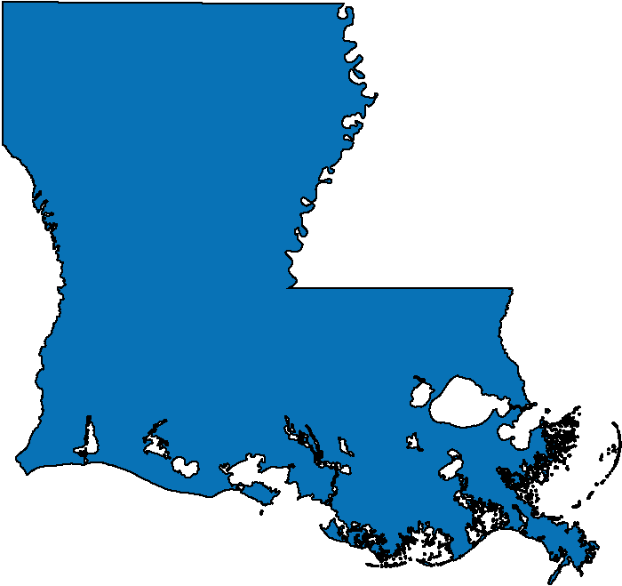






LA-SiGMA Partnering Institutions
RUSTON
BATON ROUGE
NEW ORLEANS

Slide 3









Traveling the STEM Pipeline
and Strengthening Workforce Development
Planning Grants
Pfund
TGEF
LINK
OPT-IN
SBIR/STTR
Industry-Academia
Workshops
Faculty
Industry
Mentoring
Retreat
Distance Learning
Post
Docs
Community
College
REU
RET
Workshops
Graduates
SURE
REU
Undergrad
HS & Middle
School Teachers
National
Labs
Speaking of Science
Open houses
K-12
LINK
Internship

Slide 4














Statewide Impact
Participating Campuses:
Pfund Program
SURE Program
OPT-IN Program
LINK Program
TGEF Program
RUSTON
MONROE
BATON ROUGE
HAMMOND
LAKE CHARLES
LAFAYETTE
NEW ORLEANS
THIBODAUX

Slide 5





Traveling the STEM Pipeline
Programs
LINK
Planning Grants
Pfund
SBIR/STTR
TGEF
OPT-IN
Tenured Faculty
Tenure-Track Faculty
SURE
REU
LINK
Undergrad / Graduates /Post Docs
SoS
K-12
Notes:
5

Slide 6

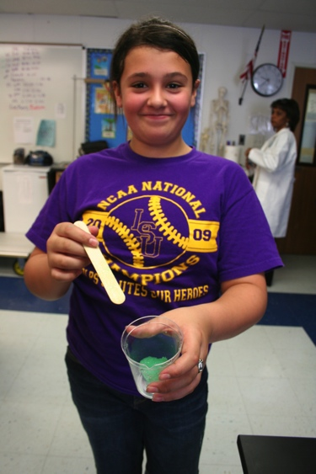
Speaking of Science (SoS)
SoS is one of the many programs administered by Louisiana EPSCoR.
The program provides faculty speakers to K-12 schools free of charge.
51SoS presentations in Year 3
2,124+
Students reached in Year 3
47% Female / 22% URM
15,725+
Students reached in the last 6 years
K-12
Notes:
6

Slide 7


Supervised Undergraduate Research
Experience (SURE)
An RFP was released in April 2013
65 applications were received
Each proposal had 2 reviewers
33 applications were funded
Of the 33 awardees:
  32 were female
  7 were African American
  3 were Hispanic
  1 was American Indian/Alaskan Native
  1 was disabled
106 SURE awards given since inception of LA-SiGMA
Undergraduate / Graduate
Notes:
7

Slide 8

Links with Industry and National
Laboratories (LINK)
Funding to visit and train at an industrial facility, research center, or national laboratory for a period of 2 – 12 weeks.
9 LINK Awards
in Year 3:
8 Faculty
3 Postdoctoral students
3 Graduate students
1 Undergraduate student
© Smithsonian Science
Oak Ridge National Lab, Tennessee
Lawrence Livermore National Lab, California
NIST Center for Neutron Research, Maryland
Center for Nanoscience and Technology, University of Notre Dame
Of the 9 Awardees, 1 was female and 1 was African American
30 LINK awards given since inception of LA-SiGMA
Tenured Faculty
Tenure-Track Faculty
Undergrad / Graduates /Post Docs
Notes:
8

Slide 9

Travel Grants for Emerging Faculty (TGEF)
Assists emerging faculty (tenure-track but untenured) by providing travel funds needed to further their research and build strong collaborations.
9 TGEF awards were given in Year 3.
National Science Foundation, Arlington, VA
2013 Congress of the International Union of Physiological Society, Birmingham, UK
2013 Epigenomics, Sequencing & SNiPs, Boston, MA
Environmental Protection Agency, RPT, North Carolina
National Institutes of Health, Bethesda, MD
Association for Contextual Behavioral Science, Sydney, Australia
Of the 9 Awardees, 3 were female.
34 TGEF awards given since inception of LA-SiGMA
Tenure-Track
Faculty
Notes:
9

Slide 10

Preliminary Planning Grants
Provides assistance to teams of researchers who are in the process of developing a proposal (or pre-proposal, if required) to a Federal funding agency for a large-scale research and/or education program.
1 Preliminary Planning Grant for $10,000 was awarded to PIs from Louisiana Tech University.
Planning Grants for Major Initiatives
Limited to applicants who have received
an invitation to submit a full proposal.
Two levels of support (I and II) based on the minimum federal funding level for the resulting Federal award.
Tenure-Track
Faculty
Tenured
Faculty
Notes:
10

Slide 11
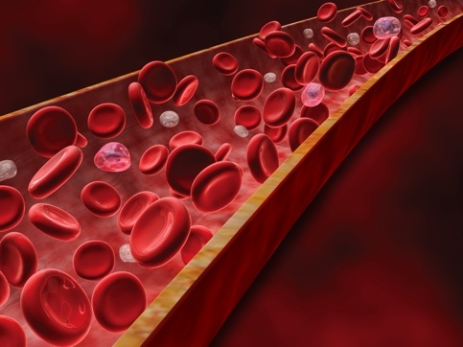
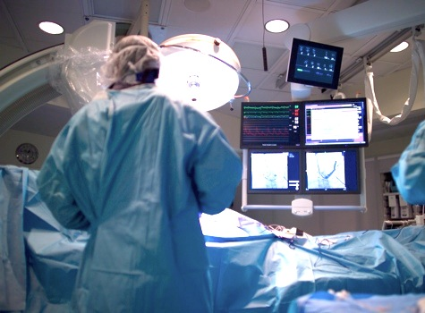

Pilot Funding for New Research (Pfund)
Awards of up to $10,000 to:
Explore new ideas
Keep pace with
cutting-edge techniques
Enhance
research focus
Tenure-Track
Faculty
Tenured
Faculty
Notes:
11

Slide 12




Impact From RII
47 Pfund Grants Awarded in 2010: Results as of 2012
28
Proposals Awarded
102
Presentations
93
Publications
$8.7 Million
External Funding
18:1 Return on Investment
Of the 47 awardees, 12 were female and 3 were African American
Tenure-Track
Faculty
Tenured
Faculty
Notes:
12

Slide 13
Impact From RII
32 Pfund Grants Awarded in 2011: Results as of 2012
10
Proposals Awarded
44
Presentations
22
Publications
$1.8 Million
External Funding
6:1 Return on Investment
Of the 32 awardees, 4 were female, 3 were African American and 1 was Hispanic.
Tenure-Track
Faculty
Tenured
Faculty
Notes:
13

Slide 14
Impact From
41 Pfund Grants Awarded in 2013
Results will be collected one year from the end of the grant.
Of the 41 Awardees:
9 were female
3 were African American and
1 was Hispanic
Tenure-Track
Faculty
Tenured
Faculty
Notes:
14

Slide 15
Cumulative Impact From RII since 2010
38
Proposals Awarded
146
Presentations
115
Publications
$10.5 Million
External Funding
13:1 Return on Investment
Tenure-Track
Faculty
Tenured
Faculty
Notes:
15

Slide 16

SBIR/STTR Phaze Zero Grants
Supports the development of projects with economic potential by offering “Phase Zero” awards that assist small businesses to prepare and successfully compete for Small Business Innovative Research (SBIR) or Small Business Technology Transfer (STTR) proposals.
11 SBIR/STTR awards were made in year 3.
Results from year 2 Phase Zero awards: 17 Phase I and Phase II awards were made (including five by NSF), totaling $7,780,000, and three Phase III contracts totaling $2,700,000
41 SBIR/STTR awards given since inception of
LA-SiGMA
Tenure-Track
Faculty
Tenured
Faculty
Notes:
16

Slide 17

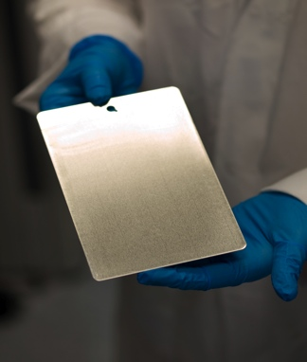
Opportunities for Partnership in Technology
with Industry (OPT-IN)
Build sustainable relationships between academia and industry
Facilitate the commercialization
of research
Enhance research competitiveness
Promote the economic development of Louisiana
Category I
Research Focus Award
Category II
Commercialization Focus Award
Tenure-Track
Faculty
Tenured
Faculty
Notes:
17

Slide 18

Opportunities for Partnership in Technology
with Industry (OPT-IN)
13 OPT-IN Awards in Year 3
Category 1 (6) Category 2 (7)
LSU ULL
LA Tech UNO
ULL LSU
UNO LA Tech
Tulane
Of the 13 awardees, 1 was female.
31 OPT-IN awards given since inception of LA-SiGMA
Notes:
18

Slide 19
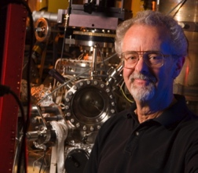
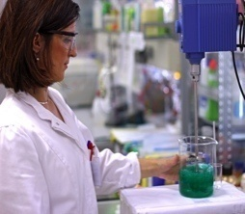
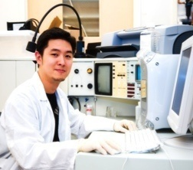

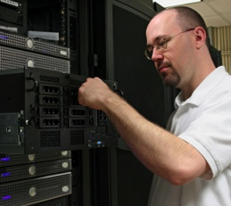
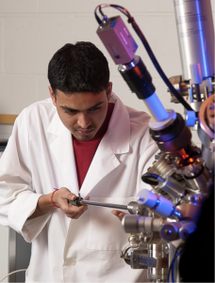
Total Impact of Programs since the
Inception of LA-SIGMA
120
Pfund
31
OPT-IN
30
Link
106
SURE
34
TGEF
41
SBIR/STTR
Notes:
19

Slide 20
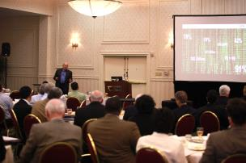
Industry-Academia Collaborative:
Next Generation Energy Technology
April 9, 2013 in Baton Rouge
Over 100 attendees
Key speakers included:
  David Bartlett, Vice President, Smarter Physical Infrastructure, IBM
  Mitchell Horowitz, Managing Director and Vice President, Battelle Group
Notes:
20

Slide 21

Other LA EPSCoR Services
A monthly newsletter is distributed to members of the State legislature, business and industry leaders, university researchers, and Federal agencies.
Faculty Expertise Database and Funding Opportunities Search/Alert System (FED) identifies sources of extramural funding.
Notes:
21

