Slide 1

SD2: Energy Materials
Ramu Ramachandran
The goal of this SD is to study materials for the generation, conversion, and storage of energy using experimentally validated computational methods.
FOCUS 1
FOCUS 2
FOCUS 3
Electrochemical Capacitors
Based on Nanotube Forests
Hydrogen Storage Materials
Catalyst Materials
Lithium ion batteries and electrochemical sensors
Notes:
In response to ERB comments from last year and as part of our Strategic Planning process, H2 storage was phased out in 2012, and the ongoing work in lithium ion batteries was elevated to the level of a Focus Area.

Slide 2


SD2: Energy Materials
Lithium Ion Batteries and electrochemical sensors
LA Tech, Xavier
Electrochemical
Supercapacitors
Tulane, UNO
CNT forest-based supercapacitors
Stable and high-capacity electrode materials.
YSZ-based exhaust gas sensors.
Energy Materials
yttria-stabilized zirconia
Catalysts for Energy Applications
LSU, LA Tech, SUBR, Grambling
DFT studies of Fischer-Tropsch catalysis
Nitrogen-doped fullerenes as Pt-substitutes in hydrogen fuel cells.

Slide 3





Electrochemical
Supercapacitors
Tulane, UNO
Focus 1: CNT-based supercapacitors
Lawrence Pratt
Noshir Pesika
Steve Rick

Slide 4

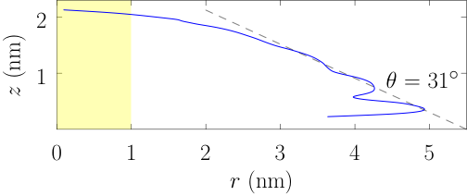
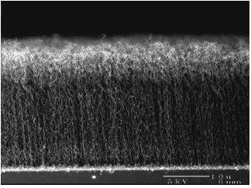
31.4±1.6°
Propylene carbonate droplet contact angle with graphite - experiment
http://mitei.mit.edu/news/novel-ultracapacitor
Electrochemical capacitors based on carbon nanotube forests show great potential.
A molecular level understanding of the interaction of CNT’s with the electrolyte is needed.
Propylene carbonate droplet contact angle with graphite - simulation.
X. You, M. I. Chaudhari, L. R. Pratt, N. Pesika, K. M. Aritakula, and S. W. Rick, “Interfaces of propylene carbonate, ” J. Chem. Phys. 138, 114708 (2013).
Focus 1: CNT-based supercapacitors
Notes:
Developed computational model that correctly predicts the contact angle of propylene carbonate with graphite.

Slide 5
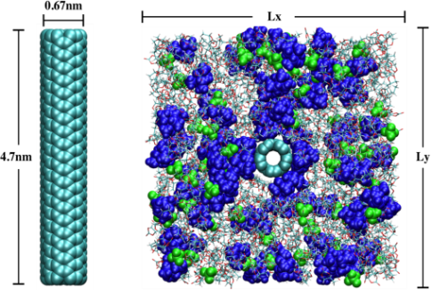
Experimentally validated model used to study the interaction of electrolyte with CNT forests under different charge/discharge conditions.
http://mitei.mit.edu/news/novel-ultracapacitor
Computer model: (C₂H₅)₄N⁺..BF₄– in propylene carbonate surrounding a carbon nanotube.
Focus 1: CNT-based supercapacitors
Notes:
Tetra-ethyl-ammonium tetrafluoroborate in propylene carbonate (TEABF4/PC).

Slide 6

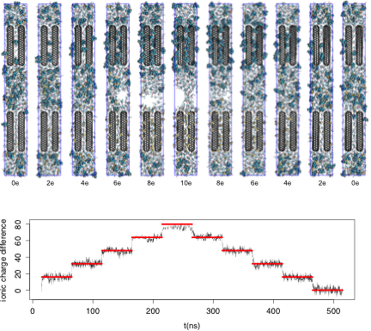
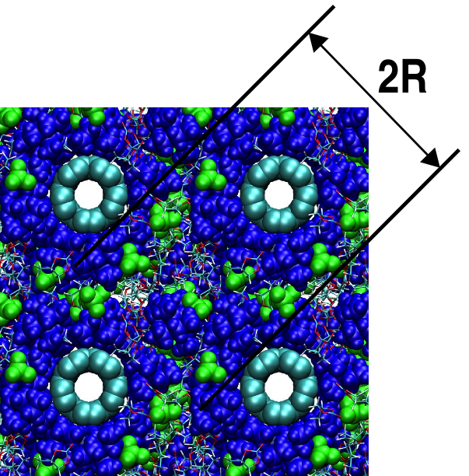
The first direct simulation of pore-filling in a CNT supercapacitor
Computer model: (C₂H₅)₄N⁺..BF₄– in propylene carbonate interacting with a carbon nanotube forest.
Direct numerical simulation: filling of CNT forest with
electrolyte solution
A molecular level understanding of the distribution of ions in the CNT forest and the charge transfer during charge-discharge cycles has been obtained.
Focus 1: CNT-based supercapacitors
Notes:
Tetra-ethyl-ammonium tetrafluoroborate in propylene carbonate (TEABF4/PC). A realistic pattern of charge density is adopted for the charge tube case .. Uniform charge density along the stem but with realistic charge concentrations on the caps. There are eight (8) C_300 tubes in all calculations here (only four are shown). The radii of the pores is about 1nm.
The graph (lower panel) shows the charge above/below the center plane on the tubes (red) and the ions (black). The ionic charge responds in nanosecond time scales to the step change in the tube charges.
We have now done this on twice the system size . Note the bubble formation as the electrolyte demixes from the propylene carbonate solvent. Such results will form the data-basis of extensive analysis of thermodynamic, transport, stress , and damage of these devices.

Slide 7

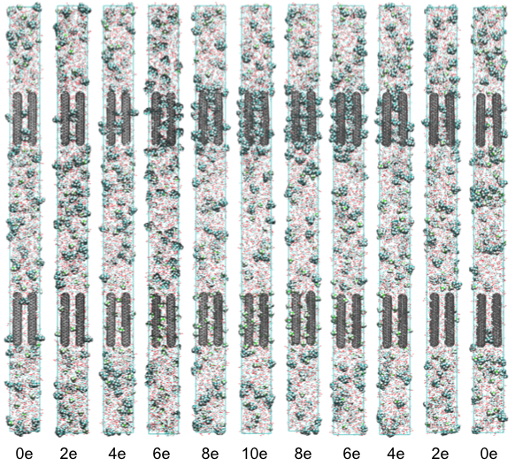
Direct simulation of filling: twice the reservoir size
X. You and L. R. Pratt, preliminary results
See posters (p. 5, 33, 81)
Focus 1: CNT-based supercapacitors
Notes:
Double-sized calculation .. Note the absence of bubbles in this case .. Note the weak filling of the pores by ions in the discharged (end frames) cases .

Slide 8
SD2 Focus 1 Milestones
Milestones | Y1 | Y2 | Y3 | Y4 | Y5
Simulation of pore filling in nanowire capacitors . | X | X | X
Study chemical damage at elevated electric potentials. | X | X | X
Optimize computational efficiency of ab initio MD techniques. | X | X
Study role of quantum capacitance in electrochemical capacitance. |  | X | X | X
Explore additional nanoforest-based capacitor systems. |  |  | X | X | X
On Track
On Track
Done
Ahead
On Track

Slide 9





Lithium Ion Batteries
LA Tech, Xavier
Focus 2(a): Li Ion Batteries
Lamar Meda
Ramu Ramachandran
Collin Wick

Slide 10



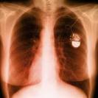

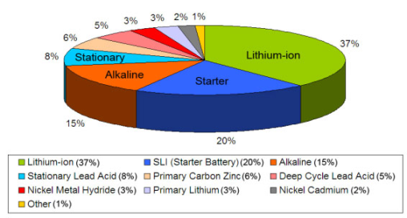
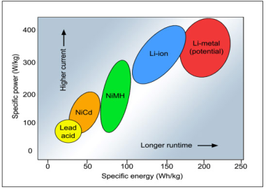
GENERAL INTRODUCTION/MOTIVATION FOR THIS WORK
Figure 1*: Revenue contributions by different battery chemistries
Need for :
Highly reactive materials with much higher energy and power density
High cyclability- electrodes maintain structural integrity upon multiple charge-discharge cycles
Focus 2(a): Li Ion Batteries
*Frost & Sullivan (2009)

Slide 11
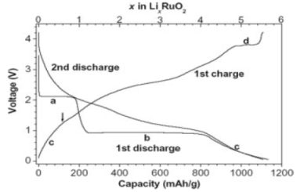
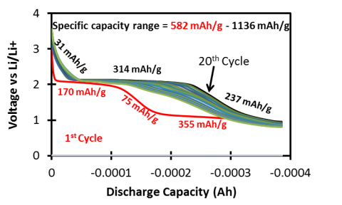
Experimental motivation for this work
Experimental studies on RuO₂ nanoparticles reported by Balaya et al.:
With “deep discharge,” electrodes cycle only twice before losing capacity.
Experimental studies on RuO₂ “nanoplates” by Prof. Meda, Xavier University:
Stopping short of deep discharge, can cycle many times without loss of capacity.
In both cases, the first discharge curve looks significantly different from subsequent discharges, suggesting that some permanent changes occur in the electrode in the first cycle.
1130 mAh/g
Balaya et al. Adv. Funct. Mater. 2003, 13, 621-625
Focus 2(a): Li Ion Batteries

Slide 12

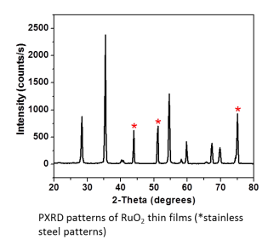
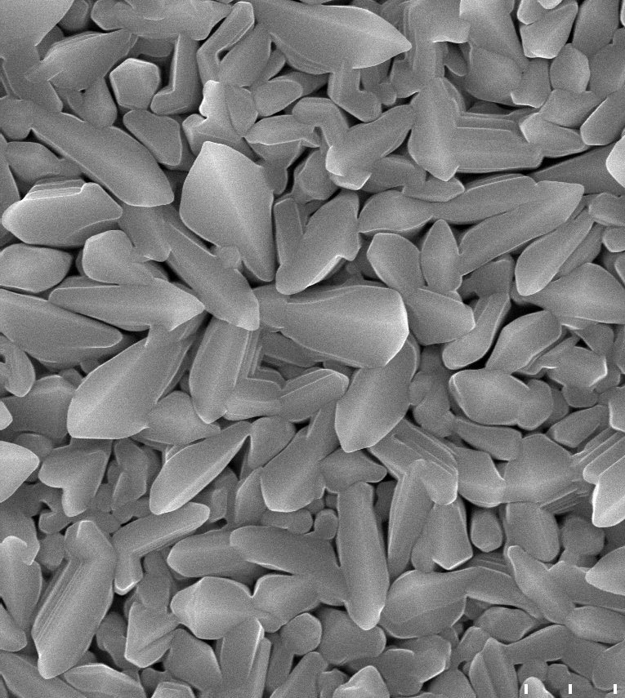
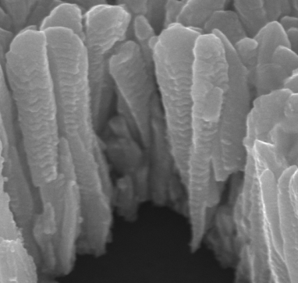
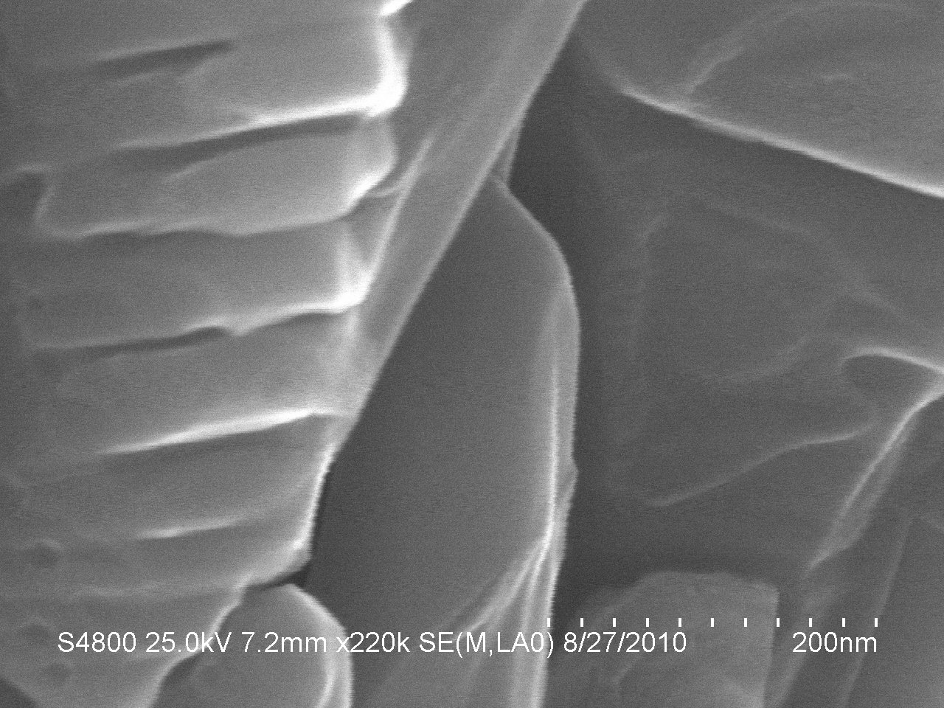




RuO₂ Nanoplates Grown by Chemical Vapor Deposition
L. Meda, Xavier University
Rutile structure
Field Emission SEM images of RuO₂ nanoplates deposited on stainless 304L substrates.
600 nm
nanoplates
100 nm
50 nm
Focus 2(a): Li Ion Batteries
Notes:
RuO₂ nanoplates are produced by chemical vapor deposition on stainless steel substrates. The XRD peaks clearly show rutile crystal structure in the deposited material (along with peaks from stainless steel). Field emission SEM images under high magnification show the nanoplate structure. Supported by NSF through PREM (MRSEC at NYU) as well as LA-SiGMA.

Slide 13
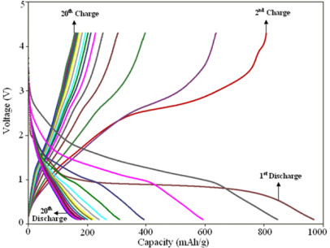
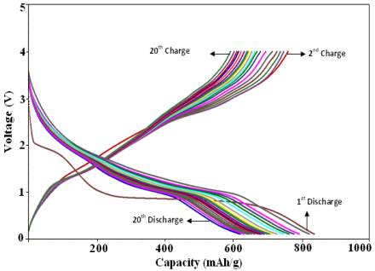
Performance of RuO₂ - 1
If you push the electrode to maximum capcaity (i.e., allow voltage to drop to zero …
850 nm stack of RuO₂ nanoplates
430 nm stack of RuO₂ nanoplates
Capacity is lost readily for the 850 nm nanoplates, but it is lost at a slower rate for the 430 nm ones.
Small materials are easy to model computationally
Focus 2: Li Ion Batteries

Slide 14
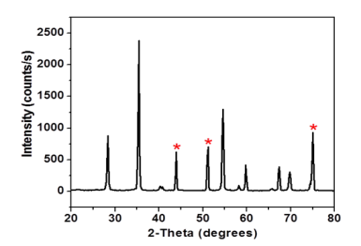
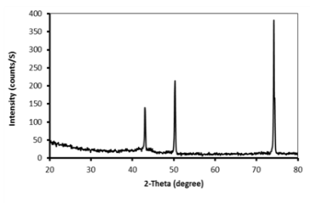
Performance of RuO₂ as an electrode material
Rutile structure is observed in the XRD of the pristine electrode, but the oxide layer appear to become amorphous after “deep discharge.”
∗ Stainless on steel substrates
∗ ∗ ∗
Focus 2: Li Ion Batteries
After 20 cycles

Slide 15

Performance of RuO₂ (contd.)
However, if you stop short of maximum capacity …
No capacity loss is observed
850 nm stack of RuO₂ nanoplates
Note: Flat regions at a particular voltage in the discharge curve represent a particular mechanism.
Focus 2(a): Li Ion Batteries

Slide 16
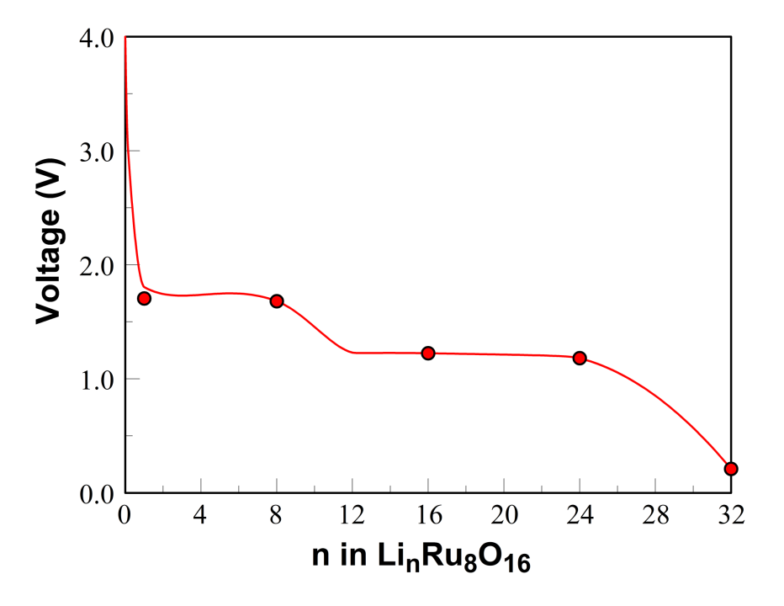
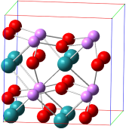
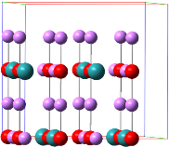
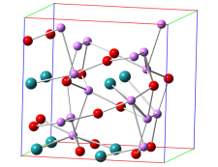
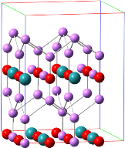
Focus 2: Li Ion Batteries

Slide 17
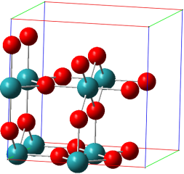
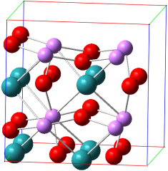

Structures of Li_{n}(RuO₂)₈ - 1
0 Li
8 Li
16 Li
Pristine Rutile
Intercalation with minimum disruption to Rutile structure
Intercalation with noticeable disruption to Rutile structure

Slide 18
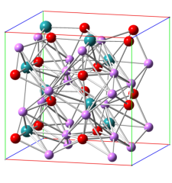
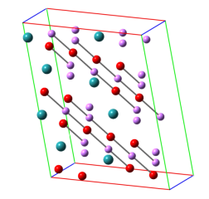
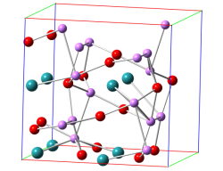
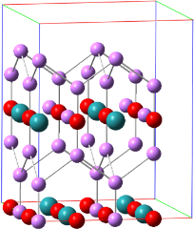
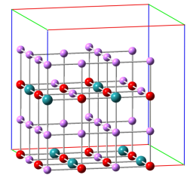
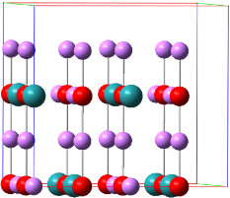
Structures of Li_{n}(RuO₂)₈ - 2
Crystalline phase change!
16 Li converged
24 Li input
24 Li converged
Hints of conversion!
32 Li converged
32 Li input
24 Li tetragonal

Slide 19
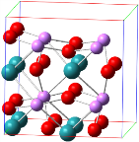
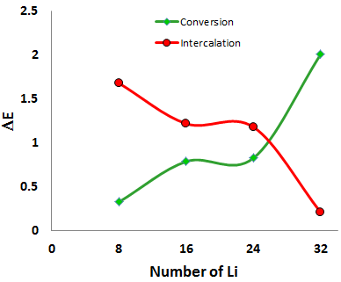
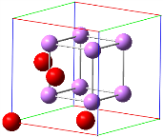
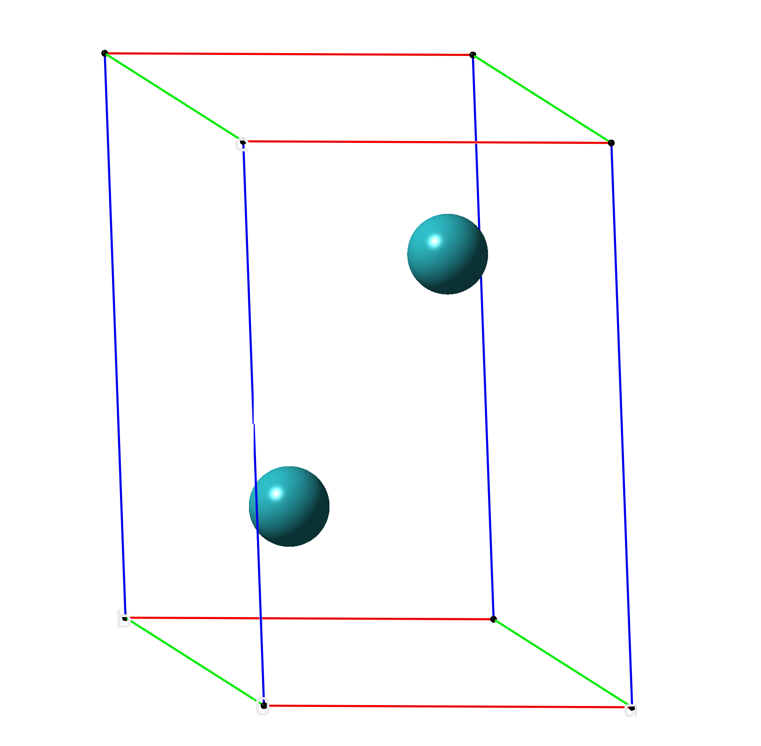
Intercalation: (RuO₂)₈ + nLi → Li_{n}(RuO₂)₈
Intercalation of Li in RuO₂
Conversion: (RuO₂)₈ + nLi → (n/2)Li₂O + (n/4)Ru + (8 – n/4)RuO₂
Unit cell of Li₂O
Unit cell of Ru metal

Slide 20
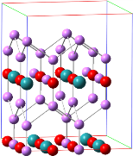

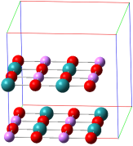

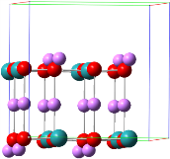
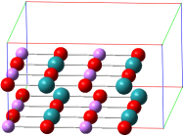
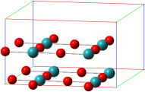
The starting RuO₂ structures for the first and subsequent discharges are different!
(a) First lithiation
0Li 8Li 16Li 24Li 32Li
(b) First delithiation
24Li 16Li 8Li 8Li-adj 0Li
Focus 2(a): Li Ion Batteries

Slide 21

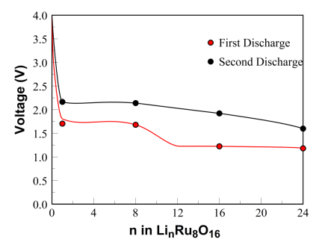
Simulations provide nearly quantitative agreement with experimental observations!
Capacity = 582-600 mAh/g
Capacity = 604 mAh/g
Posters:
Metal oxide nanoparticles as electrode materials (p. 85)
RuO₂ and other crystalline metal oxides (p. 89)
Focus 2(a): Li Ion Batteries

Slide 22

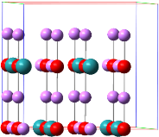

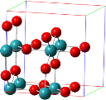
Computational/Experimental voltages and mechanism for reversible charging and discharging for RuO₂ anode materials
8 Li (during 1st discharge)
24 Li
0 Li (after 1 cycle))
0 Li (rutile)
Specific Capacity
604mAh/g
(a) Calculated first (red) and subsequent (black) discharge of Li_{n}(RuO₂)₈ up to n = 24 relative to Li/Li⁺ assuming an intercalation mechanism. The original rutile structure of RuO₂ (bottom left) changes irreversibly to tetragonal (top left) during the first cycle and becomes the reference structure for the second and subsequent cycles.
(b) Experimental discharge curves for 850 nm RuO₂ nanoplates from Meda et al.
Focus 2: Li Ion Batteries

Slide 23



Electrochemical sensors
LA Tech
Focus 2(b): Electrochemical Sensors
Erica Murray
Daniela Mainardi
Weizhong Dai

Slide 24


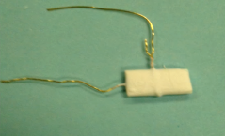
Automotive NO_{x} Sensors Murray Research Group
Commercial NO_{x} exhaust gas sensor systems can detect up to 10 ppm.
New emission standards require greater sensitivity.
Conventional NO_{x} Sensor Design:
Dense electrolyte and porous electrodes architecture
NO_{x} sensitivity capable down to 10 ppm
Novel NO_{x} Sensor Design:
Porous electrolyte microstructure with dense electrodes
Potential for NO_{x} sensitivity down to 1 ppm
Novel porous microstructure is promising for satisfying future emission standards
Au electrodes
1 cm
Porous YSZ
NGK commercial NO_{x} Sensor
Research Challenges:
Achieving ideal porosity
Excess porosity lowers sensitivity
Insufficient porosity limits gas diffusion
Identifying reaction mechanisms impacting sensing
Focus 2(b): Electrochemical sensors
Notes:
The role of microstructure was investigated for the impedancemetric response of NO_{x} sensors composed of a porous Y-stabilized ZrO₂ (YSZ) electrolyte with Au wire electrodes. The NO_{x} sensors fabricated at firing temperatures of 950°C, 1000°C, and 1050°C. Calculations based on SEM images were used to determine the YSZ porosity achieved as a result of the firing temperature. Impedance spectroscopy was used to measure the electrical response of the sensors while operating at 650°C, in gas atmospheres of 0 – 100 ppm NO and NO₂, and O₂ concentrations ranging from 1 – 18%.

Slide 25
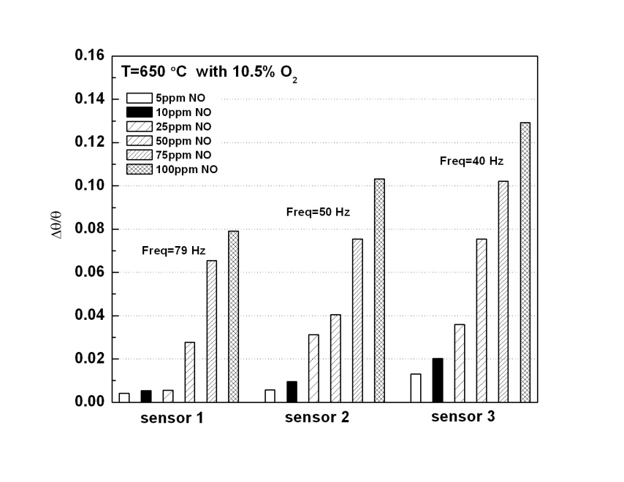
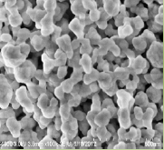
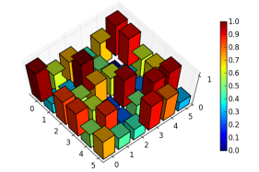
NO_{x} Sensor Research
Research Aim:
Correlate YSZ synthesis methods to porosity.
Determine sensitivity of various synthesized YSZ.
Sensor Response to NO Gas
46%
porous
48%
porous
50%
porous
NO_{x} Sensor Performance
(fraction phase angle response)
Porous YSZ
Electrolyte
Typical performance for sensors with 3 different
porous microstructures.
500nm
Research Highlights:
Greater NO_{x} sensitivity and stability achieved, particularly for NO_{x} concentrations down to 5 ppm as the porosity decreased to 46%.
Dissociative adsorption of O₂ appeared to be the dominant rate limiting reaction, based on impedance spectroscopy and modeling results.
The porous YSZ based NO_{x} sensor could be tuned to give a more rapid response.
Image analysis algorithms analyze SEM images,
Provide input to mathematical models that estimate porosity.
Notes:
The impedance results showed the YSZ porosity had a strong impact on sensor performance. Overall, the sensor with the lowest porosity (i.e., approximately 46% porous) demonstrated the lowest impedance, higher stability, and greater sensitivity to NO and NO₂. In addition, using impedancemetric sensing the response for NO_{x} concentrations ≤ 10 ppm were distinguishable at operating frequencies as high as 40 Hz such that more rapid sensing was possible.
Additional experiments were carried out to determine oxygen partial pressure and temperature dependence. The resulting data was used to assess the reaction mechanism governing the NOx response and the activation energies with respect to porosity. Dissociative adsorption appeared to be rate limiting. The activation energy values tended to decrease with respect to decreasing porosity and increasing NOx concentration.
Overall, the NOx sensor fabricated at 1050C resulting in a porosity of 46% demonstrated the best behavior/performance (i.e., lower activation energy, lower impedance, greater sensitivity and rapid response).

Slide 26

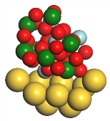
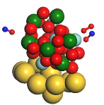




Kinetics of Nitric Oxide and Oxygen Gases on Porous Y-stabilized ZrO₂ based Sensors
Sajin Killa and Daniela Mainardi, Louisiana Tech University
Tested on a 56-atom YSZ/Au model cluster (62% YSZ porosity)
$$2NO+O2↔2NO2$$
Reaction path: oxygen surface reactions
NO association with adsorbed O₂ on a Zr surface site, followed by O₂ dissociative adsorption, atomic oxygen diffusion, and further NO₂ formation.
Extrapolated data at 62% YSZ porosity (~126 kJ/mol) indicates the calculated barriers are in reasonable agreement with experiments, especially when the RPBE functional is used.
Focus 2(b): Electrochemical sensors
Notes:
Experimental activation energies calculated based on data from impedance measurements increased in magnitude with respect to increasing YSZ porosity. Experimental oxygen partial pressure dependence of the sensors suggested that dissociative adsorption was the dominant rate limiting.
The calculated internal energy of activation at absolute zero, ΔU, and the Gibbs Free energy barrier (internal energy of activation with the thermal corrections to the Gibbs Free energy at different temperatures included), DG(T), for the forward reaction at the PWC/DNP theory level are DU = 156.2 kJ/mol and DG(650°C) = 181.7 kJ/mol (averaged for the 600-700°C temperature range of the experimental work) respectively.
The calculated internal energy of activation and free energy barrier of the reaction seem overestimated at the PWC/DNP theory level when compared to experimental findings, as expected when LDA functionals are used. In order to provide better kinetic results, the structures optimized at the PWC/DNP theory level were used to conduct single point energy calculations at the PW91/DNP, PBE/DNP, and RPBE/DNP theory levels to obtain new DU and DG values for the reaction. Additionally, the temperature corrections used in the calculation of DG in those cases are the ones calculated at the PWC/DNP theory level. Therefore, it is worth to note, that since full geometry optimizations were not perform at these three GGA levels of theory, only trends can be drawn from the results presented in the Table.

Slide 27
SD2 Focus 2 Milestones
Milestones | Y1 | Y2 | Y3 | Y4 | Y5
Computational study of lithiumion adsorption on metal oxide nanoparticles. |  |  | X
Computational study of lithium ion adsorption on metal oxide thin films and other promising electrode materials. |  |  | X | X | X
Experimental study of nanostructured metal oxides as potential electrode materials for lithium ion batteries. |  | X | X | X | X
Multi-scale computational modeling of the kinetics and thermodynamics of NOx and O₂ reactions on YSZ sensors for vehicle exhaust applications. |  |  | X | X | X
Fabrication and testing of YSZ sensors for NOx and O₂ in diesel exhaust streams. |  |  | X | X | X
Update VisTrails so that it can be used for workflow of lithium-ion battery tomography studies. |  |  | X | X | X
Done
On Track
On Track
On Track
On Track
On Track

Slide 28








Catalysts for Energy Applications
LSU, LA Tech, Southern
Grambling
Focus 3: Catalysis
Les Butler
Bin Chen
Barry Dellinger
Daniela Mainardi
Ramu Ramachandran
Collin Wick
Guanglin Zhao
Naidu Seetala

Slide 29
Towards rapid computational evaluation of Fischer-Tropsch catalysts
Shuo Yao, Oneka Cummings, Josh Riggs, Collin Wick and R. Ramachandran
Louisiana Tech University
Despite their great economic and environmental significance, the catalytic mechanisms of Fischer-Tropsch reactions are not well-understood.
+ CO
C = O
Black box
of Catalysis
CO + H₂
Metal Surface
Gasoline CH₃-(CH₂)_{x}-CH₃ + H₂O
Challenge: Very difficult to get good agreement between calculation and experiment for CO binding energies.
Developing computational protocols using DFT functionals developed by Perdew – with some success!
The first and crucial step : CO binding to metal catalyst surface.
Hypothesis: CO binding energies may be one of the diagnostics for the effectiveness of a given FT catalyst metal and its surface morphology.
Focus 3: Catalysis

Slide 30
Towards rapid computational evaluation of Fischer-Tropsch catalysts
Shuo Yao, Oneka Cummings, Josh Riggs, Collin Wick and R. Ramachandran
Louisiana Tech University
After testing several DFT functionals and computational protocols, we found that the RPBE functional with BSSE correction gave CO binding energies and adsorption sites that agree well with available experimental data for three metals.
Calculations were done with CP2K using a VDZ orbital basis coupled to plane waves.
Surface | Calculated Adsorption Energy (eV) |  | Experimental* adsorption energy (eV) | Experimental adsorption site | Predicted adsorption site
 | Without BSSE correction | With BSSE Correction
Cu(111) | -1.106 | -0.701 | -0.5(±0.05) | TOP | TOP
Rh(111) | -2.528 | -1.456 | -1.45(±0.14) | TOP | TOP
Pd(111) | -2.151 | -1.572 | -1.48(±0.09) | HOLLOW | HOLLOW
Wrong trend
Correct trend
* F.Abild-Pedersen, M.P. Andersson, Surface Science. 601 (2007) 1747-1753
Focus 3: Catalysis

Slide 31





Towards rapid computational evaluation of Fischer-Tropsch catalysts
Shuo Yao, Oneka Cummings, Josh Riggs, Collin Wick and R. Ramachandran
Black box
of Catalysis
CO + H₂
Gasoline CH₃-(CH₂)_{x}-CH₃ + H₂O
CO
http://www.asi20.com/page9/index.html
C = O
CO binding energies - very difficult to get agreement with experiments.
Developing computational protocols using DFT functionals developed by Perdew – with some success!
Collaborating with a North Louisiana start-up – Jupiter Fuels (> $3M in venture capital).
Modeling CO binding on catalyst nanowire tips.
CO adsorption on Cobalt nanowire tips
Focus 3: Catalysis

Slide 32




Fischer-Tropsch Synthesis
Fernando Soto, Purnima Kharidehal, Suraj Gyawali and Daniela Mainardi Louisiana Tech University
Core-shell nanoparticles investigated in the context of FTS mechanism
CO bonds strongly to Co top sites in pure Co and in CoNi systems
CO bonds strongly to mixed CoFe hollow sites in CoFe systems
The energy cost to hydrogenate CO varies as the composition of the nanocluster is tweaked
Co-shell (Fe)-core at a 1:1 ratio shows the most promising result with an energy cost as low as 0.1 eV for the initiation step
Co₁₀(Fe₄)
Co₁₀(Ni₄)
Fe is preferred over Ni when used as core element in a Co core-shell catalysts.
Focus 3: Catalysis
Notes:
In this project, promising stepped–surface catalysts and core-shell Co-containing binary nanocatalysts are studied using electronic structure methods. The ultimate goal is to provide insights into the design of novel catalyst for F-T reactions.
In order to implement the FTS process at a large– scale, two fundamental issues need to be addressed:
Identification of preferred sites (i.e. stepped surfaces, nanocluster surfaces) for catalytic reactions.
Identification of intermediate species and identification of preferred reaction pathways

Slide 33


Fischer-Tropsch Synthesis
Fernando Soto, Purnima Kharidehal, Suraj Gyawali and Daniela Mainardi Louisiana Tech University
See poster (p. 141)
Focus 3: Catalysis
Notes:
In this project, promising stepped–surface catalysts and core-shell Co-containing binary nanocatalysts are studied using electronic structure methods. The ultimate goal is to provide insights into the design of novel catalyst for F-T reactions.
In order to implement the FTS process at a large– scale, two fundamental issues need to be addressed:
Identification of preferred sites (i.e. stepped surfaces, nanocluster surfaces) for catalytic reactions.
Identification of intermediate species and identification of preferred reaction pathways

Slide 34


Nitrogen-doped fullerenes as fuel cell catalysts
Can N-doped C60 replace Pt in hydrogen fuel cells?
Spin-polarized DFT calculations of nitrogen-doped C₆₀ fullerene (N-C₆₀) as a cathode catalyst for hydrogen fuel cells.
F. Gao, G.L. Zhao, S. Yang, J. J. Spivey, “Nitrogen-Doped Fullerene as a Potential Catalyst for Hydrogen Fuel Cells”, Journal of the American Chemical Society, 2013, 135, 3315-3318.
Collaboration between LA-SiGMA and DoE EFRC.
Minimum energy path for H₂O formation process on O(1) through (a) direct pathway and (b) indirect pathway; and H₂O formation process on O(2) through (c) direct pathway and (d) indirect pathway, on HH Pauling site of N-C₆₀ fullerene. Embedded images show the atomic structures of the initial, intermediate, and final states of the reaction process, respectively.
Focus 3: Catalysis

Slide 35
SD2 Focus 3 Milestones
Milestones | Y1 | Y2 | Y3 | Y4 | Y5
Develop force fields with environment-dependent charges for one metal oxide system. | X
Use DFT-based ab initio MD and kinetic Monte Carlo methods to study Fischer- Tropsch and related reactions on metal/metal oxide catalytic systems. |  |  | X | X | X
Exploration of spin-state dependent structure and energetics of metal oxide clusters, especially (FeO)_{n}. |  |  | X | X | X
Perform computational modeling of PCDD/PCDF production on metal oxide clusters. |  | X | X | X
Develop computational methods for evaluating catalytic sites in carbon nanotubes for hydrogen fuel cells. |  | X | X
Computational evaluation of nitrogen doped CNT’s and fullerenes as alternatives for platinum in hydrogen fuel cells. |  |  | X | X | X
Done
On Track
On Track
On Track
Done
On Track

Slide 36






Other notable SD2 accomplishments
Shawn Cole, PhD student at LA Tech received an Indo-US Science and Technology Forum fellowship to visit and work at IIT-Delhi (ethanol fuel cells).
Steve Rick, UNO, received a $450,000 grant from NSF: “The Effects of Charge Transfer on Aqueous and Ionic Systems.”
Daniela Mainardi, LA Tech, receives AIChE Excellence and Service Award; partner in North Carolina A&T NSF CREST Center for biofuels.
LA Tech REU and RET programs (including “STEM Week”) focused on “Energy Materials.”

Slide 37





X-ray interferometry data and sinusoidal fitting functions.
(1)
(2)
(3)
• Eq 1 is tradition; currently solved with FFT (not robust)
• Eq 3ff is our new algorithm. It is 1000-fold faster than Levenberg-Marquardt, robust, and flexible. Submitted to Rev. Sci. Instr.
• Result of a collaboration with Prof. Warren Johnson, LIGO, LSU
Notes:
Grating-based X-ray interferometry yields 3 images simultaneously.
Point to the plot:
absorption image comes from the average X-ray counts
phase contrast image comes from the shift of the sinusoid
small-angle scattering image comes from the amplitude of the sinusoid
Tomography data set has ~1000 interferograms, each taken with a camera with ~1M pixels, for a total of 10^10 interferograms to solve. A fast algorithm is essential. Constrained L-M takes 10 milliseconds; way too slow. Warren Johnson’s LIGO algorithm takes 500 s.
Paper submitted to Rev. Sci. Instr. Talks given at Synchrotron Radiation Instrumentation (held at NIST; travel supported by LaSIGMA) and at ICTMS (Belgium; overhead return supported travel)

Slide 38




On the way to NIST
neutron tomography
“ICTMS” Ghent, Belgium, July, 2013
Ham: neutron tomography and hydrogen storage
Olatinwo: X-ray interferometry movies and flame retardants
Butler: new algorithm for X-ray interferometry
APS: “Fire at the beamline”
X-ray interferometry movies and flame retardants.
Notes:
NIST: LaSIGMA supported our wrap-up neutron imaging at NIST of hydrogen storage (paper submitted). Next NIST imaging will be on batteries (beamtime proposal pending).
Left-Bolaji Olatinwo (chemistry grad student), right-Bradley Wood (was LSU REU undergrad)
APS: LaSIGMA/NSF supported trip for X-ray interferometry imaging of battery and burning flame retardants.
ICTMS: Overhead return supported trip for Bolaji Olatinwo (grad student), Dr. Kyungmin Ham (CAMD tomography staff scientist), and Les. Trip shows high value of international science travel. European, Japan, Australian tomography is quite advanced. Ham and Olatinwo gave posters. Les gave a talk on a new algorithm.

