Slide 1

External Engagement
Noshir Pesika
[LA-SiGMA] will provide for efficient collection and dissemination of information between participants, the K-12 community, two-year colleges, and the general public.

Slide 2

External Engagement Strategies
Interaction with
NSF
International Partnerships
Public Media
Science
Museums
External Engagement
Strategies
Public Lectures
Local Industry
Internal Communications

Slide 3


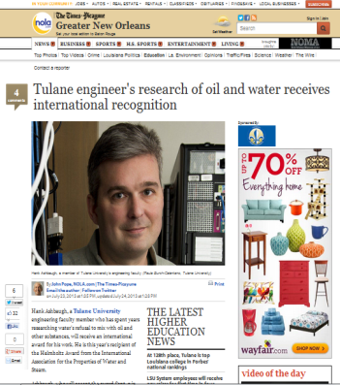
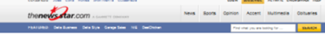
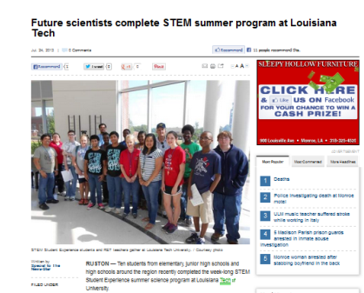

Public Media
Public Lectures, News Media, EPSCoR Newsletters
Interview on Public Radio with RET teachers.
Print media stories about LA-SiGMA in North & South Louisiana.
LA-SiGMA featured in EPSCoR newsletters.
Notes:
Hank Ashbaugh, Helmholtz Award from the International Association for the Properties of Water and Steam.
3

Slide 4
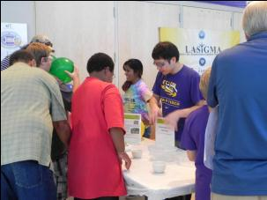
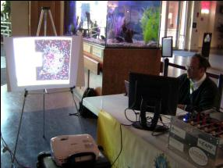
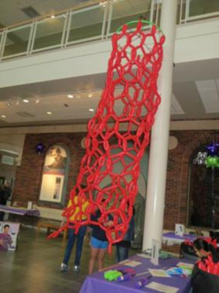
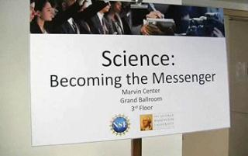
Engaging the Public
SciPort Discovery Center, Shreveport, February 21, 2012
Super Science Saturday, Baton Rouge, October 15, 2011 & October 26, 2012. Over 2,600 people attended
Nanodays in Baton Rouge,
March 26 & April 2, 2011; March 24 and 31, 2012; March 30 & April 6, 2013
Over 1,250 visitors
Public talks by DiTusa, Garno, Kurtz, & Sprunger
Balloon Nanotube at the 2013 NanoDays hosted at the Louisiana Art & Science Museum, Baton Rouge
NSF/LA EPSCoR sponsored workshop: Science: Becoming the Messenger, November 17, 2011
Notes:
4

Slide 5
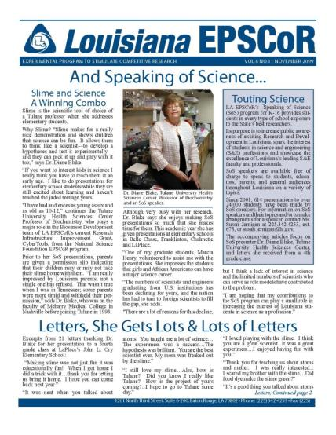
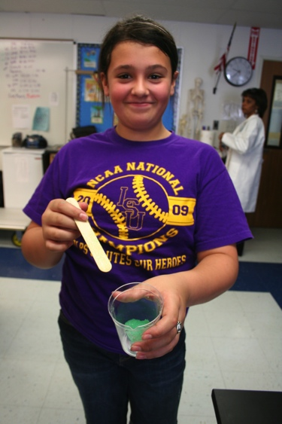
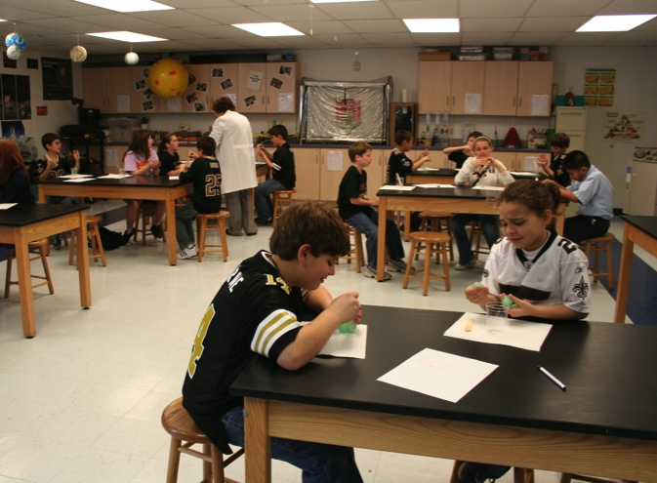
Public Lectures: Speaking of Science (SoS)
SoS is one of the many programs administered by Louisiana EPSCoR.
The program provides faculty speakers to K-12 schools free of charge.
51SoS presentations in Year 3
Students reached in Year 3
2,124+
15,725+
Students reached in the last 6 years
Notes:
5

Slide 6
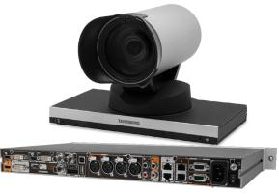
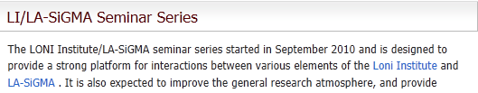
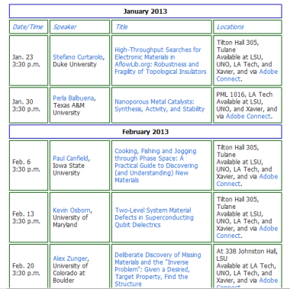
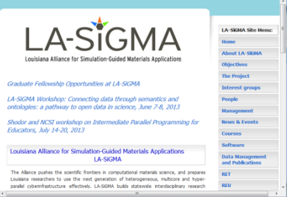
Target: Internal Communications
Leverage cyberinfrastructure, video-conferencing, collaboration tools,
web portal, all-hands meetings.
Monthly seminars over Polycom available to other campuses.
State-of-the-art HD synchronous video, lecture/seminar capture, and digitization equipment purchased in collaboration with LONI & BoR.
Web portal operational http://lasigma.loni.org
More than 3,500 visits to main webpage since Dec. 2011.
Notes:
6

Slide 7
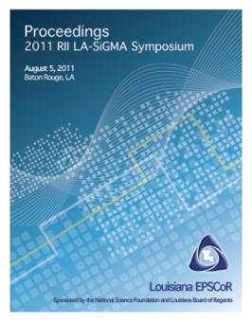
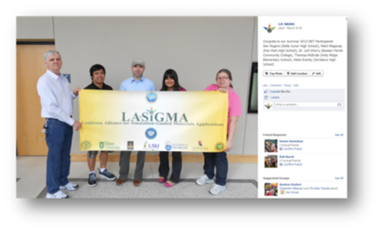
Target: Internal Communications
Leverage cyberinfrastructure, video-conferencing, collaboration tools,
web portal, all-hands meetings.
2 meetings held this year, including EPSCoR RII LA-SiGMA symposium.
111 contributed papers total
44 contributions in year 3
LA-SiGMA Facebook page
Over 4,00 direct hits, more than 16,000 people saw associated content in the
last year
Notes:
7

Slide 8


Industrial Collaborations
La Tech researchers continue to build their relationship with Ford and Jupiter Fuels
Xavier working with Absorption Systems, Inc. of Philadelphia
UNO working with Vertex Pharmaceuticals
LSU working with Albemarle Corporation
La Tech collaborates with Nanovation, LLC
UNO working with Radiant Technologies, Ind.
Notes:
8

Slide 9

Target: National and International Partnerships
Indo-US Joint Center proposal
NSF Materials World Network with German researches
NSF-G8 Research Councils proposal awarded (LA-SiGMA, Japan, Germany)
DAAD Student Exchange program with LA-SiGMA every summer.
La Tech collaboration with IIT-Delhi, India
MOU with Universidad Nacional Cordoba and Rio Cuarto, Argentina.
Notes:
9

Slide 10
External Engagement Milestones
Strategies | Y1 | Y2 | Y3 | Y4 | Y5
Leverage multiple avenues to engage the general public. | X | X | X | X | X
Create a web portal for distribution of project deliverables. | X | X | X | X | X
Create a repository and version control system for code development and distribution. | X | X | X | X | X
Leverage cyberinfrastructure to facilitate communication. | X | X | X | X | X
Use Newsletter/Brochures/Highlights to publicize Alliance activities. | X | X | X | X | X
Create formal mechanisms for engagement with NSF. | X | X | X | X | X
Establish new national, industrial and international collaborations. | X | X | X | X | X
On Track
On Track
On Track
On Track
Ahead
On Track
On Track
On Track

