Slide 1



NSF Research
Infrastructure Improvement
InterCampus & IntraCampus
Cyber Connectivity (RII C2)
Dr. Gene D’Amour
Senior Vice President for Resource Development
Xavier University of Louisiana July 30, 2013

Slide 2

Xavier’s NSF RII C2 Grant
Funding to connect Xavier to LONI and strengthen collaborative computational research and educational opportunities for Xavier students and faculty
  ∽$1.2 million in ARRA funding
  ∽$674,000 to BoR for fiber;
  ∽$500,000 to Xavier for education, training, and research
Notes:
HAVE FIRST BULLET (FUNDINGS … ) COME IN WITH SLIDE TITLE – done sj

Slide 3
RII C2 Objectives
Enhance Research Competitiveness
Advance training and workforce development
Facilitate collaborative research in
Materials Science
Xavier
and
LONI
Engage minority undergraduates in Computational Science research projects
Facilitate collaborative research in Computational Science
Advance curricula in
Computer Science, Engineering and Materials Science
to engage minority students
Notes:
Enhance overall research competitiveness??? ARE WE SUPPOSED TO ENHANCE IT IN ALL FIELDS OR JUST THE COMPUTATIONAL SCIENCES?
I revised the top square accordingly.

Slide 4
Management Plan
Project Execution Team communicated regularly to discuss the progress of the grant
September 20, 2012: All Hands Meeting
  21 attendees
  Presentations by LONI staff, pilot project PIs, undergraduate research students, LONI/LSU training staff
Notes:
Who is the project execution team? For how long did the meeting go.
Project Execution Team – Michael Khonsari, Les Guice, Joel Tohline, Gene D’Amour
Meeting lasted 2 hours

Slide 5
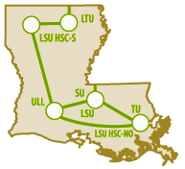
Status of LONI Connection
Xavier is now fully connected to LONI
Connection doubled bandwidth at the University from 250 MB to 500 MB
  Faculty and staff network increased from 150 MB to 200 MB
  Student network increased from 100 MB to 300MB
  Faculty/students can conduct research
  via LONI at a speed of 10GB
Notes:
HAVE LAST 3 BULLETS COME IN ON ONE CLICK (NOT WITH 2ND BULLET) – done sj

Slide 6
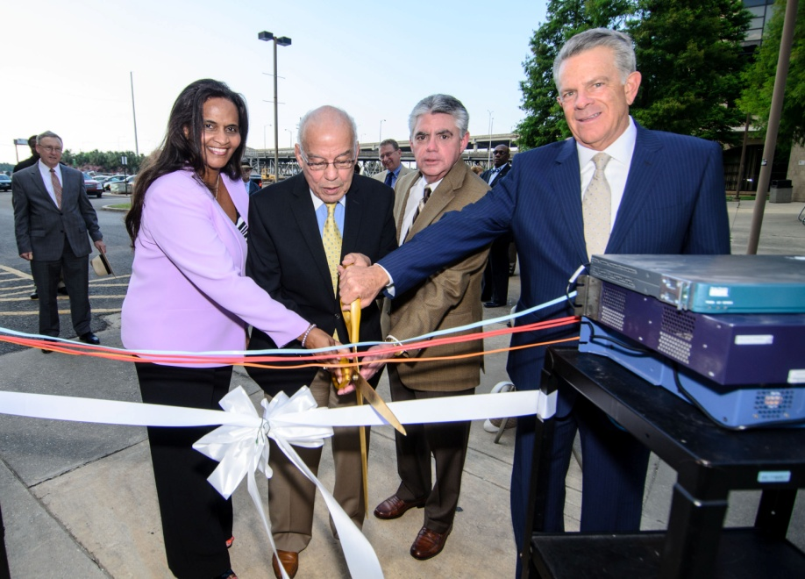
Status of LONI Connection
Board of Trustees’
Ribbon Cutting Ceremony:
June 7, 2013
Speakers at the ceremony included:
  Dr. Norman Francis, President, Xavier University
  Melva Williams, Vice President for Technology Administration, Xavier University
  Donnie Vandal, Executive Director, LONI
Notes:
Check with PR. Did we get any press on this??
No, Richard Tucker said he didn’t think it got picked up in the press, but it was included in the IA Newsletter.

Slide 7
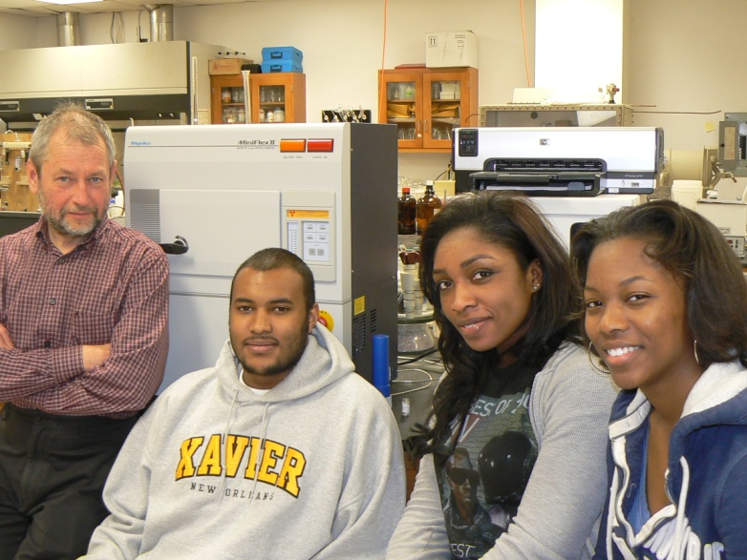
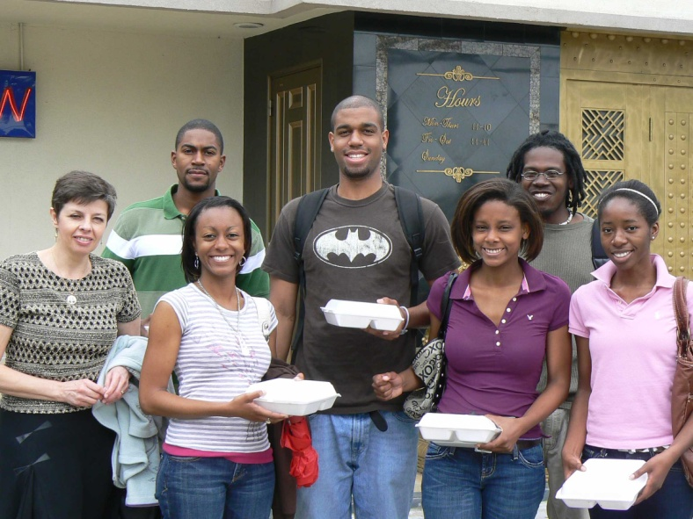
Enhancing Competitiveness
Collaborative Computational Research at Xavier
Computational Materials Science Research – in conjunction with RII Track 1 (Lamar Meda, Vladimir Kolesnichenko, Galina Goloverda, Kevin Riley)
5 publications / 5 presentations

Slide 8
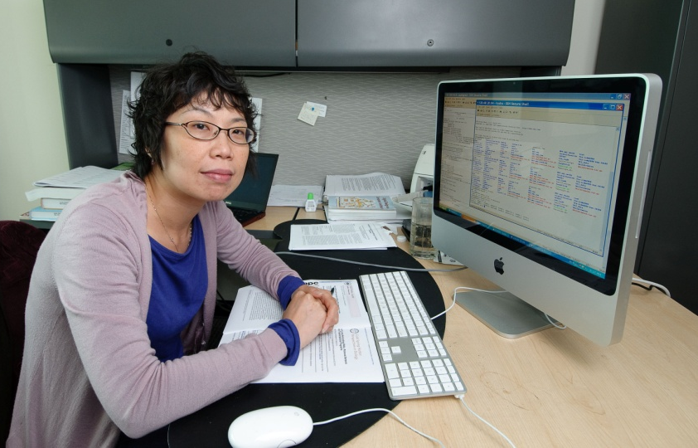
Enhancing Competitiveness
Bioinformatics (Andrea Edwards and Karen Zhang)
Awarded $463K DoD Data Mining Grant
Bioinformatics core proposed in RCMI renewal grant
6 journal publications, 1 book chapter, 3 presentations

Slide 9

Enhancing Competitiveness
Mathematics Research
Dominic Marcello (LSU Postdoc) working with Valerio DeAngelis (Xavier Math Faculty) to use LONI for research
Chapter published in Numbers and Functions by Victor Moll

Slide 10
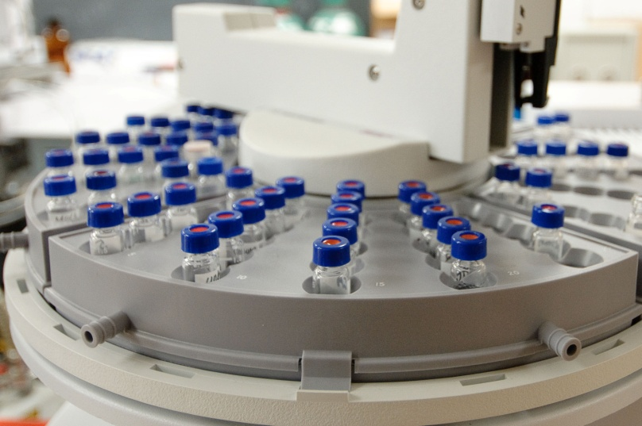
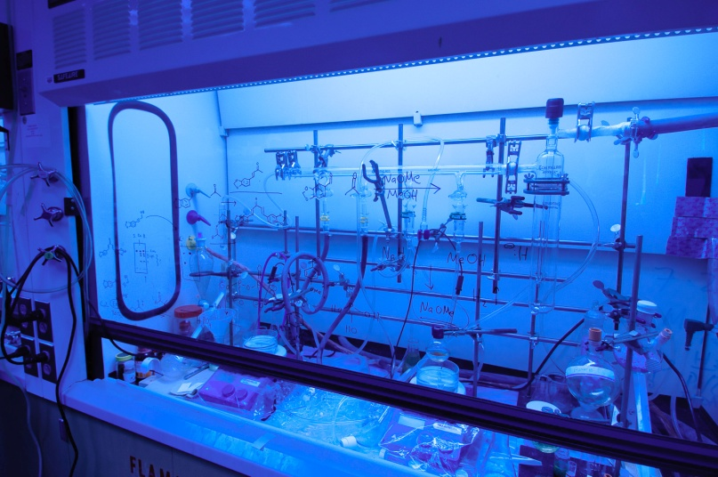
Enhancing Competitiveness
Pilot Projects for Collaborative Computational Research
3 projects awarded at∽34K each:
  Lamar Meda (Xavier) and Ramu Ramachandran / Collin Wick (LaTech)
  Jian Zhang (Xavier) and Guang-Lin Zhao (SUBR)
  Jessica Graber (Xavier) and Lev Kaplan (Tulane)
Notes:
These were LONI $??
Yes

Slide 11
Enhancing Competitiveness
Synthesis and Characterization of Nanostructure Ruthenium
  Lamar Meda (Xavier faculty)
  Ramu Ramachandran (LaTech faculty)
  Collin Wick (LaTech faculty)
  Geoffrey Stevens (Xavier undergraduate)
Objective: Use chemical vapor deposition to grow ruthenium oxide nanomaterials as a possible electrode material for lithium-ion batteries
Notes:
HAVE FOUR NAMES COME IN AT SAME TIME AS FIRST LINE – done sj

Slide 12
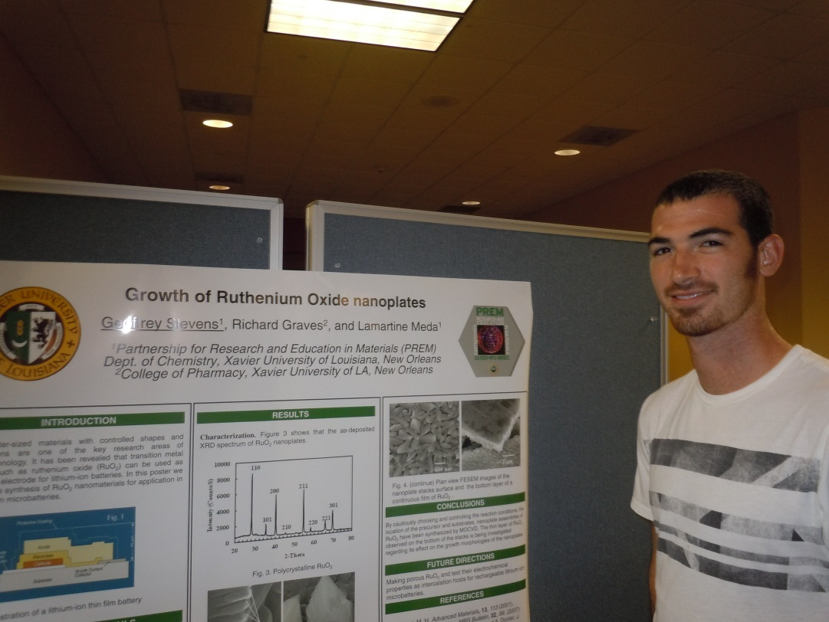
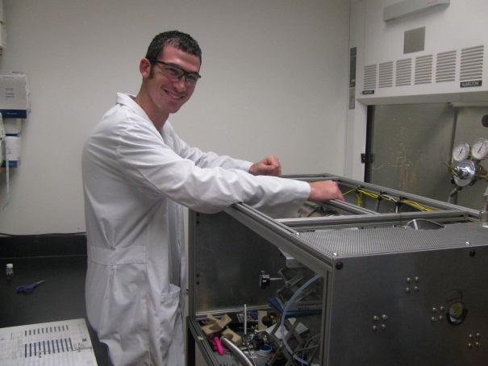
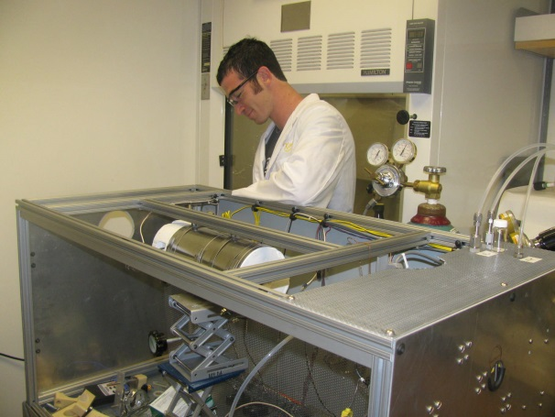
Enhancing Competitiveness
7 presentations including 1 student presentation
Notes:
AFTER ALL PICTURES COME IN THEY THEN DISAPPEAR ON CLICK AND THE FIRST LINE REMAINS. RATHER, AFTER ALL PICTURES COME IN, BE ABLE TO CLICK TO MOVE TO NEXT SLIDE. – done sj

Slide 13
Enhancing Competitiveness
A Study of Gas-Sensing Properties of Tin Oxide Nanoparticles
  Jian Zhang (Xavier faculty)
  Guang-Lin Zhao (SUBR faculty)
  Mark Raymond (Xavier undergraduate)
  Nicole Patterson (Xavier undergraduate)
Objective: Develop a nanostructured tin oxide system and seek a theoretical description of the gas sensing properties for such a system through large scale nanomaterial simulation

Slide 14
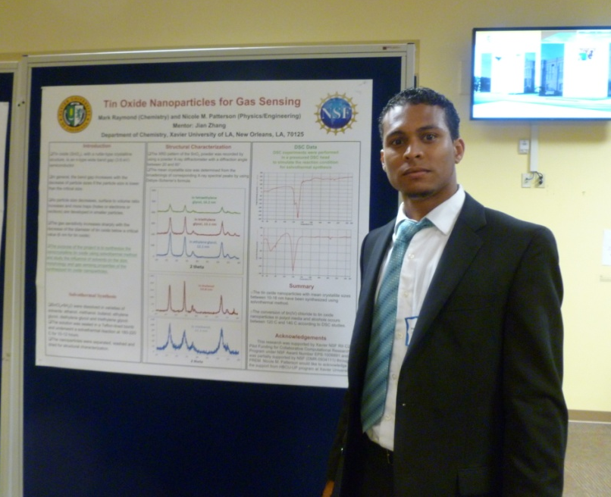
Enhancing Competitiveness
Student presentation at Xavier Festival of Scholars

Slide 15

Enhancing Competitiveness
The Interaction of Linear and Nonlinear Effects in Freak Wave Formation
  Jessica Graber (Xavier faculty)
  Lev Kaplan (Tulane faculty)
  Kedric Hayes (Xavier undergraduate)
  Justin Cutrer (Xavier undergraduate)
  Jhamal Davis (Xavier undergraduate)
Objective: to familiarize students with the programs used to model wave formation in the deep ocean
Student presentation at Southeastern Region American Physical Society conference
Notes:
HAVE NAMES COME IN WITH FIRST LINE – done sj

Slide 16
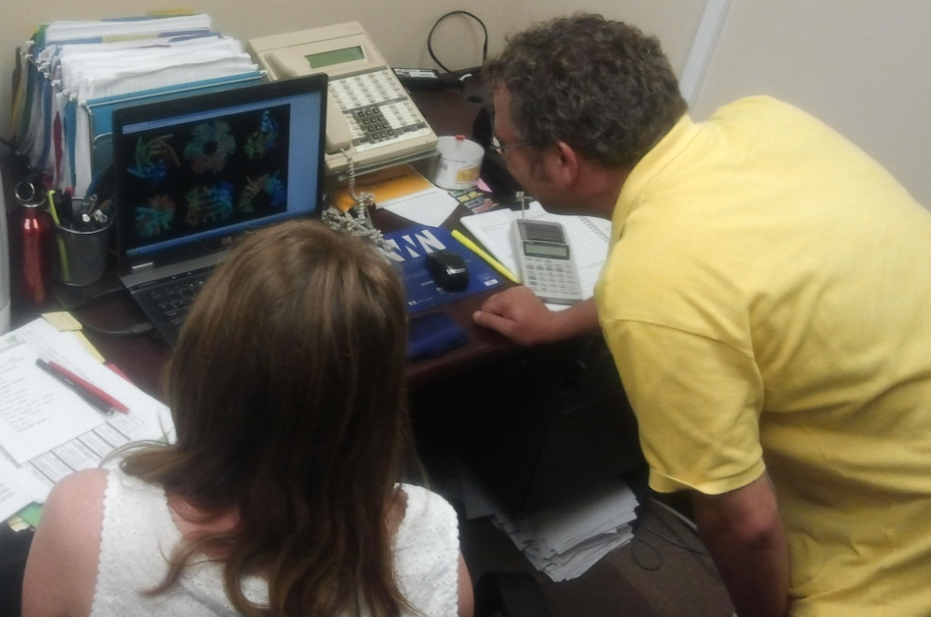
Enhancing Competitiveness
$20,000 start-up package provided to new Computational Chemistry faculty member, Kevin Riley
Used for purchase of computers and software including Pymol, Yasara, Gaussian, and Molpro
Working with 7 undergraduate researchers
3 journal publications
Notes:
LONI $??
Yes

Slide 17
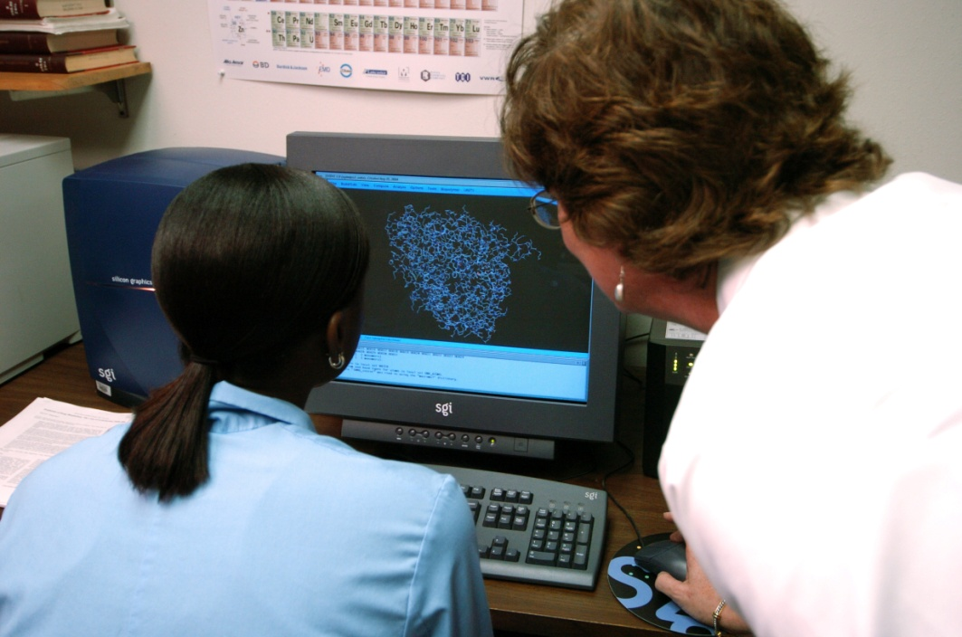
Enhancing Competitiveness
37 undergraduate student researchers supported in the last year
Computer Science
Chemistry
Physics

Slide 18
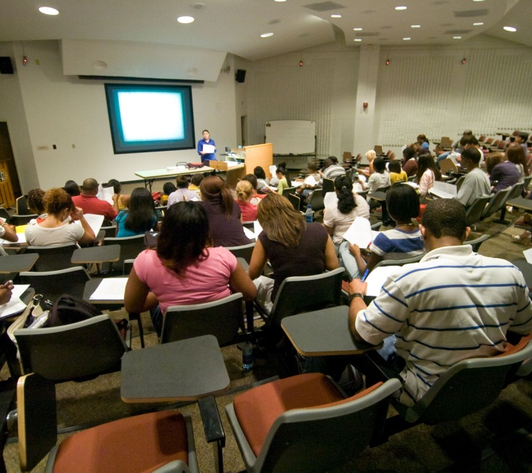
Advancing Curricula
Three New Computer Science Courses
Robotics and Intelligent Systems (offered as Mobile Devices in Spring 2012)
Bioinformatics Programming
(developed Summer 2012, to be offered Spring 2014)
Data Mining
(developed Summer 2011, to be offered Spring 2015)
Additional data-intensive courses to be offered Fall 2014:
Scientific Computing and Data Analysis
Notes:
Offered as Mobile device -- don’t understand what this means
The class was originally supposed to be called Robotics and Intelligent Systems, but due to student interest the class was reworked and called Mobile Devices and relied heavily on app design/development.

Slide 19
Advancing Curricula
New computational content formulated for:
Existing courses (computational content to be added Fall 2013)
  Introduction to Engineering
  Introduction to Engineering Design
  Engineering Graphics
New courses (to be offered Fall 2013)
  Fundamentals of Materials Science, 3000-level
  Advanced Materials Synthesis, 4000-level

Slide 20
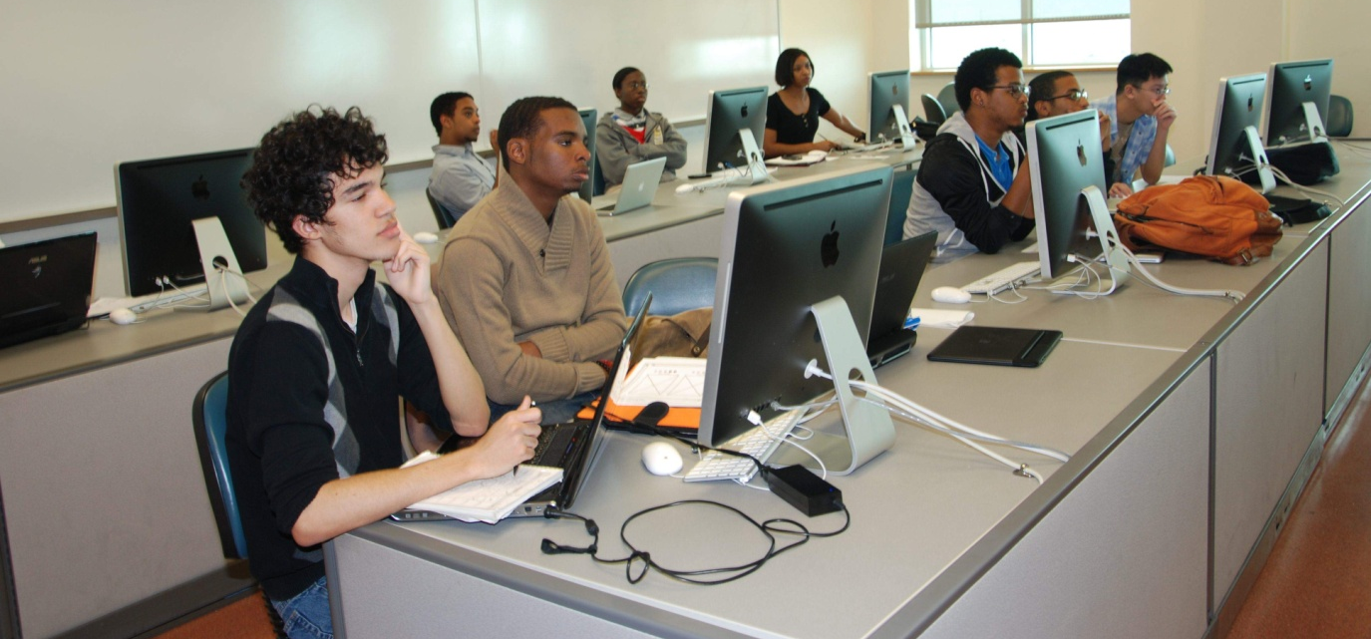
Advancing Student Training
November 2012: 6 undergraduate computer science students attended the SC12 Supercomputing Conference in Salt Lake City, Utah
Participated in an international programming competition
Notes:
SECOND BULLET ON CLICK

Slide 21
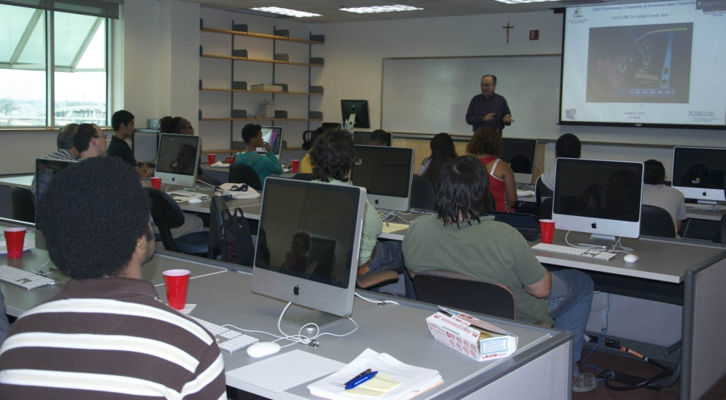
Advancing Student Training
January 2013: LSU-led HPC workshop hosted at Xavier
20+ students attended and learned about upcoming research and training opportunities
Alexandria Robinson
(Xavier student) – one of 40 students chosen to participate in national XSEDE Scholars Program in
Summer 2013
Notes:
The Extreme Science and Engineering Discovery Environment (XSEDE) Scholars Program is a national program for U.S. students from underrepresented groups in the area of computational sciences. As a Scholar, you will learn more about high performance computing and XSEDE resources, network with cutting-edge researchers and professional leaders, and belong to a cohort of student peers to establish a community of academic leaders. In particular, the focus is on the following underrepresented groups: African Americans, Hispanics, Native Americans, and women. THANKS!

Slide 22

Advancing Student Training
February 2013: 15 Computer Science students toured the LSU Computing Services mainframe room
  Saw first-hand HPC hardware
  Discussed networking LONI servers
  Discussed HPC networks including Google’s search engine

Slide 23
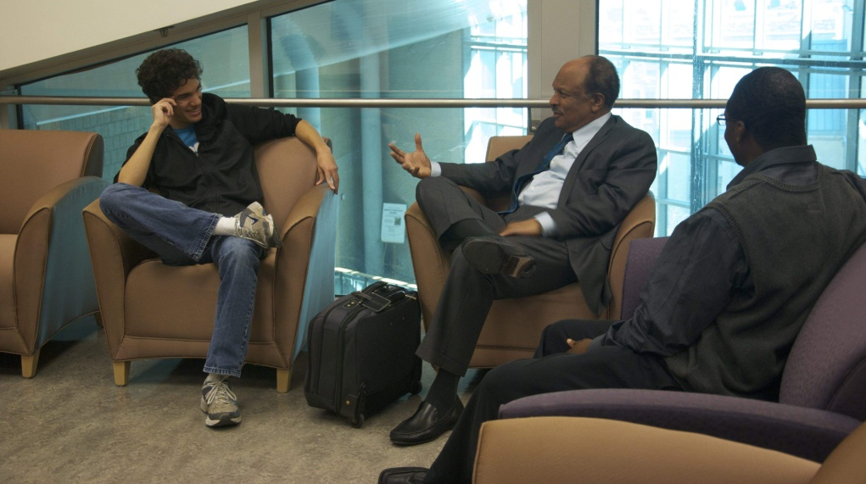
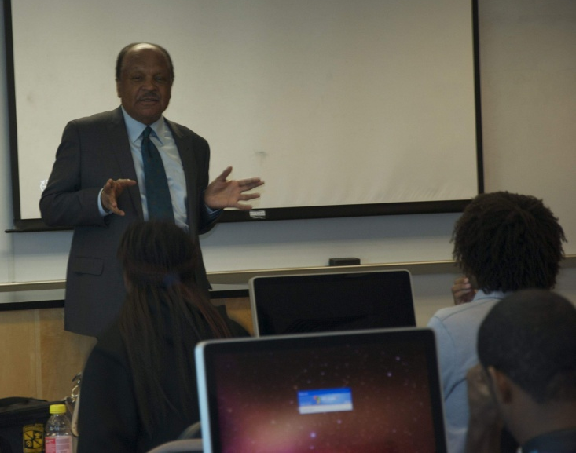
Advancing Student Training
March 2013: Dr. William A. Lester, Professor of Graduate School and Theoretical/Physical Chemistry at UC-Berkeley, visited Xavier and spoke with students about:
  His academic history
  Ways he uses computation in
  his research
  Importance of computation
  to his research
  Success in grad school
Notes:
4 BULLETS COME IN ON CLICK – done sj

Slide 24
Advancing Faculty Training
June 12-13, 2013 (Baton Rouge, LA): Xavier jointly hosted the 2nd Annual High Performance Computing User Symposium, with Louisiana State University
Symposium consisted of invited talks and a poster session discussing research using HPC systems
Excellent opportunity for the LONI user community to come together and share experiences and methods and for Xavier faculty to learn more about HPC research in the State
Notes:
TWO BULLETS EACH COME IN ON INDIVIDUAL CLICKS – done sj

Slide 25
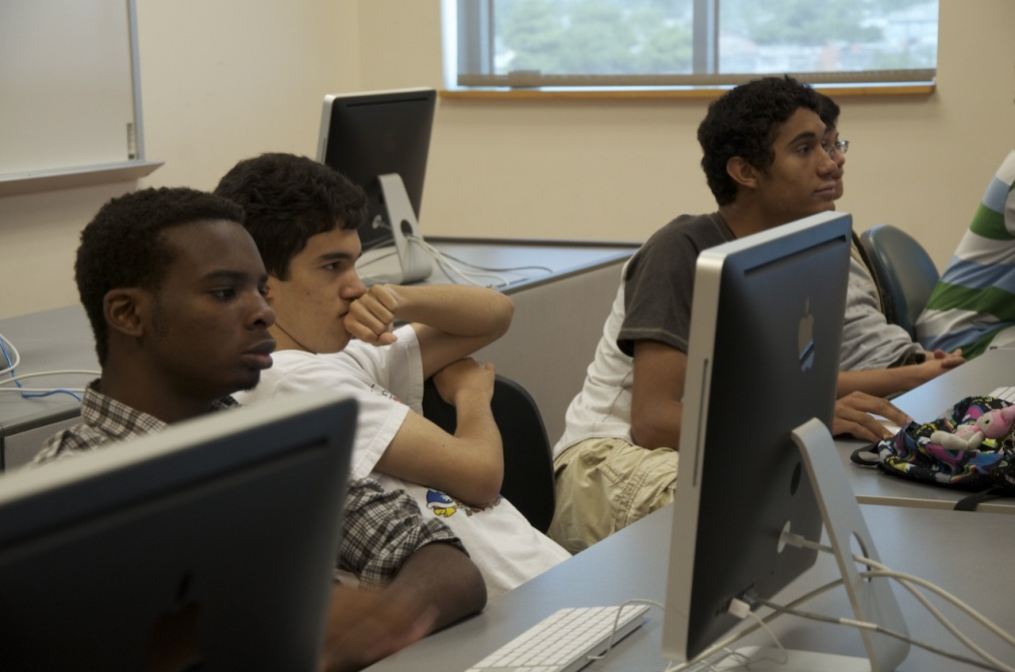

Workforce Development
1 full-time position (Grant Coordinator)
1 postdoctoral associate
42 undergraduate students
Equivalent to 2.5 full-time employees (fiber construction)
Notes:
Don’t understand this one. Will need explanation
This is the number of people hired through the grant. At Xavier, we hired Melanie, a postdoc, and 42 undergrads. The fiber construction number was given to me by Lonnie Leger. It was calculated using the ARRA job creation guidelines, which is based on the number of hours worked per person. Basically 1,300 hours were worked by an undisclosed amount of people and according to the guidelines that equals to 2.5 full time people.

Slide 26
Project Evaluation
External Evaluator – Cindi Dunn, Kansas State University
Internal Evaluator – Melanie Steen Sighinolfi
Conducted focus groups with undergraduate students, faculty, and management team
(April – July 2013)
Currently awaiting final evaluation report

Slide 27
Metric | Goal | Actual
Proposals | 10 | 10 submitted ‡ 4 funded ‡‡
Publications | 15 | 18
Presentations | 15 | 20
Courses with HPC content added | 5 | 5
Minority students attending courses | 100% | 7
Faculty & students attending HPC training activities | 25 | 50
Minority students engaged in research | 10 | 42
Student presentations | 10 | 5
Student publications | 5 | 0
Student graduation rate | 100% | 8 students have graduated
Minorities entering grad school in STEM fields | 60% | 4 (50% of graduates)
Minority graduates entering workforce in STEM fields | 40% | 4 (50% of graduates)
Patent disclosures and licenses | 2 | 0
Number of jobs created | 25 | 46.5
‡ 4 Pilot, 2 DoD, 2 NSF,1 BoR, 1 LBRN
‡‡ (3 Pilot, 1 DoD)
Notes:
How difficult would it be to switch columns so actual is 3rd column and goal is 2nd?? Changed.
Don’t understand goal vs. actual in those I made red. The way we originally thought we were going to calculate student graduation rate is that 100% of the students who participated in the program graduated. During the 3 year grant period only 8 students (out of 42) have graduated thus far. The others are freshman, sophomores, etc. 4 of the graduates have been accepted into graduate school and the other 4 are working in STEM fields.
How calculate # of jobs created? See slide 25.

Slide 28

THANK YOU!

