Slide 1


Cindi Dunn Lead Evaluator for LA-SiGMA EPSCoR Office of Educational Innovation and Evaluation Kansas State University
July 29, 2013

Slide 2
Evaluation Questions
Who are the Louisiana EPSCoR participants? (LA-SiGMA, Females, URM populations)
To what extent are project initiatives implemented (fidelity of implementation)?
What are the short-term and long-term impacts of project initiatives?
How has the multi-scale computational tools developed by LA-SiGMA transformed advances in electronic materials, energy materials, and biomolecular materials?
How has expanded and enhanced computational tools created by LA-SiGMA assisted Louisiana researchers and students?
To what extent have LA-SiGMA researchers established interdisciplinary and interinstitutional collaborations that enhance the work of the project?
To what extent has the project contributed to a diverse and technically trained STEM workforce (pre-college, community college, Historically Black Universities and Colleges)?
How has the project engaged the Louisiana community in outreach and dissemination of efforts?
To what extent have sustainable partnerships with industry and national and international laboratory collaborators been created and expanded?
To what extent has Louisiana EPSCoR been successful in enhancing the competitiveness of Louisiana research enterprises?
What mechanisms have been put in place to ensure continued availability and accessibility to project initiatives?

Slide 3
Analysis and Data Sources
Content analysis:
Project formative and summative reports
Observations and data collected in project meetings (PET, annual meeting, Internal Evaluation Team correspondence, etc.)
Descriptive and content analysis:
Participant information collected through OASIS
LA-SiGMA Project Progress Survey
Citation analysis: Year 1 and 2 publications
Notes:
Developed through specific recommendations from the RSV team
Recommendation 4: Evaluation questions should be rethought
annually and mechanisms developed to ensure that evaluation results are used formatively.”

Slide 4
Who are the Louisiana EPSCoR participants?
LA-SiGMA programs
 | Year 1 | Year 2 | Year 3* | Gain/loss
LA-SiGMA Faculty | 59 | 64 | 70 | +11
Post-Doctoral Students | 7 | 13 | 8 | +1
Graduate Students | 57 | 71 | 65 | +8
Undergraduate Students | 59 | 74 | 62 | +3
Technical/Non-technical Staff | 13 | 15 | 16 | +3
Total | 195 | 237 | 221 | +26
 | Year 1 |  |  | Year 2 |  |  | Year 3*
 | Women | URM |  | Women | URM |  | Women | URM
LA-SiGMA Faculty | 14% | 12% |  | 14% | 11% |  | 17% | 11%
Post-Doctoral Students | 14% | 0% |  | 15% | 8% |  | 25% | 13%
Graduate Students | 21% | 12% |  | 24% | 16% |  | 24% | 27%
Undergraduate Students | 36% | 29% |  | 38% | 36% |  | 41% | 44%
Total | 23% | 18% |  | 25% | 21% |  | 27% | 26%
*Year 3 data is based on information obtained from between October 2012 and April 2013.
Bold blue text indicates an increase from Year 2.

Slide 5
To what extent are project initiatives implemented (fidelity of implementation)?
Most major goals and milestones were met for Year 3.
All SD1, SD2, SD3 milestones are complete, ahead of schedule, in progress or on target for Year 3.
All CI milestones are on target for Year 3.
Most KSD milestones are on target for Year 3 with mitigation plans.
LA-SiGMA Project Progress Survey Module in OASIS:
Process | Outcomes | Commitment | Efficiency | Effectiveness | Productivity
4.16 (0.78) | 4.27 (0.78) | 4.38 (0.78) | 4.45 (0.79) | 4.31 (0.79) | 4.18 (0.78)
Scale (1 = strongly disagree to 5 = strongly agree) Mean and (Standard Deviation) shown
*Year 3 data is based on information obtained from between October 2012 and April 2013.
Bold Blue text indicates an increase from Year 2.
Notes:
SD = Science Driver
KSD = Key Strategic Directions (Diversity, Workforce, External Engagement)
RET expansion of pilot program close to commencement.
Establishing co-mentoring; Planning for Major Initiatives; Grantwriting Workshops; SBIR/STTR Phase Zero Initiative, NOT MET.

Slide 6
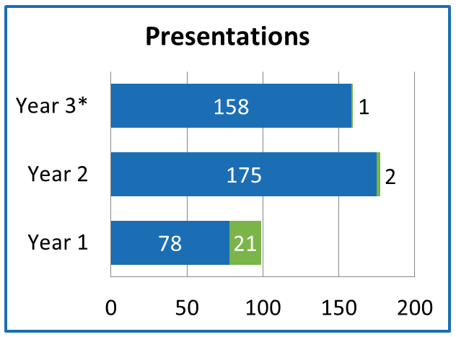
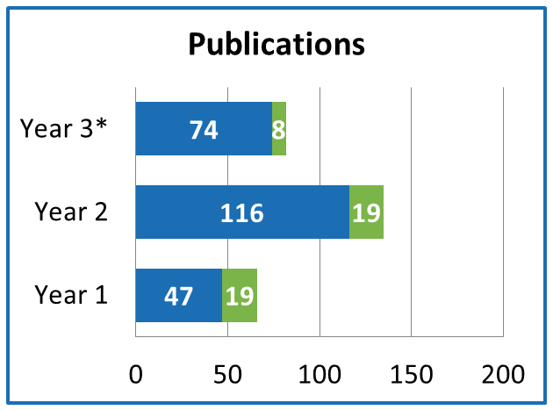
What are the short-term and long-term impacts of project initiatives?
How has the multi-scale computational tools developed by LA-SiGMA transformed advances in electronic materials, energy materials, and biomolecular materials?
More than 2 codes will be ported to National Leadership Class machines by Year 3.
4 researchers ported code
4 codes with full documentation will be publically available.
1 code contained full documentation
NSF Acknowledged NSF Not Acknowledged
*Year 3 data is based on information obtained from between October 2012 and April 2013.
Notes:
Two summative goals were stated in the funded proposal that align to the use of computational tools by Year 3: 1) more than two codes will be ported to National Leadership Class machines, and 2) Four codes with full documentation will be publically available. In Year 3, four researchers each reported porting one code exceeding the goal. Only one of the codes, as reported in OASIS, included full documentation.

Slide 7
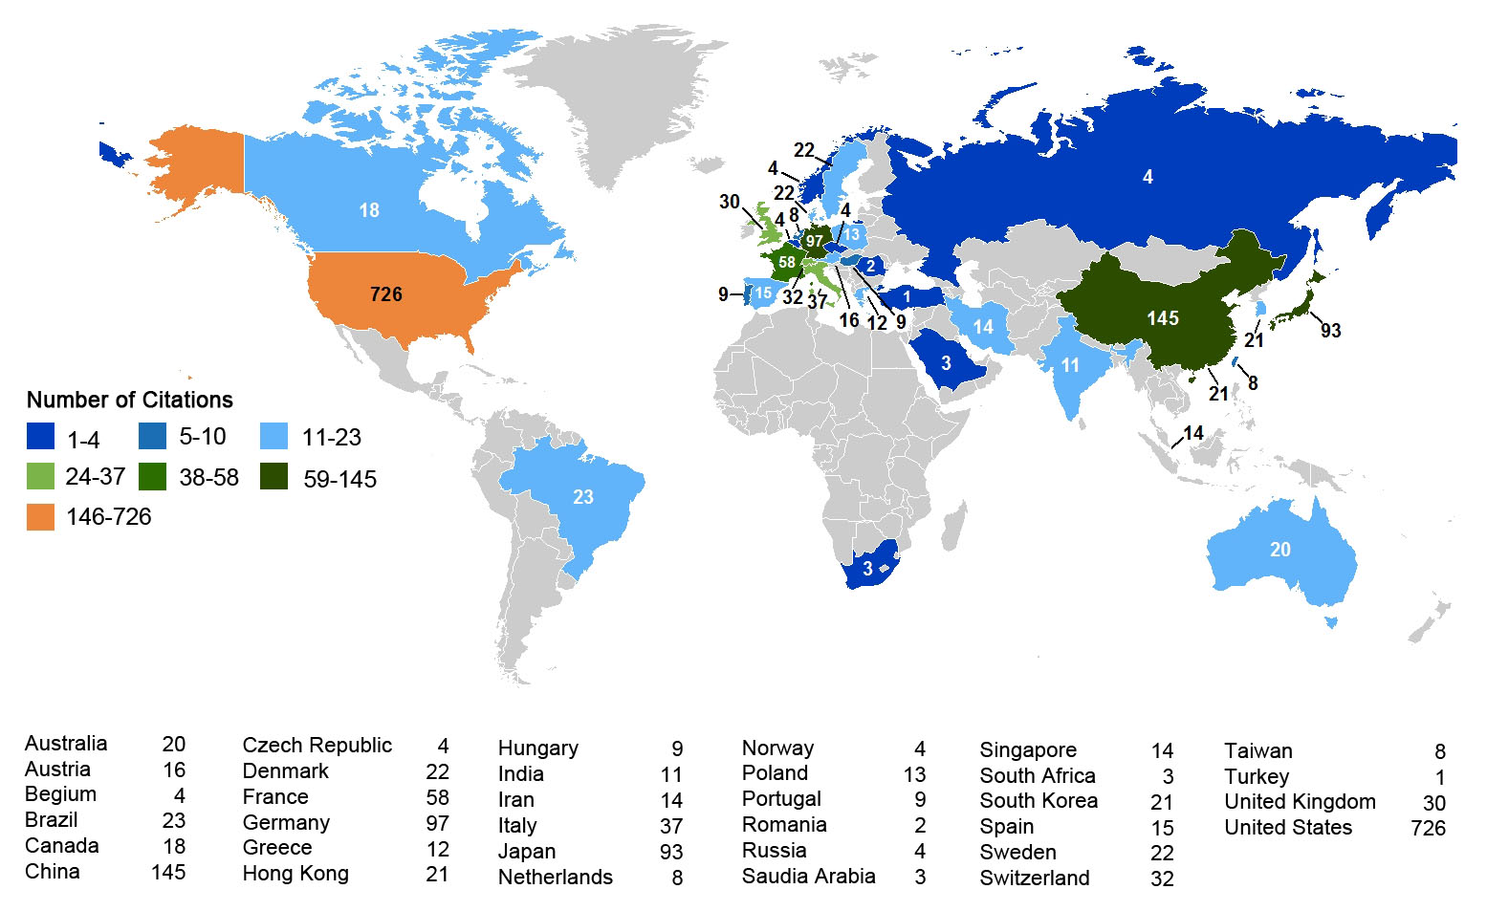
Location of Authors in World Citing Year 1 (970 authors) and Year 2 (547 authors) LA-SiGMA Publications (does not include self citations)

Slide 8
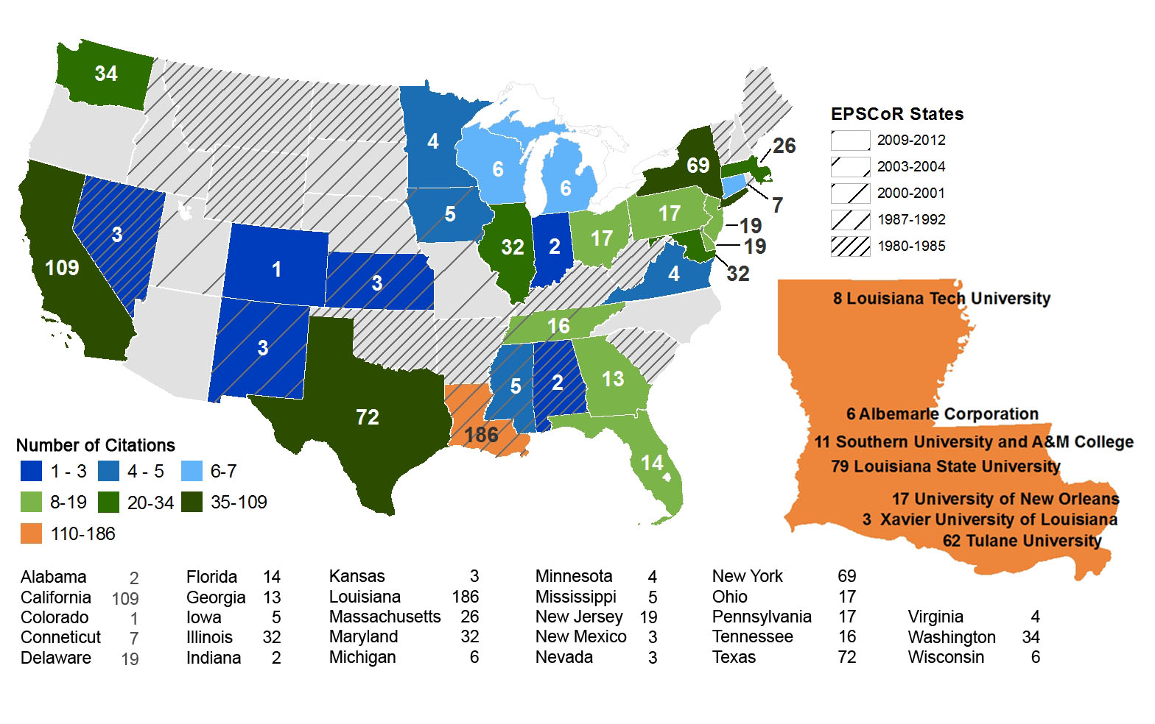
Location of Authors in US Citing Year 1 (970 authors) and Year 2 (547 authors) LA-SiGMA Publications (does not include self citations)

Slide 9
How has expanded and enhanced computational tools developed by LA-SiGMA assisted Louisiana researchers and students?
Research Infrastructure Tools and Platforms | Year 3*
Computational Tools
Multi-core Computers | 54%
Massively parallel | 39%
MPI coding | 24%
GPU (heterogeneous) | 19%
OpenMP | 7%
Hybrid Programming | 7%
Other | 2%
None of the tools listed | 41%
Platforms
LONI (local) | 37%
LONI (remote) | 34%
National SC Centers | 10%
TeraGrid | 8%
None | 32%
Year 5 goal is 25% of researchers use cyber tools.
Year 3: 59% of researchers use tools.
*Year 3 data is based on information obtained from between October 2012 and April 2013.
Bold Blue text indicates an increase from Year 2 to Year 3.
Notes:
One summative project goal is the 25% of LA-SiGMA researchers will use Cyber tools by Year 5. In Year 3, 41% of LA-SiGMA researchers have not used any of the tools listed (an increase from 39% in Year 2), yielding 59% of LA-SiGMA researchers who have used at least one computational tool; exceeding the Year 5 goal.

Slide 10
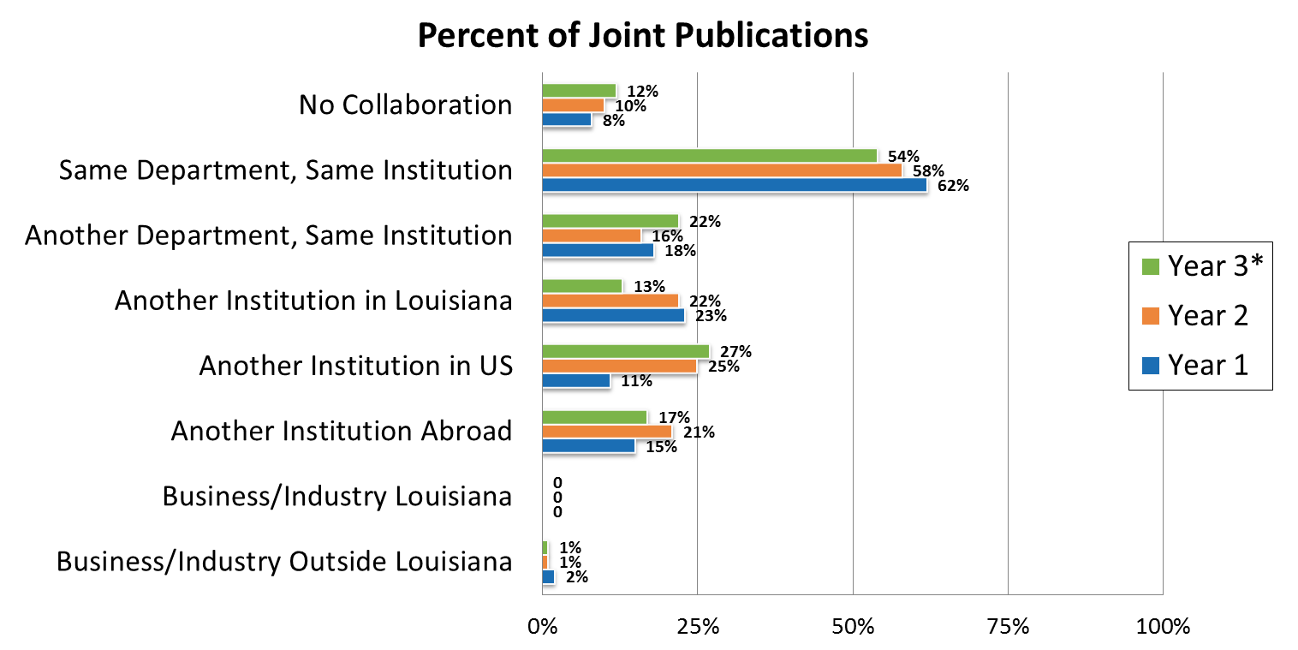
To what extent have LA-SiGMA researchers established interdisciplinary and interinstitutional collaborations that enhance the work of the project?
*Year 3 data is based on information obtained from between October 2012 and April 2013.

Slide 11
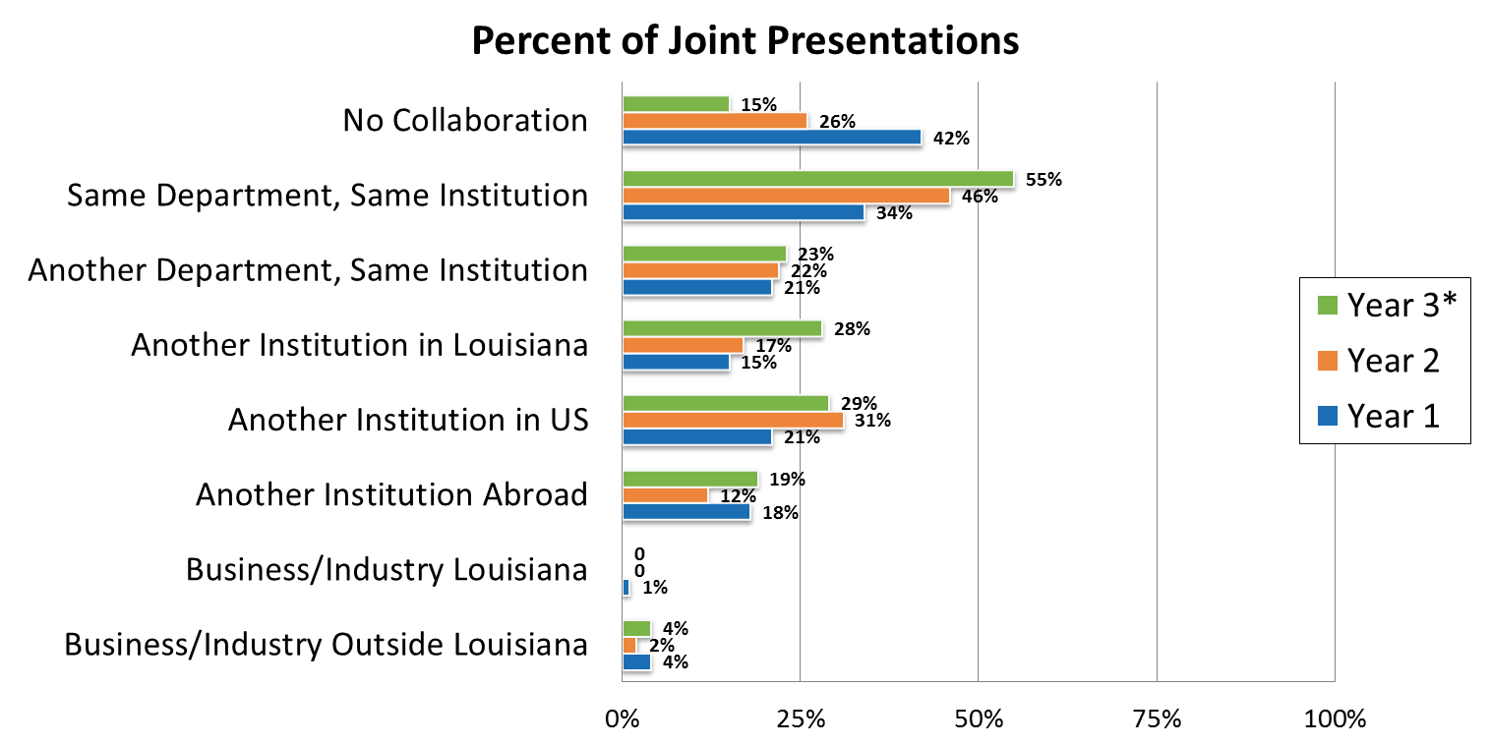
To what extent have LA-SiGMA researchers established interdisciplinary and interinstitutional collaborations that enhance the work of the project?
More than 5 papers or conference presentations resulting from internships each year.
Year 3: 1 researcher and 1 student
*Year 3 data is based on information obtained from between October 2012 and April 2013.
Notes:
A summative goal indicated in the funded proposal stated, “More than 5 papers or conference presentations resulting from internships each year.” In Year 3, the goal was not met; one researchers and one student reported a conference presentation that were a result of an internship or extended travel.

Slide 12
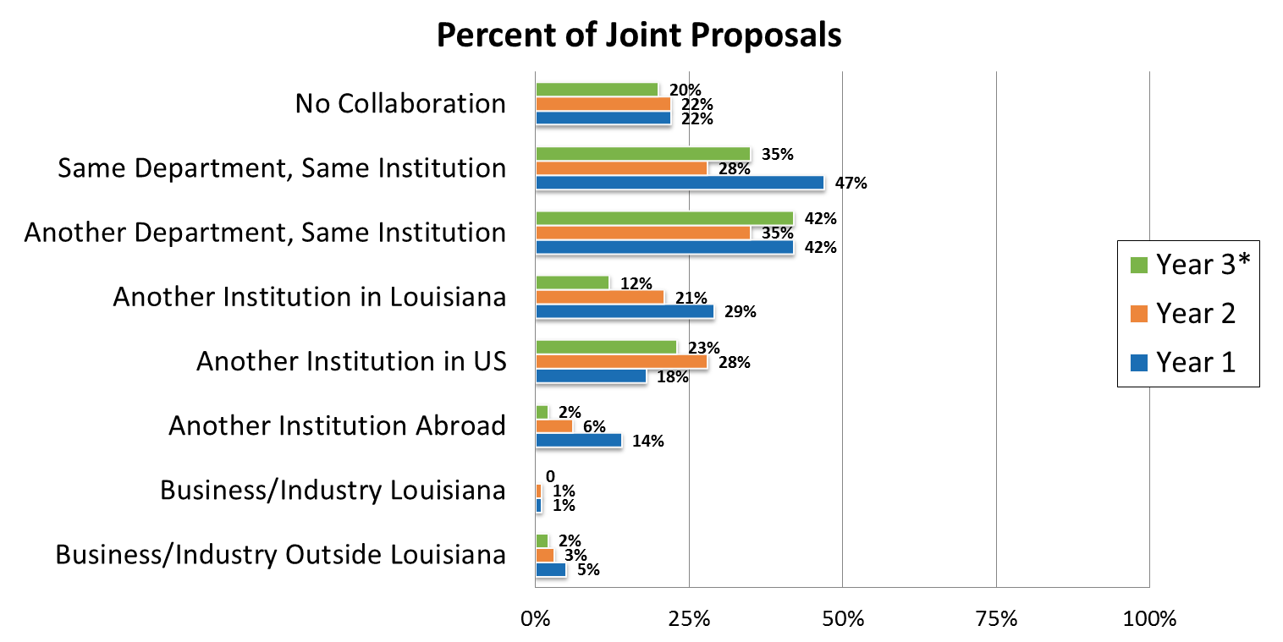
To what extent have LA-SiGMA researchers established interdisciplinary and interinstitutional collaborations that enhance the work of the project?
10 Collaborative grants each year
10 collaborations with LA institutions
19 faculty from other US institutions
2 included persons from institutions outside US
*Year 3 data is based on information obtained from between October 2012 and April 2013.
Notes:
A summative project goal was to submit a statewide IGERT for materials science by Year 2. A review of proposals submitted by LA-SiGMA faculty to OASIS showed two IGERT proposals were submitted in Year 1; thus meeting the goal. Neither proposal was funded.
Another summative goal, as indicated in the funded proposal, was each year, 10 major collaborative grants with interdisciplinary and interinstitutional researchers would be submitted. Of the 80 proposals submitted in Year 3, 10 included faculty from other Louisiana institutions, 19 included faculty members from other institutions in the United States, and 2 included persons from institutions outside of the United States. The goal was met.
By Year 5, at least 10 industrial grants to support research in materials science should be secured. One proposal awarded each year included a business collaborator.

Slide 13

*Year 3 data is based on information obtained from between October 2012 and April 2013.

Slide 14
To what extent has the project contributed to a diverse and technically trained STEM workforce?
Retention
Undergraduates: 5 graduated, 1 enrolled in graduate school
Graduate: 10 graduated, 2 took positions in business
Post-Doctoral: 1 took a position as a research associate in Mathematics at PSU
REU: All 18 participants pursuing a graduate degree, or interested
Skills Gained
REU published papers (3), presented at conferences (7), won awards based on research (3)
RET teachers gained a better understanding of math/science theories
77% of research students learned:
Toolkit of research skills for multiple discipline research
Value of listening to other disciplines
Comfort collaborating with other disciplines
25% of REU from 2-year colleges enter degree programs at 4-year institutions
All REU students plan to enroll in 4-year institutions
15% of RET will represent 2-year colleges
Year 3: 24%
Years 1-3: 18%
20 students secure NSF Graduate Fellowships
Year 3: 2 students
100% 6-year graduation rate of females and URM are being monitored
*Year 3 data is based on information obtained from between October 2012 and April 2013.
Notes:
Specific goals were set to involve students and teachers from two-year institutions: 1) 25% of REU students from two-year colleges enter degree programs at four-year institutions, and 2) 15% of teachers for RET will represent two-year colleges. Outreach Coordinators report all REU students from two-year colleges have or plan to enroll in a four-year college. In Year 3, four of the 17 (24%) RET participants were from community colleges; thus meeting the goal in Year 3. over the three year period, six of the 33 (18%) RET participants were from two-year colleges.
A goal by Year 5 is at least 20 students secure NSF Graduate Fellowships. Two students reported in Year 3 as receiving a Fellowship. No students were reported in Year 1 or 2 for this metric.
An overall project goal is that 100% of the women and URM who participate in the project will graduate in six years. Since this is past the duration of the project, OEIE is tracking students during Years 1-5; however, reporting on this goal will occur after the project.

Slide 15
RSV Recommendation: How has the project increased and enhanced participation from pre-college, community college, and Historically Black College and University (HBCU) groups?
Pre-college
700 K-12 participants
Community College
Grant writing workshop yields a proposal
Baton Rouge Community College new curriculum for Associates degree
Invited talk at LA Community and Technical College Annual Conference to engage Community College students/faculty
HBCU
3 HBCU contribute to LA-SiGMA research
Students participate in REU and SURE
URM students from elementary school visit Xavier laboratory
*Year 3 data is based on information obtained from between October 2012 and April 2013.

Slide 16
How has the project engaged the Louisiana community in outreach and dissemination of efforts?
LA-SiGMA outreach programs served 1,358 participants
69% of researchers participated in one or more outreach activities; 39% in Year 2
REU, RET mentoring
K-12: presentations, summer workshops, open house
64% of researchers have engaged in dissemination efforts for the project; doubling Year 2 participation (32%)
Public lectures
Lectures to industrial audiences
Researchers participated in 1-10 activities in Year 3; average of 2 outreach activities per researcher
*Year 3 data is based on information obtained from between October 2012 and April 2013.

Slide 17
RSV Recommendations: What strategies were effective in strengthening public engagement and what were the outcomes of these strategies?
11% of LA-SiGMA researchers participated in Speaking of Science (SoS) programs in Year 3*; 15% in Year 2; no participation in Year 1
“LA-SiGMA Resource of the Month” distributed to a large mailing list of LA K-12 educators, beginning in January 2013
LA-SiGMA investigators delivered lectures about their research and/or science & engineering to variety of audiences:
Boys and Girls Club
Perry Initiative program (Tulane University)
UPWARD Bound Program
The Sally Ride Festival (LSU)
BREC’s Highland Road Observatory
*Year 3 data is based on information obtained from between October 2012 and April 2013.

Slide 18
To what extent have sustainable partnerships with industry and national and international laboratory collaborators been created and expanded?
4th Annual Industry – Academia Workshop
LA-SiGMA researchers connect with business and industry leaders
Industry collaborations
Tomography procedure
Test LA-SIGMA materials
Fabricates key component of gas sensor
National and International Laboratory Collaborations
GPGPU – enabled algorithms
Molecular scale theory
Code development
Metal Organic Frameworks
Integrated First – Density Functional Theory
10 Industrial grants support research in Materials Science to participating institutions
Year 3: 13 OPT-IN awards
*Year 3 data is based on information obtained from between October 2012 and April 2013.

Slide 19
RSV Recommendation: What strategies were effective in increasing collaborations with industry and what were the outcomes of these strategies?
Louisiana Economic Development (LED) and Battelle presenting their final report to the LA Innovation Council next week – makes several specific references to LA-SiGMA (materials science programs)
18 LED program directors heard the LA-SiGMA team make presentations on their research and that has informed them more about LA-SiGMA capabilities as they recruit companies
SBIR/STTR Zero awards to assist in the development of small business plans
17 Phase 1 and Phase II, totaling $7,780,000
3 Phase III, totaling $2,700,000
*Year 3 data is based on information obtained from between October 2012 and April 2013.

Slide 20
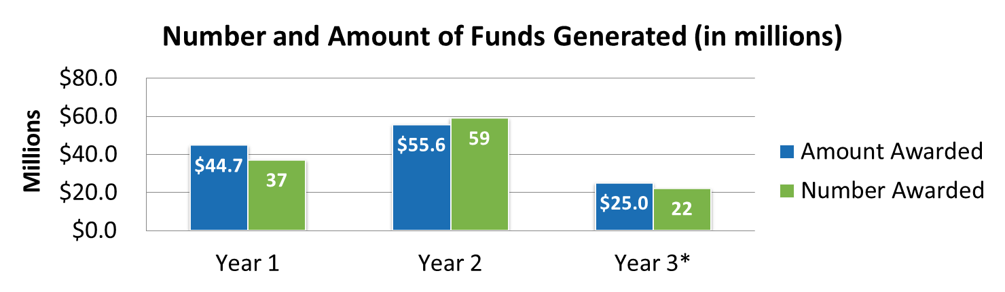
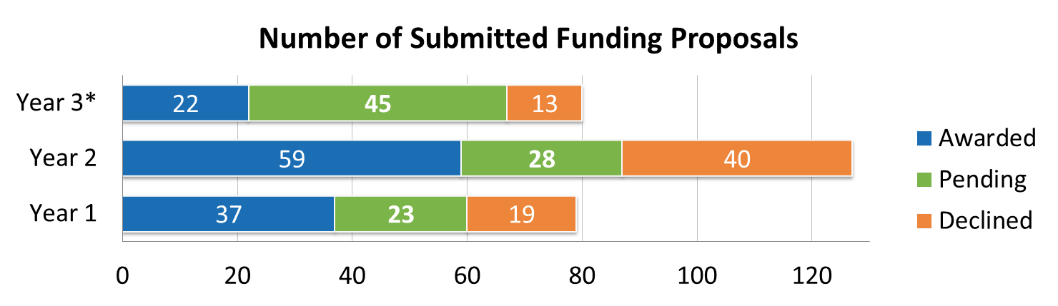
To what extent has Louisiana EPSCoR been successful in enhancing the competitiveness of Louisiana research enterprises?
IGERT in Materials Science
Met Year 1
LA-SiGMA funding rate at least “US average funding rate of federal proposals” (23%)
 | Year 1 | Year 2 | Year 3*
Awarded | 37 | 59 | 22
Submitted | 79 | 127 | 80
Funding Rate | 47% | 46% | 28%
*Year 3 data is based on information obtained from between October 2012 and April 2013.
Notes:
Project leaders set a goal, as stated in the funded proposal, to submit four accepted pre-proposals for centers resulting in two site visits for federal funded centers. In Year 3, two pre-proposals were submitted.
Another goal stated for each year of the project is for the funding rate of the LA-SiGMA project to meet at least the “US average funding rate of federal proposals submitted.” Since the Louisiana EPSCoR project is funded by NSF, the value 23% which is posted in the “FY 2010 Report on the NSF Merit Review Process” is used for comparison. Both Year 1 (47%) and Year 2 (46%) LA-SiGMA funding rates, as shown in table 7, exceed the 23% federal funding rate posted by NSF. The 8-month funding rate for Year 3 (28%) currently also exceeds the federal funding rate.

Slide 21
What mechanisms have been put in place to ensure continued availability and accessibility to project initiatives?
4 accepted pre-proposals for centers resulting in 2 site visits
2 pre-proposals submitted
Management structure fully integrated within the LA BOR and BOR programs augment LA-SiGMA
Monthly progress updates and strategy discussion meetings
Growth in research competitiveness (funding, knowledge transfer) and interdepartmental/interinstitutional collaborations (LA, US, abroad) builds strong infrastructure

Slide 22
Summary -Next Steps:
Metrics are in place to measure long-term outcomes
Work with internal evaluation team:
Improve reporting for Research.gov
Capture direct use of LA-SiGMA created materials
Researchers update Year 3 data in OASIS
As per RSV, PET sets Year 4 evaluation questions based on Year 3 progress

