Slide 1











Report on Student Retreat
Chinedu E. Ekuma
Louisiana State University

Slide 2


Purpose
The aim of the LA-SiGMA Student Retreat is to facilitate an environment where all Undergraduate, Graduate students, and Post-Docs supported by LA-SiGMA can network, present ongoing researches and findings, practice presentation skills, and discuss barriers and potential solutions, as it pertains to the respective science driver. The overarching goal is to have a student lead event that will foster discussions and provide positive feedback.
LA-SiGMA providing the necessary glue!

Slide 3
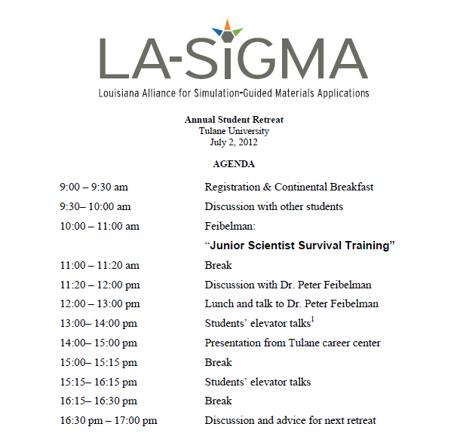
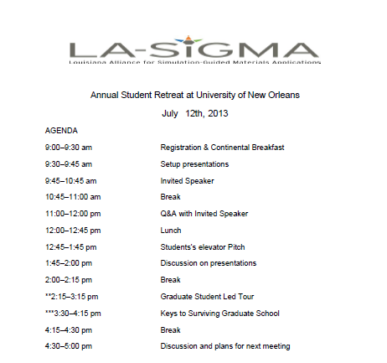
Agenda
Notes:
3

Slide 4
Attendance
LSU 8
LA-Tech 7
SUBR 6
Grambling 0
Tulane 3
UNO 9
Xavier 0
Total = 32
Notes:
What students thought of retreat. You could remove this slide if you like and only add what you like. They may not need to see all of what is on there. U decided
4

Slide 5
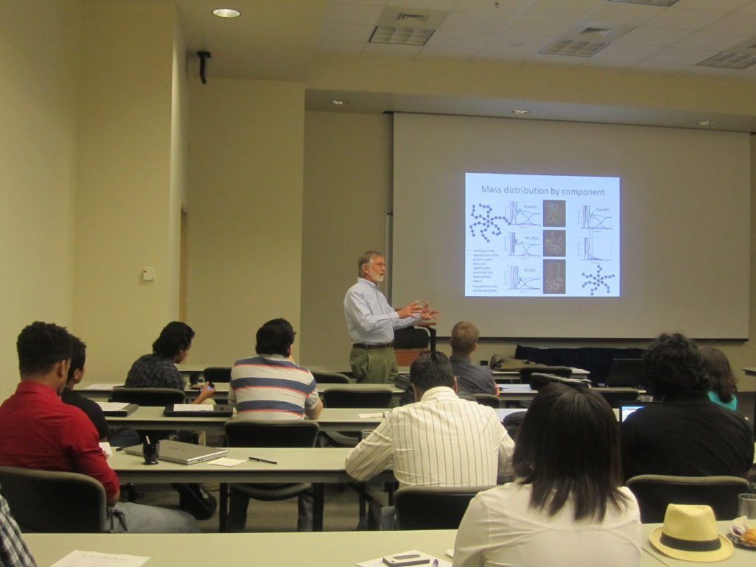
Guest Speaker -1
Dr. W. Swope, a Research Staff Member in Science and Technology at the IBM Almaden Research Center gives a talk to LASiGMA students.
Notes:
5

Slide 6
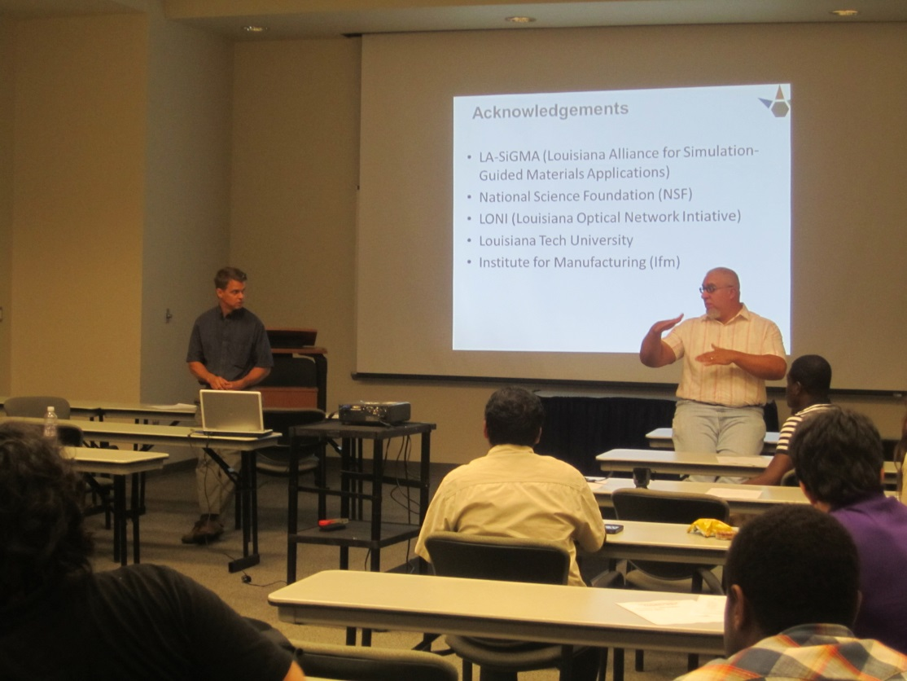
Guest Speaker -2
Dr. Chris Summa, Computer Science, UNO led the panel on the discussion on Keys to Surviving Graduate School.
Notes:
6

Slide 7
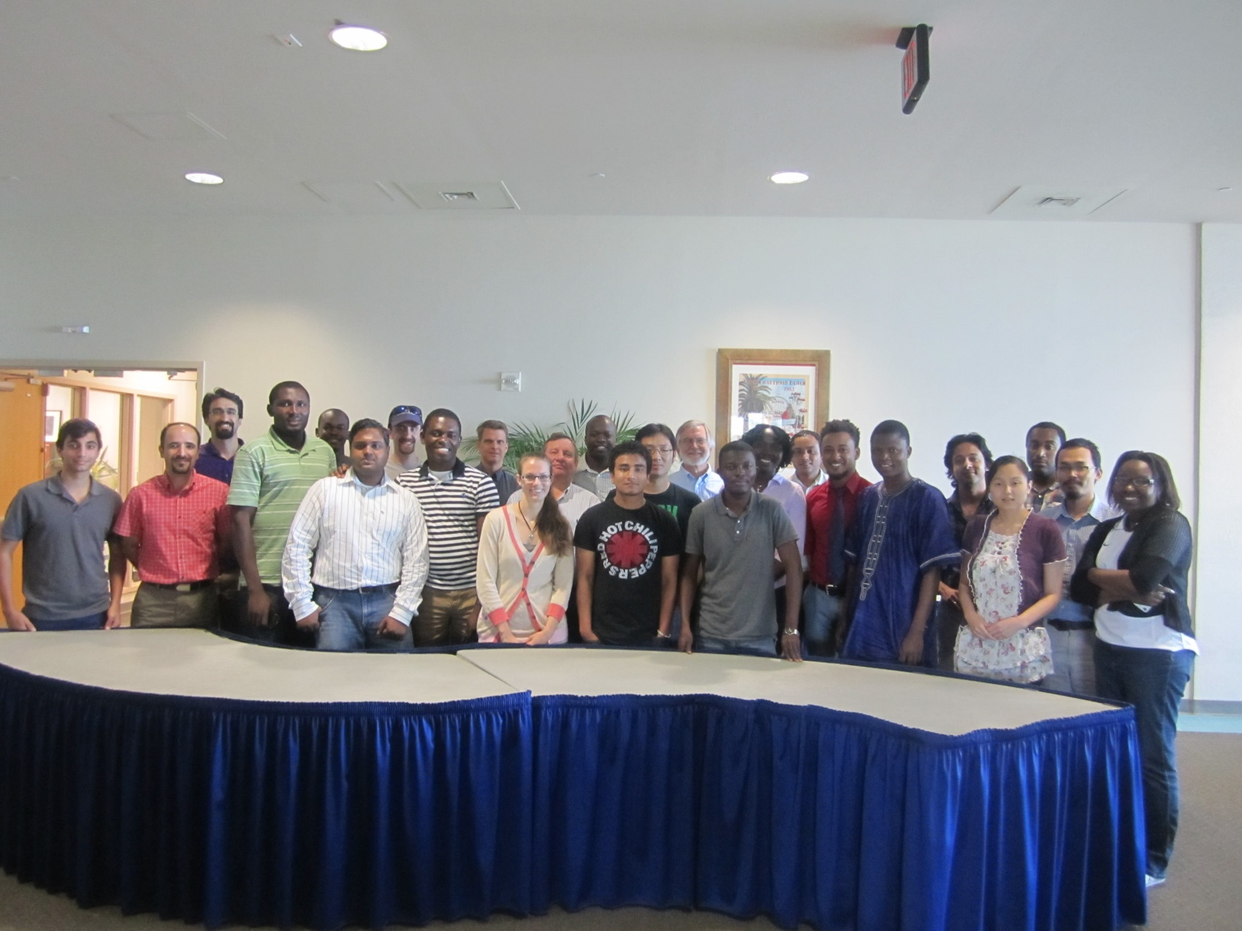
Photo Speaks
Notes:
7

Slide 8
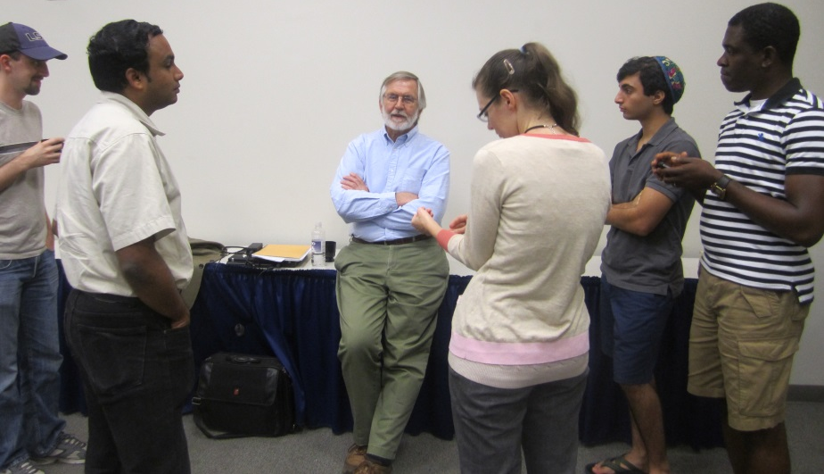
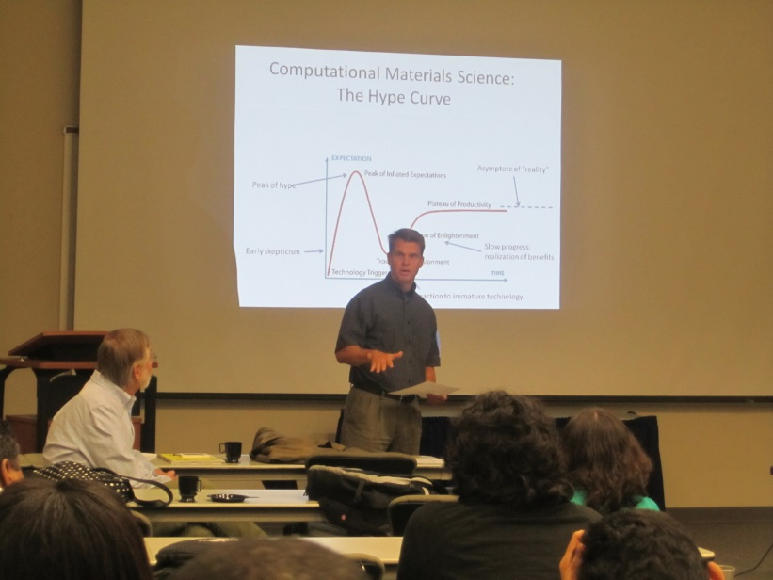

Information sharing at its best…
Notes:
8

Slide 9
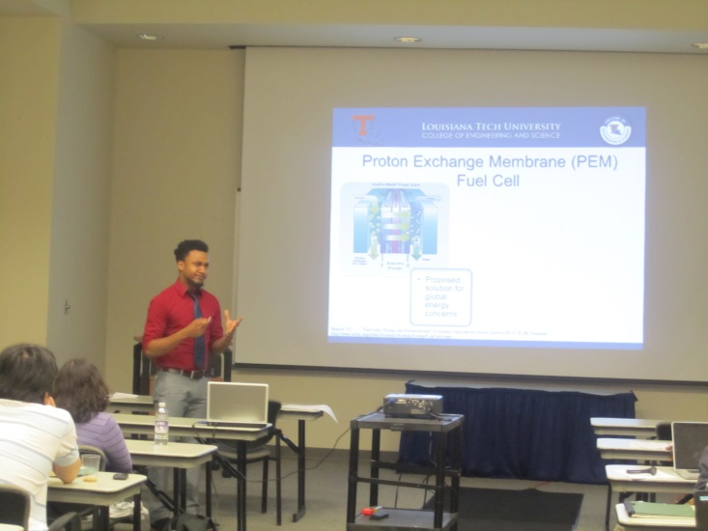
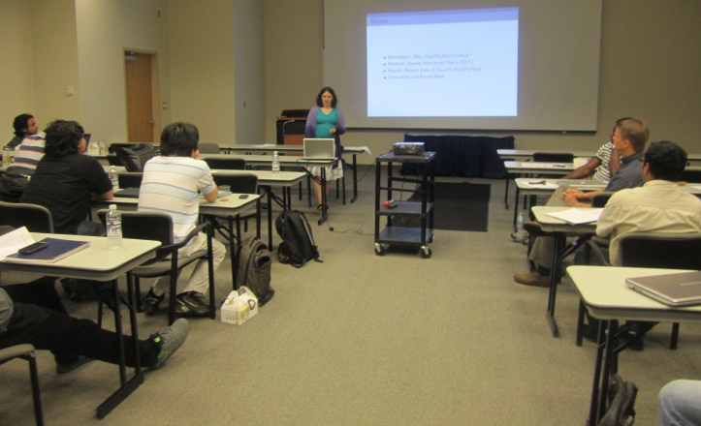
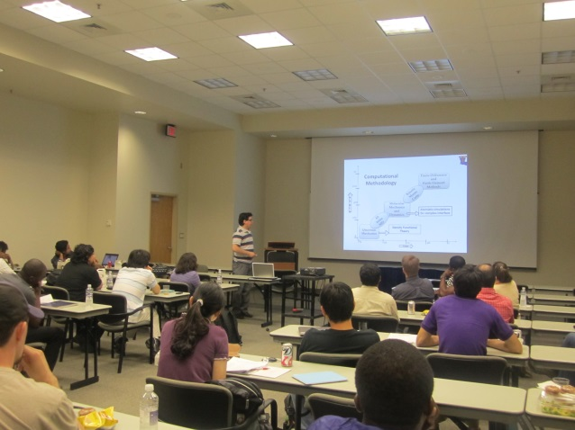
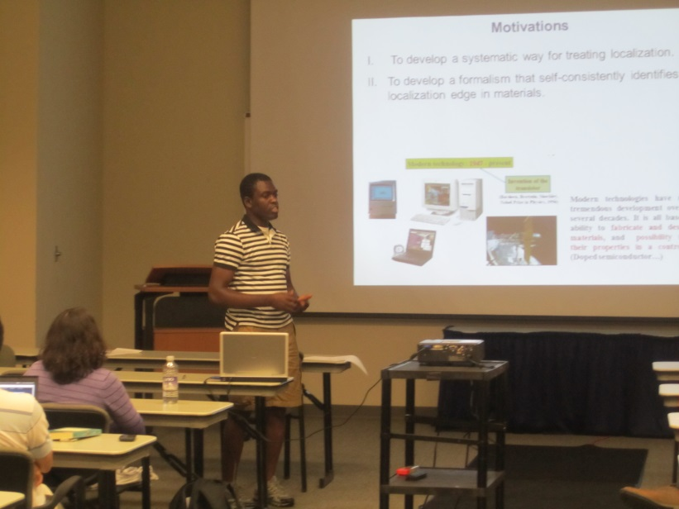
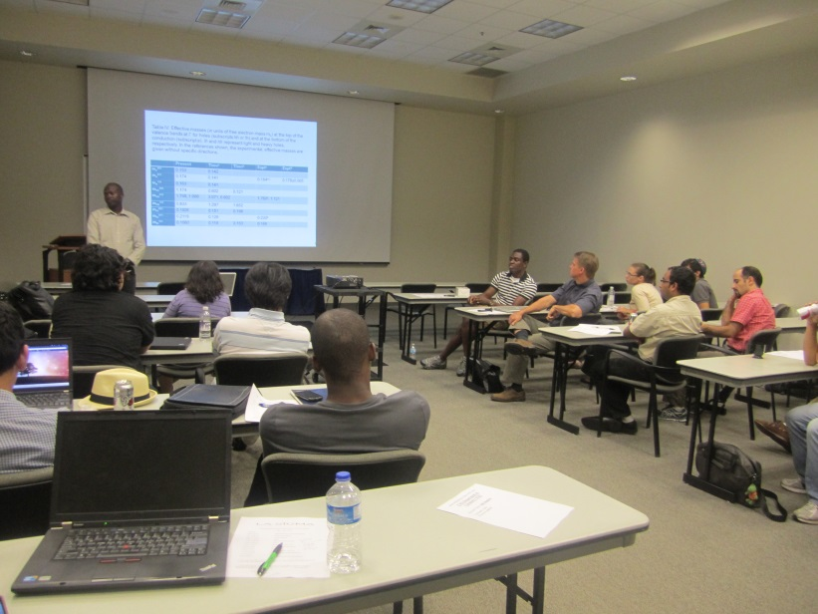
Photo Speaks
Throughout the day LASiGMA students presented updates respective to their research area.
Notes:
Various presenters throughout the day from LATECH, LSU, SUBR
9

Slide 10
Major Accomplishments
Students learned about what their peers are doing.
Excellent networking opportunity.
Students enjoyed guest speakers.
Acquainted with projects from all science drivers.
Practice presentation skills.
Notes:
10

Slide 11
Need for Cont. Student Retreat
Track progress of students’ project.
Critical for retention of students.
Useful for tracking student’s progress to degree completion.
Coalescing of ideas on student level.
Notes:
11

Slide 12
Next Steps
Identify date for 4th Annual Retreat.
Identify funding (BoR?).
Identify location
Increase from one day to two days.
Increase guest speakers.
Notes:
Add and or detract as you see fit
12

Slide 13
Special Thanks
BoR
Dr. Michael Khonsari
Dr. Steve Rick
Shelley Lee
Leigh Townsend
Our Guest Speakers
Notes:
13

Slide 14

The End
Thank you for your attention
Notes:
14

