Slide 1

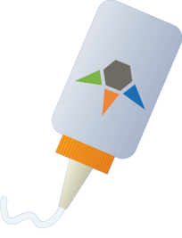
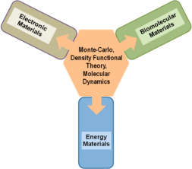
Computational Teams
Cybertools/Cyberinfrastructure
CTCI
Thomas C. Bishop
Louisiana Tech University
“The glue”
Develop and experimentally validate common computational tools essential for three Science Drivers.

Slide 2

CTCI Research Themes
Data &
Execution Management
LA Tech, LSU, Tulane
GPU and Phi Codes
LA Tech, LSU, UNO
SD1, SD2, SD3
SD1, SD2, SD3
CTCI Teams
Density Functional
Grambling, LA Tech, LSU, Southern, Tulane
Force Field
LA Tech, LSU, Tulane, UNO
SD1, SD2
SD2, SD3
Team foci have evolved since the proposal was submitted.

Slide 3
CTCI Milestones
Milestones
Leverage LONI
Build on CCT/Cybertools
Migrate to Leadership Class Machines
Expand LA-SiGMA impact via codes

Slide 4
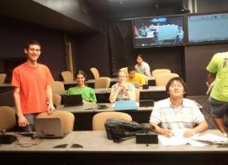
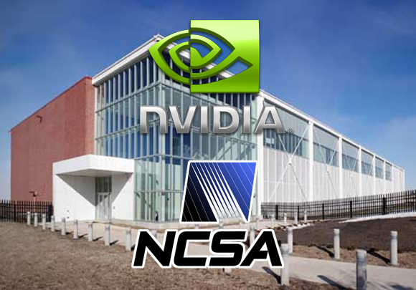
Heterogeneous GPU Computing:
GPU Programming Team
A novel collaboration of over 30 faculty, students, and postdocs from LSU, LA Tech, UNO, and Louisiana School for Math, Sciences and the Arts (RET/REU). Using the Collaboratorium* at LSU.
Basis for successful MRI and CRI proposals, including a 1PFLOP PHI cluster (equivalent to the world’s fastest machine, Kraken, in 2008)
LA-SiGMA GPU Team Goal
Develop efficient codes to study complex systems on next generation heterogeneous machines like BlueWaters, Stampede, and Titan.
Developing codes for quantum and classical systems and drug discovery.
*This room was initially renovated as part of an NSF-supported IGERT at CCT.

Slide 5
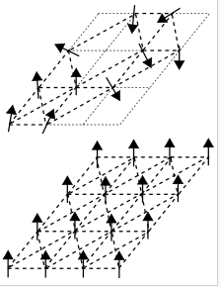
Heterogeneous GPU Computing:
GPU Simulation of Spin Glass
Many metastable structures thus many timescales to explore.
World’s fastest GPU code at 35 ps/spin flip proposal for 3D Edwards-Anderson glass.
TBs of data stored in HDF5 with XML metadata
Preliminary result:
Finite size scaling shows that there is no transition.
Notes:
Image and caption taken from wIKIPEDIA
Schematic representation of the random spin structure of a spin glass (top) and the ordered one of a ferromagnet (bottom)
Spin glasses display many metastable structures leading to a plentitude of time scales which are difficult to explore experimentally or in simulations.

Slide 6
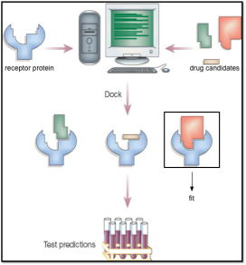
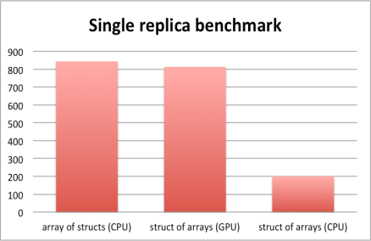
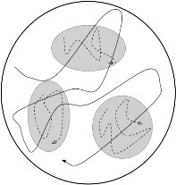
Heterogeneous GPU Computing:
GPU drug Docking (GPUDoc)
Computer-aided drug development holds the significant promise of faster and cheaper drug discovery.
Swapping between low and high temperature systems (shaded regions) accelerates sampling.
A 4-fold speedup is obtained over CPU calculation for single replica, 50-fold for multiple replicas.

Slide 7
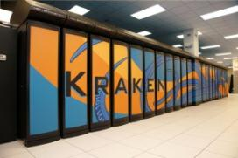
Scaling of Multi-Scale Methods to 30,000 Cores
Interdepartmental collaboration at LSU develops a latency hiding technique.
Kraken at the National Institute for Computational Sciences
Codes ready for National Leadership Class Machines.
Solving the Parquet Equations for the Hubbard Model beyond Weak Coupling, K. Tam, H. Fotso, S.-X. Yang, T.-W. Lee, J. Moreno, J. Ramanujam, and M. Jarrell, Phys. Rev. E 87, 013311 . Selected as NSF Highlight
Notes:
We find that imposing the crossing symmetry in the iteration process considerably extends the range of convergence for solutions of the parquet equations for the Hubbard model. When the crossing symmetry is not imposed, the convergence of both simple iteration and more complicated continuous loading (homotopy) methods are limited to high temperatures and weak interactions. We modify the algorithm to impose the crossing symmetry without increasing the computational complexity. We also imposed time reversal and a subset of the point group symmetries, but they did not further improve the convergence. We elaborate the details of the latency hiding scheme which can significantly improve the performance in the computational implementation. With these modifications, stable solutions for the parquet equations can be obtained by iteration more quickly even for values of the interaction that are a significant fraction of the bandwidth and for temperatures that are much smaller than the bandwidth. This may represent a crucial step towards the solution of two-particle field theories for correlated electron models.

Slide 8
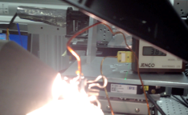
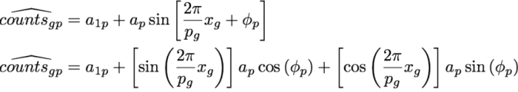
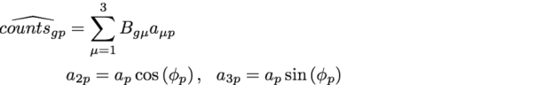
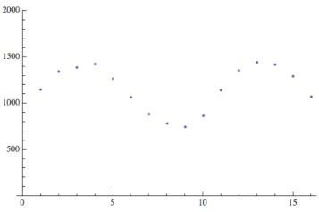


New Algorithm for X-ray
Interferometry Data Analysis
Traditional Method: FFT (not robust)
New and Improved: 1000-fold faster, more robust than Levenberg-Marquardt
Butler (LSU) & Johnson(LIGO), Rev. Sci. Instr., Submitted
Notes:
IMAGE: X-ray interferometry at APS 23 ID-C
Top right is a smoker extractor mounted atop temperature sensitive interferometer
Bottom left is an IR heater that burns a flame retardant in a polymer blend
Grating-based X-ray interferometry yields 3 images simultaneously.
Point to the plot:
absorption image comes from the average X-ray counts
phase contrast image comes from the shift of the sinusoid
small-angle scattering image comes from the amplitude of the sinusoid
Tomography data set has ~1000 interferograms, each taken with a camera with ~1M pixels, for a total of 10^10 interferograms to solve. A fast algorithm is essential. Constrained L-M takes 10 milliseconds; way too slow. Warren Johnson’s LIGO algorithm takes 500 s.
Paper submitted to Rev. Sci. Instr. Talks given at Synchrotron Radiation Instrumentation (held at NIST; travel supported by LaSIGMA) and at ICTMS (Belgium; overhead return supported travel)

Slide 9
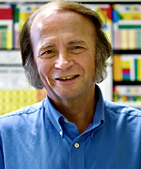
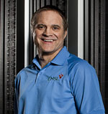
Density Functional Theory
LA-SiGMA member and DFT pioneer John Perdew of Tulane University was elected to the National Academy of Sciences 2011.
110,000 + Google-Scholar citations for DFT Potentials. Most recently for van der Waals interactions in the semilocal meta-GGA
Mentoring
New LA-SiGMA member and HPC pioneer William Shelton of LSU has won three Gordon Bell and a Computerworld Smithsonian awards.
Expert in HPC, DFT, and Big Data
Mentoring
John
Perdew
William
Shelton
Perdew’s election gives
LA-SiGMA two of Louisiana’s four members of the National Academies.

Slide 10

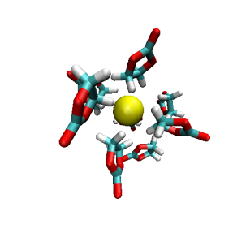
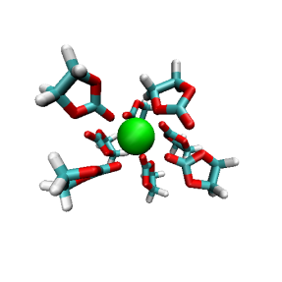
Force field development for ethylene carbonate/ion solutions
K⁺
Cl⁻
Used Thermodynamic Integration (TI) to calculate solvation free energies of ions and determine parameters that agreed with experiment for five ions K+,F-,Cl-,Br-, and I-..
Pair correlations show that the ethylene carbonate binds the ions edge on to ethylene carbonate. Only K+ and Cl- are shown
Victoria Bishop, Dexter Taylor, Steve Rick, UNO Chemistry, Summer REU program
Notes:
Ethylene carbonate is a commonly used solvent in batteries and other materials.
Optimized interaction parameters were determined by fitting to experimental free energies.
Ethylene carbonate is a commonly used solvent in batteries and other materials.
Optimized interaction parameters were determined by fitting to experimental free energies.
We used thermodynamic integration to calculate the solvation free energies of the ions and determined parameters that agreed with experimental solvation energies.
Using the optimized parameters, we examined the structure of the EC solvent around the five ions (K+,F-,Cl-,Br-, and I-) studied. Only K+ and Cl- are shown
The other anions are similar to Cl-.The ions bind edge on as seen in the g(r)’s and snapshots from simulation.
The interactions appear to be stronger with cations than anions, based on the free energies and structure
Ethylene carbonate (EC) is a polar, aprotic liquid and a good solvent for ions, used in lithium batteries. Molecular dynamics computer simulations are used to investigate the thermodynamic and structural properties of ions in an EC solution.

Slide 11
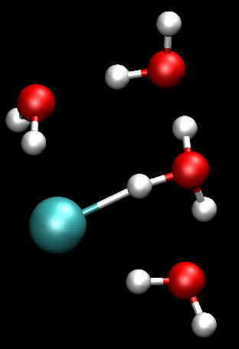
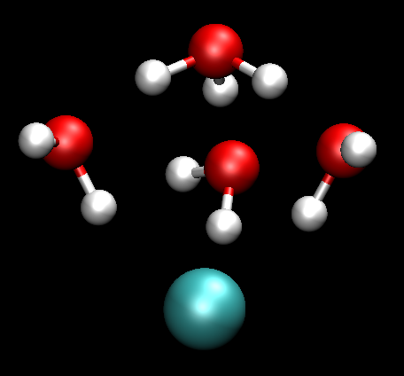
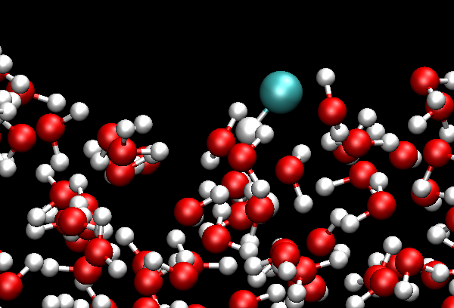
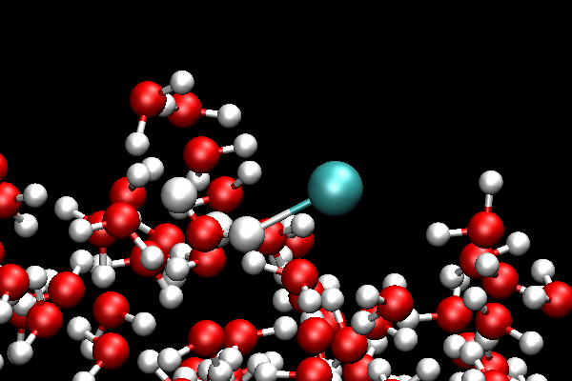
Reactive Model to Investigate HCl Dissociation at the Surface of Water
Contact Ion Pair
Relevant to acid catalysis in biofuel generation, hydrolysis and transesterification.
Calculated pKa of HCl compares favorably with experiment 5.5 (calc) vs 7.0 (exp)
Three step mechanism:
HCl makes oriented contact with water
Dissociation into a contact ion pair
Further dissociation to solvent separated ion pair
Hydronium’s greater propensity for the interface makes the surface of water more positively charged.
Solvent Separated Ion Pair
Molecular HCl
Contact Ion Pair

Slide 12

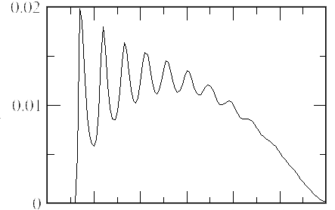
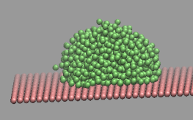
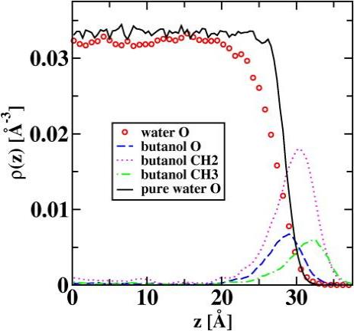
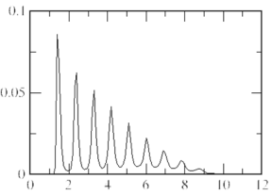
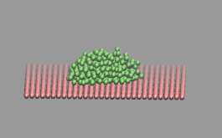
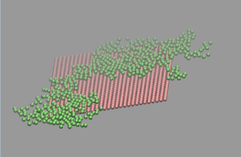
Surface-Induced Nucleation
Low surface potential
Medium surface potential
Surface catalyzes not only the formation of the droplets but also the transition of these droplets into crystal structures due to the surface-induced layering effects (see density profiles plots).
When surface attraction is too strong, crystallization may be inhibited due to the spreading of the particles on the surface and the corresponding formation of two-dimensional clusters (see snapshots on the left).
Strong surface potential

Slide 13
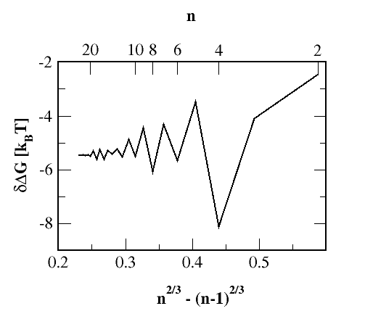
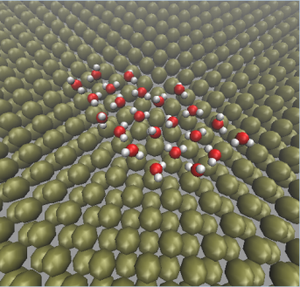
Nucleation of Water Clusters on
a Platinum Surface
Water clusters on a platinum surface display unconventional hydrogen bonding structures compared to the bulk liquid water.
The free energy data (plotted on the right) show unusual odd-even effects that persist for even very large cluster sizes, consistent with the preferred 4-membered ring structures shown on the left.
Water-Platinum potential is borrowed from Heinzinger, Spohr, Electrochimica 34 (12), 1849-1856 (1989)

Slide 14
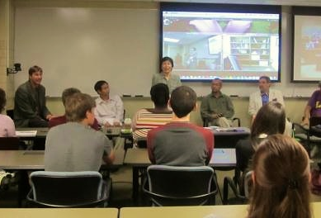
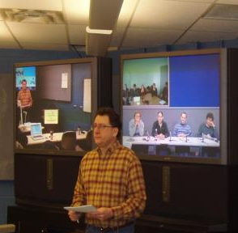
Leveraging and Extending LONI Facilities
LA-SiGMA REU panel
LA-SiGMA graduate courses
Builds upon State LONI investments to bring HD video to each campus.
LA-SiGMA collaborative (LONI, BoR) solutions for HD synchronous video, lecture/seminar capture, and sharing. In installation.
Notes:
QB 5540/2, Dell 3072, IBM 416=54.85 M SU’s 41.1M in the 3Qs. 7.3/41.1 = 18%
Rwh 0.160 M Sus Collin 0.300 M Sus Hank 0.100 M SUs Steve R. 0.005 Sus Tom B 0.300 M Sus Lawrence 1.3 M
Ramu .875 M Sus Daniela 0.100 M Sus David 0.200 M, Mark/Juana 4M
Running total 7.34 M

Slide 15
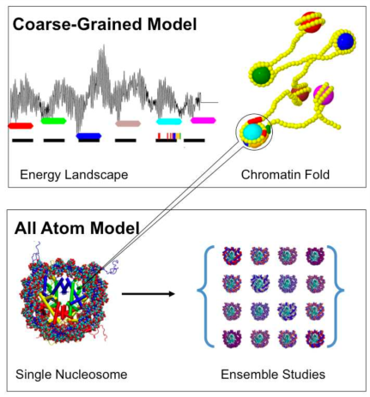
Leveraging and Extending LONI Cybertools
to Investigate Genomic Biomaterials
Refines and extends tools developed by Cybertools to produce publicly available execution management tools.
Millions of simulation and analysis tasks to study folding of DNA managed using collaboratively developed “ManyJobs” and “BigJobs” software.
Running Many MD Simulations on Many Supercomputers.
The anatomy of successful ECSS projects: lessons of supporting high-throughput high-performance ensembles on XSEDE.
Proceedings of the 1st Conference of the XSEDE '12.
LA Tech (Bishop), LSU (Jha), Jack Smith (WVU, XSEDE Fellow)
Nucleosomal DNA: Kinked, Not Kinked or Self-Healing Material?, R. Mukherjee and T. Bishop, Frontiers in Nucleic Acids Chapter 5, pp 69–92. ACS Symposium Series, Vol. 1082, 2012

Slide 16
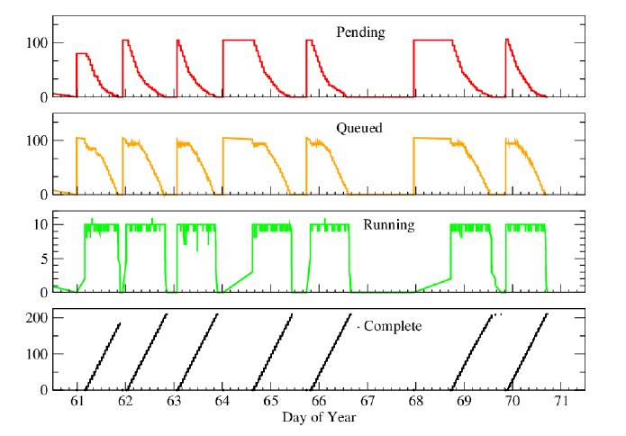
Execution Management Across XSEDE Resources
BigJobs on LONESTAR
2100 Simulation tasks
240 CPU/simulation
100 Sims/BigJob
2400 CPU/BigJob
500,000 SU in 10 days
2.1μs of simulation
8.2 TB of DCD data
2.1M snapshots analyzed -> 370GB
Scalable Online Comparative Genomics of Mononucleosomes: A BigJob.
Proceedings of 2nd Conference of XSEDE '13 .

Slide 17
Knowledge Discovery and Data Mining (KDD)
Classification:
classifying or predicting outcomes based on patterns/behavior in data.
Feature Selection / Extraction:
finding the features most strongly related to a particular class.
Clustering:
finding new classes or refining existing ones.
Initial Data
Pre- processed
Data
Target
Data
Transformed
Data
Model
Selection
Preprocessing
Data Transformation
Data Mining
Interpretation
Unsupervised Learning: Clustering, Association Rule Discovery
Supervised Learning: Predictive Classification models
Algorithm Design in Distributed Environment:
Scalability, Reliability, Availability, Evolution
Notes:
Data cleaning
Data integration from multiple sources
Warehousing the data
Data cube construction
Data selection for data mining
Data mining
Presentation of the mining results
Storage of Patterns and Knowledge

Slide 18
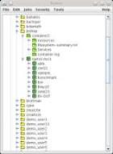
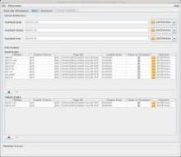
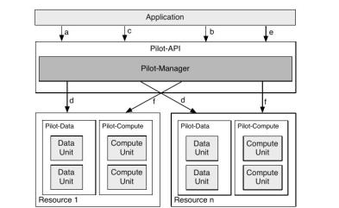
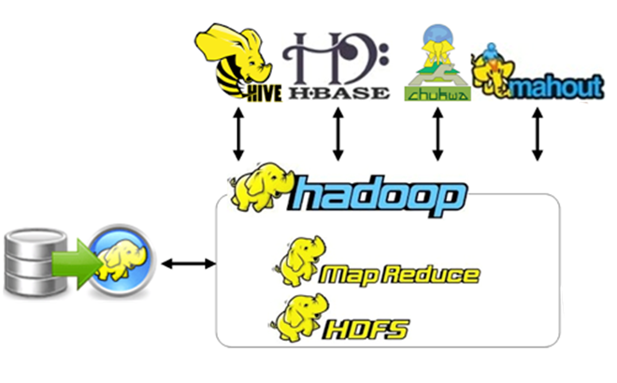
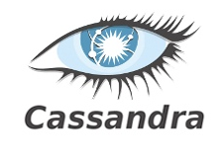




Workflow Management & Data Enabling Technologies
Pilot Jobs with SAGA & BigJobs
Global Federated File System (GFFS):
Data and Queue Management
XSEDE Campus Bridging Pilot Project

Slide 19
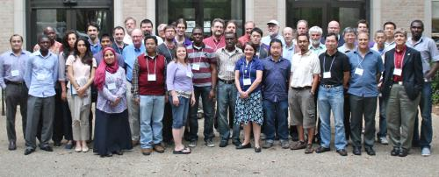
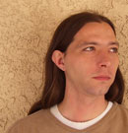
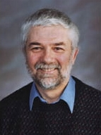
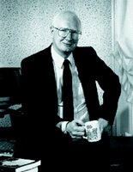
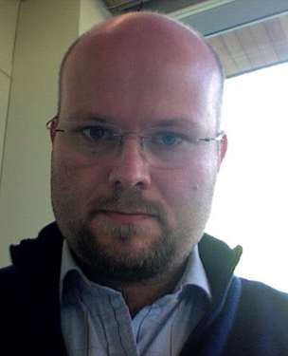
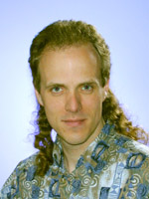
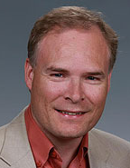
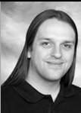

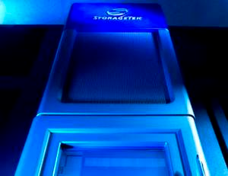
Data Management
2013 Data Workshop
June 7-8, 2013
“Connecting data with semantics and ontologies”.
LA-SiGMA data plan and advisory team
Long term visit
8 invited experts in data management and semantics
Data sharing through website
Data sharing pilot project with members on all campuses
Pilot projects
HDF5 + CML/XML
Partnership with TACC
LA-SiGMA is helping to guide LONI’s efforts.
Notes:
Rwh 0.160 M Sus Collin 0.300 M Sus Hank 0.100 M SUs Steve R. 0.005 Sus Tom B 0.300 M Sus Lawrence 1.3 M
Ramu .875 M Sus Daniela 0.100 M Sus David 0.200 M, Mark/Juana 4M
Running total 7.34 M

Slide 20
CTCI Milestones
Milestones | Y1 | Y2 | Y3 | Y4 | Y5
Leverage LONI | X | X | X | X | X
Build on CCT/Cybertools | X | X | X | X | X
Migrate to Leadership Class Machines |  |  | X | X | X
Expand LA-SiGMA impact via codes |  |  | X | X | X
On Track
On Track
Ahead
On Track
Challenges/Barriers:
Mitigation plan:
More GPU, data use/reuse, 3 CTCI faculty depart.
Added a GPU and a data use/reuse expert. Succession plans for departing faculty.

