Slide 1




Louisiana EPSCoR RII – Track 1
Reverse Site Visit
September 8, 2011

Slide 2
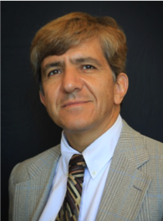



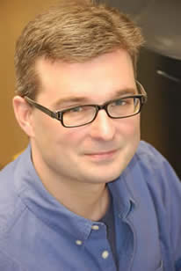
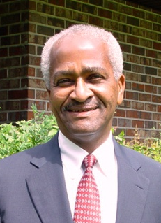
Welcome from the LA-SiGMA Team
Dr. Michael Khonsari
LA EPSCoR Project Director
Associate Commissioner
Dr. Juana Moreno
Physics & CCT
LSU
Dr. Henry Ashbaugh
Chemical Engineering
Tulane
Dr. Randall Hall
Chemistry
LSU
Dr. Ramu Ramachandran
Chemistry
LA Tech
Dr. Kerry Davidson
Deputy Commissioner
LA Board of Regents

Slide 3

Presentation Outline
Project Overview (Michael Khonsari)
Common Computational Tools: The Glue (Randall Hall)
Science Driver 1 (Juana Moreno)
Science Driver 2 (Ramu Ramachandran)
Science Driver 3 (Henry Ashbaugh)
Workforce Development (Juana Moreno)
External Engagement (Ramu Ramachandran)
Diversity (Randall Hall)
Evaluation and Assessment (Henry Ashbaugh)
Sustainability, Management & Impact (Michael Khonsari)

Slide 4
Louisiana’s Research Infrastructure Improvement Strategy
2010-2015
Project Overview
Michael Khonsari
Louisiana EPSCoR Project Director
Associate Commissioner for Sponsored Programs Research & Development
Louisiana Board of Regents

Slide 5


We are on the cusp of a second Information Technology revolution that in the words of Arden Bement*
“…will dwarf, in sheer transformational scope and power, anything we have yet experienced in the current information age.”
*Cyberinfrastructure: The Second Revolution, Chronicle of Higher Education, Jan 3, 2007

Slide 6

At the heart of this revolution is peer-to-peer collaboration, new modes of research and education, and virtual organizations that work across institutional boundaries.
This is the premise of our RII research.
Notes:
6

Slide 7



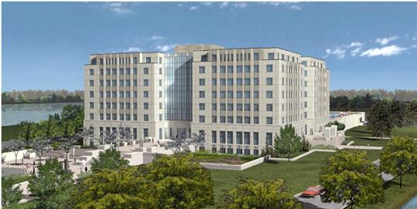
LA EPSCoR & Board of Regents
Claiborne Building
Baton Rouge, LA

Slide 8
S&T Framework and Alignment
High Growth Target Industry
Materials &
Chemicals
Energy
Production
Coastal
Resilience
Digital
Media
Cyber
Security
Biomedical
Bioengineered
Solutions
Core Industry S&T Sectors
Petrochem
Energy &
Environ
Transport, Constr & Mfg
Aerospace
Info Tech & Services
Arts &
Media
Agriculture &
Bio Prod
Health
Care
Translational Research Domains
Energy
Coastal
Environmental
Digital
Biomedical
Agricultural
Core Enabling S&T Research
Materials Science
Nanotechnology
Computational Science Information Technology
Bioscience
Biotechnology
21st Century Building Blocks
Atoms & Molecules
Bits & Bytes
Nucleic & Amino Acids
Foundational Sciences
PHYS
CHEM
MATH
ENGR
COMP
SCI
EARTH
SCI
AGRI
SCI
BIOL
BIOM
SCI
ECON
& SS

Slide 9


LA EPSCoR: Catalyst for Collaboration
LA EPSCoR has broken down boundaries between campuses.
LA EPSCoR is a proven catalyst for achieving increased statewide collaboration and national competitiveness.

Slide 10
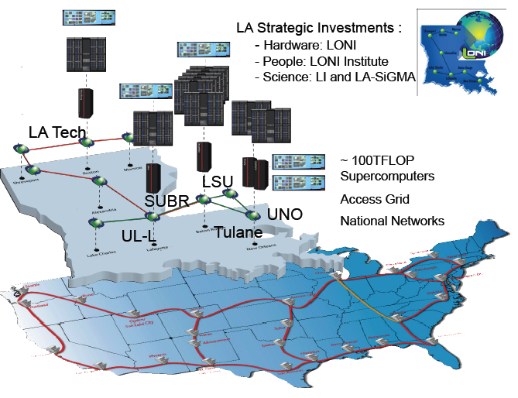
Louisiana Optical Network Initiative (LONI)
and Statewide LONI Institute

Slide 11
NSF RII Award (2010-2015)
Statewide Research Focus
Establishment of…
Notes:
11

Slide 12
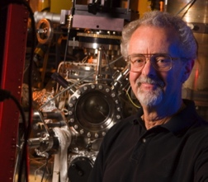
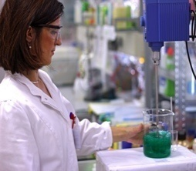
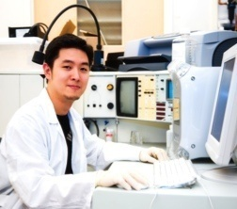

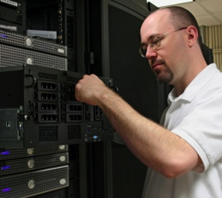
Participants: 179 partners
54
Faculty
5
Post-Doc
44
Graduate
58
Undergraduate
18
Technical / Non-Technical Staff
Notes:
12

Slide 13
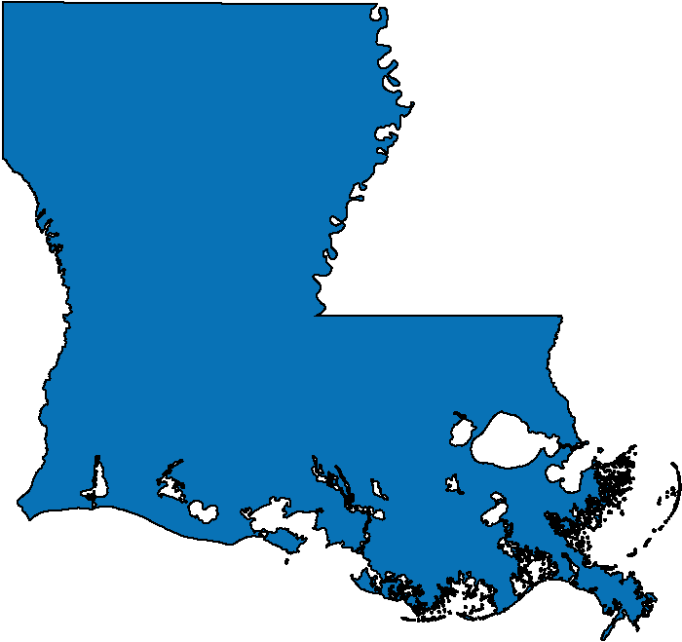







Partnering Institutions
RUSTON
BATON ROUGE
NEW ORLEANS

Slide 14

LA-SiGMA Vision
To make transformative advances in materials science research and education through a sustained multi-disciplinary and multi-institutional alliance of researchers.
Notes:
14

Slide 15
Realizing the Vision
Strategies
Science Drivers
Cyberinfrastructure & Common Computational Tools
Diversity
Workforce Development
External Engagement
Sustainability
Year 1 Activities: On Target and On Time
Strategic Planning
Diversity Advisory Council
Industrial Liaison Committee
Recruitment
Initiate Research
Delivery of Courses
External Review Board

Slide 16
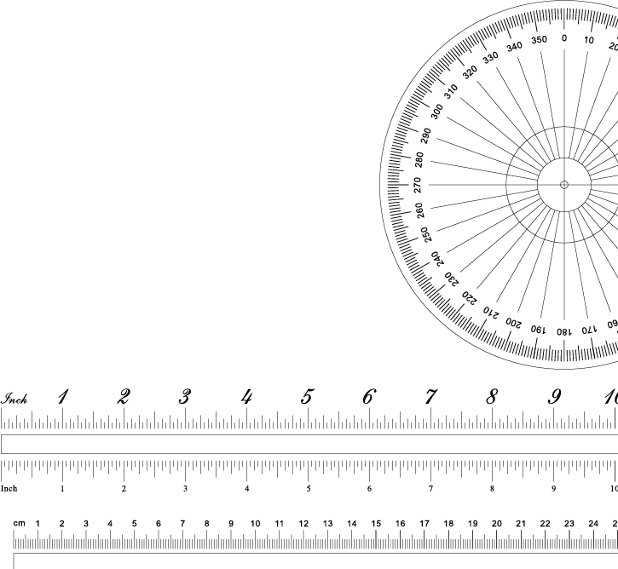
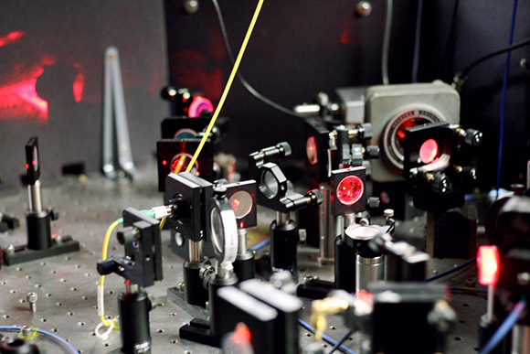

Scientific and Technological Challenges
Addressing multiscale complex phenomena calls for:
Unprecedented collaboration of computer scientists, applied mathematicians, scientists, and engineers with expertise at each scale from sub-nanometer to millimeters in length and from femtoseconds to several seconds in time.
Notes:
16

Slide 17
Formalisms, Algorithms, and Codes
Science Drivers
Common Computational Challenges and Barriers
Correlated Electronic Materials
Energy Materials
Biomolecular Materials
Multiple length & time scales, multiscale interactions & correlations
Refinements to
methods & models
COMMON
COMPUTATIONAL TOOLS
Monte Carlo Methods
Density Functional Theory
Molecular Dynamics
Testable Predictions
Shared Experimental Facilities
AMRI
UNO
Advanced Materials
Research Institute
Center for Advanced Microstructures & Devices
Institute For
Micromanufacturing
CAMD
LSU
IfM
LA Tech

Slide 18

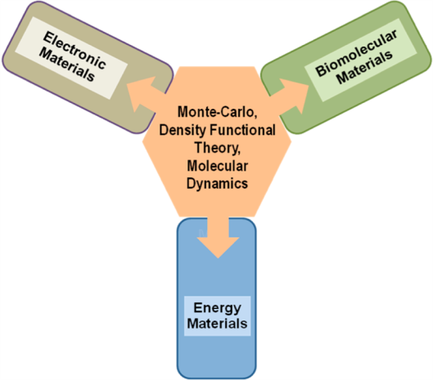

Computational Teams
Cybertools/Cyberinfrastructure
CTCI
Randall Hall
“The glue”
Develop and experimentally validate common computational tools essential for three Science Drivers

Slide 19

Formalisms, Algorithms, Codes, and Technology
Challenges: Time scales, Length scales, & Accuracy
FAC for new computer architectures (GPUs)
FAC for accurate calculations and simulations
(Density Functional Theory
& Force Fields)
Throughput
(Execution Management)
HD synchronous video for collaboration
Formalisms, Algorithms, & Codes (FAC)
Complexity
Computer Speed
Based on slide from D. P. Landau, UGA
Advances in formalisms, algorithms, and codes are mainly responsible for the increase in the size and complexity of problems we can study.

Slide 20
CTCI Research Themes
Execution
Management
LA Tech, LSU
GPU Programming
LA Tech, LSU, UNO
CTCI Teams
Density Functionals
Grambling, LA Tech, LSU,
Southern, Tulane
Force Fields
LA Tech, LSU,
Tulane, UNO

Slide 21
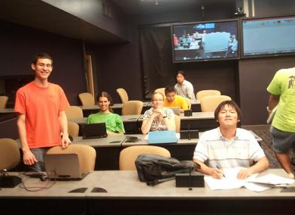
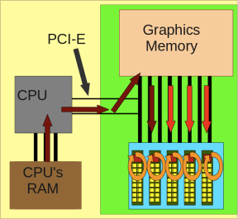
GPU Programming
GPU Programming Team
A novel collaboration of 25 faculty, students, and postdocs from LSU, LA Tech, UNO, and Louisiana School for Math, Sciences and the Arts (HS and RET/REU). Using the Collaboratorium* at LSU.
NSF Software Infrastructure for Sustained Innovation (SI²) proposal has been submitted.
LSU “Condo”
LA-SiGMA to purchase GPU nodes on LSU’s flagship computer in Fall 2011.
~130 Tflops would have been 3rd most powerful computer in the world Nov. 2007.
*This room was initially renovated as part of an NSF-supported IGERT at CCT.

Slide 22
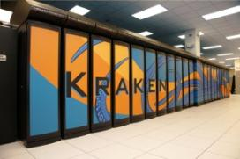
Scaling of Multi-Scale Methods to 30,000 Cores
Interdepartmental collaboration at LSU develops a latency hiding technique.
Kraken at the National Institute for Computational Sciences
Result is efficient use of 30,000 or more processors.
Solving the Parquet Equations for the Hubbard Model beyond Weak Coupling, K. Tam, H. Fotso, S.-X. Yang, T.-W. Lee, J. Moreno, J. Ramanujam, and M. Jarrell, submitted Physical Review E.

Slide 23
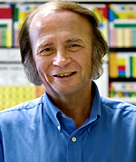
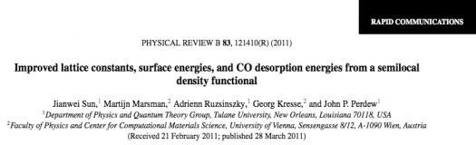
Density Functional Theory
LA-SiGMA member and DFT pioneer John Perdew of Tulane University was elected to the National Academy of Sciences 2011.
Perdew’s election gives LA-SiGMA two National Academy members in the Alliance.

Slide 24
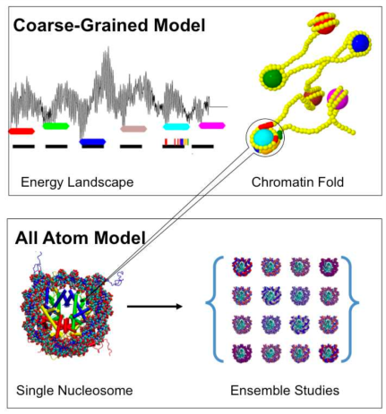
Molecular Dynamics and Execution Management
Over 10,000 simulation and analysis tasks to study folding of DNA managed using collaboratively developed “ManyJobs” and “BigJobs” software.
Publically available execution management tools.
LA Tech (Bishop), LSU (Jha)
Nucleosomal DNA: Kinked, Not Kinked or Self-Healing Material?, R. Mukherjee and T. Bishop, ACS Books, “Frontiers in Nucleic Acids”, under revision.
Running Many MD Simulations on Many Supercomputers, R. Mukherjee, H. Fujioka, A. Thota, T. Bishop, S. Jha. In preparation.

Slide 25
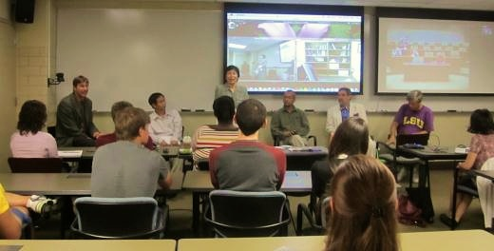
Leveraging LONI Facilities
LA-SiGMA REU panel
LA-SiGMA investigating collaborative (LONI, BOR) solutions for HD synchronous video, lecture/seminar capture, and digitization.
Will bring HD and video capture to the State.
Notes:
QB 5540/2, Dell 3072, IBM 416=54.85 M SU’s 41.1M in the 3Qs. 7.3/41.1 = 18%
Rwh 0.160 M Sus Collin 0.300 M Sus Hank 0.100 M SUs Steve R. 0.005 Sus Tom B 0.300 M Sus Lawrence 1.3 M
Ramu .875 M Sus Daniela 0.100 M Sus David 0.200 M, Mark/Juana 4M
Running total 7.34 M

Slide 26


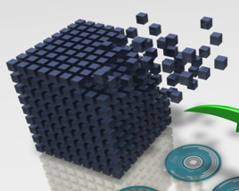
Data Management
Not required for this RII.
UNO has a local implementation of Digital Commons.
LONI is developing a plan, first report due mid-September.
Immediate
Website
Short Term
Modules on
the CCT SVN
Long Term
Data repository
with Metadata
and Search Engine
CCT at LSU and Tulane are developing plans; LA-SiGMA team members at SUBR and Xavier may collaborate with CCT on these plans.
http://www.cct.lsu.edu/NSF_DataManagement_Plan
http://www.uno.edu/orsp/ORSPHome/ProposalDevelopment/DataManagement
Notes:
Rwh 0.160 M Sus Collin 0.300 M Sus Hank 0.100 M SUs Steve R. 0.005 Sus Tom B 0.300 M Sus Lawrence 1.3 M
Ramu .875 M Sus Daniela 0.100 M Sus David 0.200 M, Mark/Juana 4M
Running total 7.34 M

Slide 27
Cyberinfrastructure Milestones
Milestones | Y1 | Y2 | Y3 | Y4 | Y5
Leverage LONI | X | X | X | X | X
Build on CCT/Cybertools | X | X | X | X | X
Migrate to Leadership Class Machines |  |  | X | X | X
Expand LA-SiGMA impact via codes |  |  | X | X | X
On Track
On Track
Ahead
Challenges/Barriers:
Mitigation plan:
More GPU expertise and more applied math, 3 faculty depart.
Adding 2 GPU experts; in discussion with applied mathematicians.

Slide 28

SD1: Electronic and Magnetic Materials
Juana Moreno
Extend local approximations [Density Functional Theory (DFT) and Dynamical Mean Field Approximation (DMFA)] to multi-scale approaches
FOCUS 1
FOCUS 2
FOCUS 3
Multiscale Methods for Strongly Correlated Materials
Correlated Organic & Ferroelectric Materials
Superconducting Materials
New FOCUS
Low Energy Electron Diffraction

Slide 29
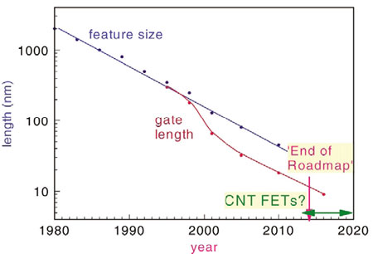
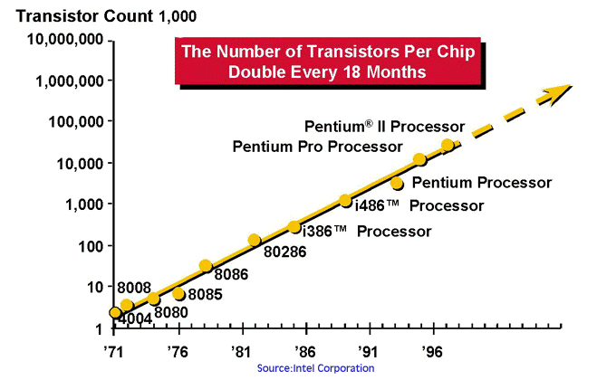
We need faster, smaller, more efficient chips
Materials Today
By 2020 a transistor in a chip may reach the size of a few atoms.
Devices based on a new paradigm are needed!

Slide 30
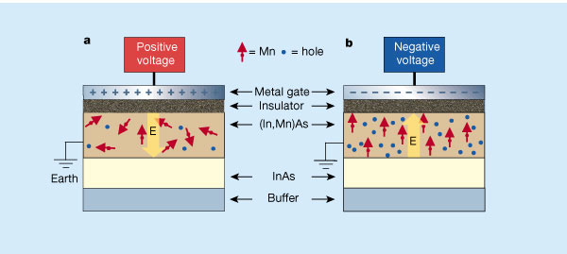
Strongly Correlated Systems:
Complexity and Competing Orders
Electrical control of
magnetization
H. Ohno et al., Nature (2000)
Competing phases emerge as a function of control parameter.
Electron correlations at different length scales.
Correlations lead to complex spin, charge, and orbital phases.
Tunability allows device applications.

Slide 31
SD1 Research Themes
Organic &
Ferroelectric Materials
Tulane, LA Tech, Grambling, UNO, Xavier, LSU
Development Multiscale Methods
Tulane, LSU
Non-local Approximations for DFT
Multiscale Many-Body approach
Electronic &
Magnetic Materials
Metalloporphyrins
Oxide clusters
Multiferroic composites
Inverse LEED method for structural investigations
Superconducting Materials
Southern, LSU, Tulane
Iron-based superconductors
Cuprate superconductors

Slide 32
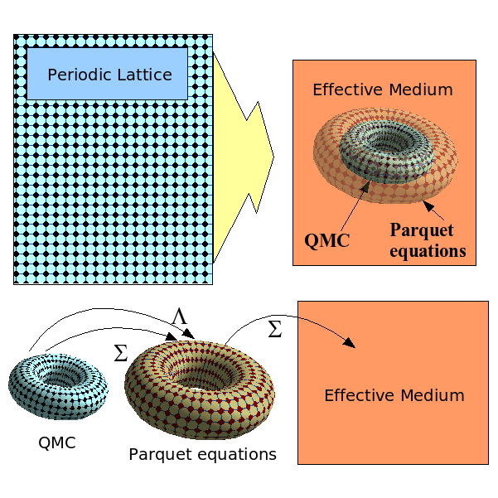
Focus 1
Computing at the Petascale: Multiscale Many Body
QMC for short length scales
Dual-Fermion diagrammatics for intermediate length scales
Mean-field approximation for long length scales
QMC scales exponentially with problem size, while Multi-Scale Many-Body scales algebraically.
MSMB could lead to simulations of electronic and magnetic materials with predicted capabilities.
Dual Fermion Dynamical Cluster Approach for Strongly Correlated Systems, S.-X. Yang, H. Fotso, H. Hafermann, K.-M. Tam, J. Moreno, T. Pruschke, M. Jarrell, arXiv:1104.1739.
Solving the Parquet Equations for the Hubbard Model beyond Weak Coupling, K.M. Tang, S.-X. Yang, H. Fotso, J. Moreno, J. Ramanujam, M. Jarrell. In preparation.
Notes:
32

Slide 33
SD1 Focus 1 Milestones
Milestones | Y1 | Y2 | Y3 | Y4 | Y5
Develop continuous time QMC solver for 16-way multicore supercomputers. | X | X
Incorporate Hyper-GGA functionals into common DFT codes including VASP. |  | X | X
Develop MSMB solver able to treat multiple correlated orbitals. |  | X | X | X
Port hyperparallel codes to NSF national leadership class machines (Blue Waters). |  |  | X | X | X
On Track
Ahead
Ahead
Ahead

Slide 34
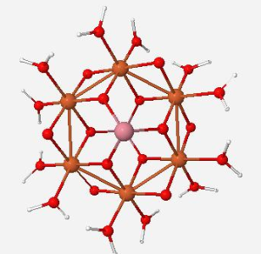
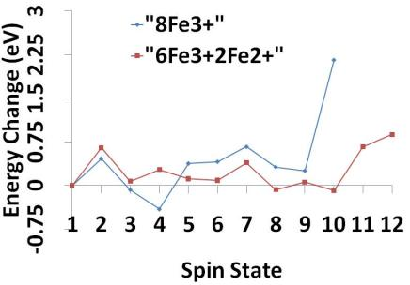
Focus 2
Iron Oxide Molecular Clusters as Building Blocks of Non-Volatile Memory (Xavier, Tulane, UNO)
Computational/Experimental effort to synthesize spinel-type iron oxide clusters, and investigate their ground state using QM/MM approach.
Co₂Fe₆H₂₄O₂₄ cluster. Spinel-type structure with water ligands.
Elementary clusters derived from spinel-type structures are candidates for molecular magnets which can be used for high capacity memory devices.
Notes:
Our groups are engaged in developing novel techniques for the synthesis, fabrication and characterization of two-phase multiferroic materials with different connectivity schemes. Two-phase ME nanocomposite with different architectures, such as core-shell nanoparticles, nanocables and thin film structures are fabricated by a combination of chemical and physical methods. These efforts are complemented by modeling studies aimed at understanding the role of the shared interfaces on the ME coupling in these nanocomposites. By optimizing their morphology and connectivity schemes, our goal is to maximize the coupling between the ferroelectric and magnetostrictive phases and, ultimately, enhance the ME response at room temperature.

Slide 35
SD1 Focus 2 Milestones
Milestones | Y1 | Y2 | Y3 | Y4 | Y5
Test array of DFT functionals for prediction of metalloporphyrin and ferroelectric properties. | X | X
Prepare and measure electrical/magnetic properties of metalloporphyrin nanostructures. | X | X
Prepare organic magnets and ferroelectrics. | X | X | X
Develop experimentally validated computational models for porphyrin systems using magnetoresistance and electrical conductance measurements as guides |  | X | X | X | X
Develop multiscale models of metalloporphyrin systems using DFT parameters |  |  | X | X | X
Predict charge transport in metalloporphyrins and compare with experiments |  |  | X | X | X
Predict properties of ferroelectrics using new nonlocal meta-GGA DFT functionals |  |  | X | X | X
Develop experimentally validated models of organic magnets and ferroelectrics |  |  | X | X | X
On Track
On Track
On Track

Slide 36
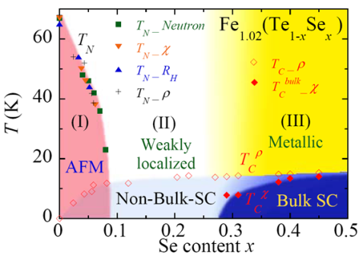
Focus 3
Superconducting Materials
What is the pairing mechanism in pnictides?
Tulane/UNO collaboration: Unusual interplay between magnetism
and superconductivity in iron chalcogenide Fe_{1.02} (Te_{1-x} Se_{x} )
Bulk superconductivity occurs only when the (π, 0) magnetic correlations are strongly suppressed and spin fluctuations near (π, π ) become dominant.
Liu et al., Nature Materials 9, 716 (2010).

Slide 37
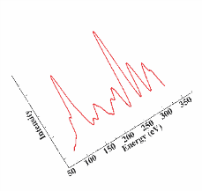
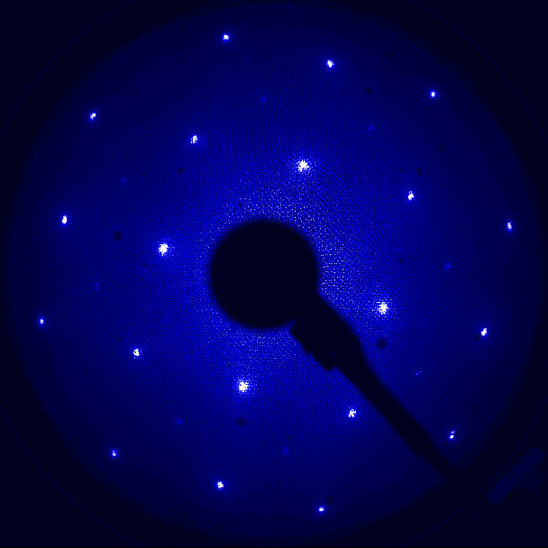
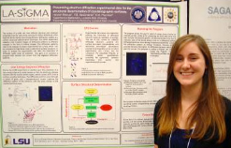
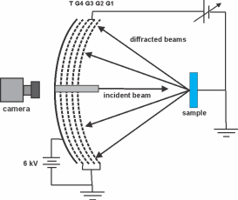
New Focus
Low Energy Electron Diffraction: An Inverse Problem for Structural Determination
(LI/LA-SiGMA seed funded)
Surface Probe: I vs. V curves contain structural information.
Since new complex materials have many atoms in the unit cell, extracting the structure is computationally challenging.
Manuel at SURF, LSU
Better inverse problem techniques will improve material characterization

Slide 38
SD1 Focus 3 Milestones
Milestones | Y1 | Y2 | Y3 | Y4 | Y5
Address the bottlenecks and numerical instabilities in the parquet equations by employing better parallel linear systems solvers and develop multiband parquet codes. | X | X | X | X | X
Incorporate Ramanujam’s advanced tensor rotation and contraction methods (Tensor Contraction Engine) into parquet codes. | X | X
Use hybrid QMC to address the origin of the QCP and competing order in cuprate models. | X | X
Study overscreening in pnictide models using new Hyper-GGA functionals. | X | X | X
Use methods that combine LDA models obtained from downfolding and DCA/MSMB to study correlation and phonon effects in the pnictides. | X | X | X | X | X
On Track
On Track
On Track
Behind*
On Track
*Challenge/Barrier:
Mitigation Plan:
Additional time was required to test the Hyper-GGA functional before porting it to Solid State codes.
Testing is almost complete & porting will take place
in the 2nd year of the award.

Slide 39
SD2: Energy Materials
Ramu Ramachandran
The goal of this SD is to use DFT functionals, reactive force fields, and Monte Carlo and Molecular Dynamics methods to study materials for the generation, conversion, and storage of energy.
FOCUS 1
FOCUS 2
FOCUS 3
Electrochemical capacitors and fuel cell electrodes
Hydrogen Storage Materials
Catalyst Materials
New FOCUS
Lithium ion batteries

Slide 40

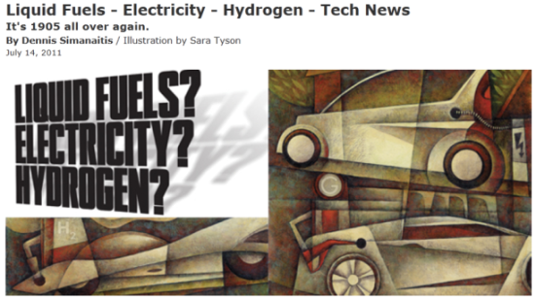
The July 14 report in Road & Track magazine almost completely captures the foci of Science Driver 2
1905: Energy sources:
Electricity, Steam, Gasoline
Environmental Concern: Horse manure
2011: Energy sources:
Electricity, Hydrogen, Alternate Fuels
Environmental Concern:
Green House gases

Slide 41
SD2 Research Themes
Electrochemical
Tulane, UNO, LA Tech, Xavier, LSU
Hydrogen Storage
LA Tech, LSU
CNT forest-based supercapacitors
Lithium ion batteries
Role of dopants in metal hydrides
Direct imaging of H₂ storage materials
Energy Materials
Metal Oxide Catalysts
LA Tech, LSU, Xavier
Transferable force fields for
metal oxides
DFT studies of catalytic reactions
Plans to develop reactive force fields

Slide 42
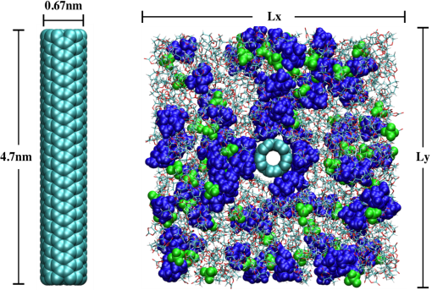
Focus 1
Electrochemical capacitors and fuel cell electrodes
Realistic simulations of the role of molecular interactions in electrochemical capacitance are rare.
Intrinsic (or quantum) capacitance depends on electron correlation effects that have been neglected in historical discussions of this phenomenon.
Novel aspect:
Focus on the energetics allows intrinsic capacitance to stand out, helping to shed light on its dependence on quantum aspects like electron correlation.
G. G. Hoffman, L. R. Pratt, X. You & N. Pesika (Tulane), S. W. Rick & R. Mariano (UNO).

Slide 43
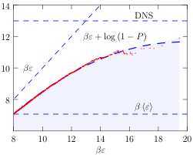
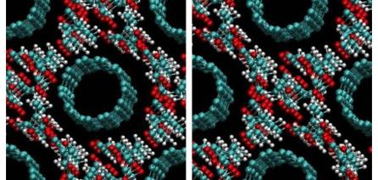
Interplay between experiment and modeling
Initial computations suggest that the filling of nanotube forests by propylene carbonate (PC) is thermodynamically unfavorable. This is contradicted by experimental results.
Problem traced to poor representation of long range (dispersion) interactions in DFT functionals.
The PBE-D dispersion functional is now being employed to study liquid propylene carbonate. Running on Kraken using Teragrid support.
An example of interplay between experiments and modeling.
The role of long-range interactions and electron correlation in electrochemical capacitance models being clarified.

Slide 44
SD2 Focus 1 Milestones
Milestones | Y1 | Y2 | Y3 | Y4 | Y5
Simulation of pore filling in nanowire capacitors . | X | X
Study chemical damage at elevated electric potentials. | X | X | X
Optimize computational efficiency of ab initio MD techniques. | X | X
Study role of quantum capacitance in electrochemical capacitance. |  | X | X | X
Explore additional nanoforest-based capacitor systems. |  |  | X | X | X
Predict catalytic sites in nanotubes. |  | X | X | X | X
Design, build, and test fuel cells and use results to guide new calculations. |  |  | X | X | X
On Track
On Track
On Track
Ahead

Slide 45
Focus 2
Hydrogen Storage Materials
Many challenges have to be overcome to make hydrogen a viable alternative fuel. Progress in the past decade has been disappointing.
The most important: finding materials with favorable hydrogen absorption and desorption characteristics.
We are developing multi-scale approaches coupled with direct imaging to understand how dopants influence the relevant properties of candidate materials.
Structure and Dynamics
Cohesive energy
Preferred Dopant site
Kinetics
Rate-limiting steps in decomposition
Role of dopant
Thermodynamics
Formation of alloys
Reaction Pathways

Slide 46
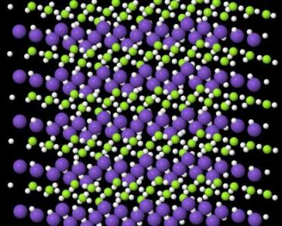
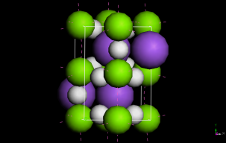
Role of dopants in complex metal hydrides
Plane wave DFT methods are used to study the effect of transition metal dopants on light metal hydrides.
Titanium is found to be the best dopant.
Novel aspects:
Detailed understanding of the role of dopants and adsorption sites in complex formation (e.g., TiMgH₃ vs TiMgH₇), percolation of H atoms in the lattice, and hydrogen desorption energies.
X-ray and neutron tomography of complex metal hydrides in real time show activity of various sites – to be compared with simulations.
(Na/K)MgH₃
K
Mg
H
Grand canonical ensemble simulation of KMgH₃; LSU (Hall, Chen) & LA Tech (Mainardi).
Synergy between real-time imaging and simulation leading to an improved understanding of complex metal hydrides.

Slide 47
SD2 Focus 2 Milestones
Milestones | Y1 | Y2 | Y3 | Y4 | Y5
Extend MC methods to calculate free energies of H₂ uptake in storage materials. | X | X | X | X | X
Use existing force fields to calculate H₂ uptake in bulk alloys. | X | X | X | X | X
Develop finite element model to track 3D microstructure evolution. |  | X | X | X
Perform X-ray nanotomography imaging of H₂ uptake. [Argonne’s Advanced Photon Source (APS), and neutron tomography at NIST] | X | X | X | X | X
On Track
On Track
Ahead
On Track
Challenge/Barrier:
Mitigation plan:
Dobbins (LA Tech; X-ray nanotomography) on extended leave during Y1.
Les Butler (LSU) providing imaging experiments; Will re-evaluate the research direction in Y2 or Y3.

Slide 48
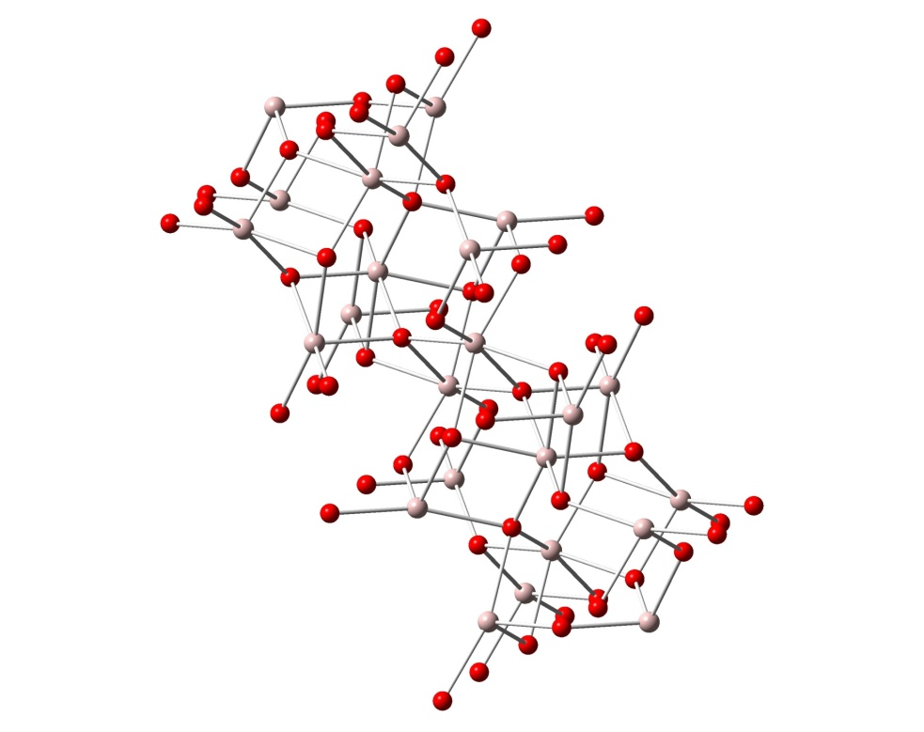
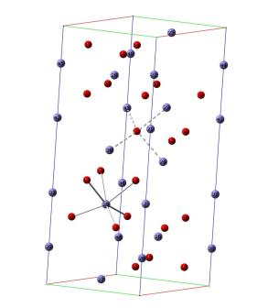
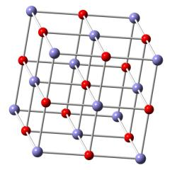
Focus 3
Catalyst Materials
Metal oxide catalysts are critical for Fischer-Tropsch type reactions that lead to energy-dense liquid fuels from low energy density feedstock.
Also interested in metal oxide nanocluster catalytic processes that result in polyaromatic species that pose serious health risks.
Need catalyst force fields that can be coupled to reactants and products.
Need reactive force fields to study reactions on the surfaces at large enough length and time scales.
Al₂O₃
Fe₂O₃
FeO

Slide 49
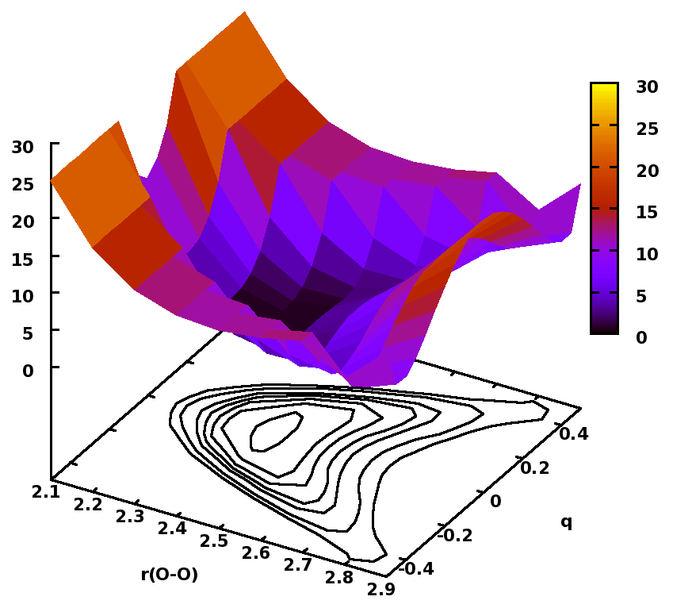
Force field development for metal oxide catalysts
Several DFT-based force fields (nonreactive) currently under development.
DFT studies of catalytic reactions also underway to guide reactive force field development.
Novel aspect:
Empirical Valence Bond (EVB) theory to construct reactive force fields.
Expect simpler development and smoother potentials than the ReaxFF approach of the Goddard group (Caltech).
Multi-state EVB reactive potential for hydrogen transfer from H₃O⁺ to either of two hydrogen-bonded H₂O molecules (Wick, LA Tech).

Slide 50
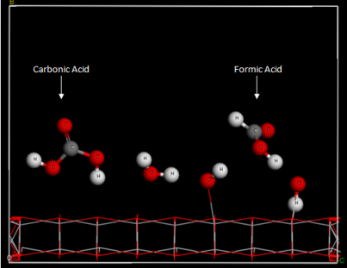
Catalytic reactions studied by DFT methods
CO₂ reduction by H₂O on Titania (TiO₂) and Zirconia (ZrO₂) surfaces studied using plane wave DFT/LDA:
  MS thesis directed by Mainardi (LA Tech).
  Both catalyze the reaction
  CO₂ + 2H₂O → HCO₂H + 2 OH
  Reaction barrier on TiO₂ is lower.
  Calculated reaction paths can guide reactive FF development.
Formic acid formation on TiO₂.
Greater insight into catalytic reactions for generating liquid fuels.
Close collaboration with two local companies: Carbon Capture Energy Technologies, and Avoyelles Renewable Fuels, Inc.

Slide 51
SD2 Focus 3 Milestones
Milestones | Y1 | Y2 | Y3 | Y4 | Y5
Develop force fields for one metal oxide system. | X
Study water gas shift and Fischer-Tropsch reactions. | X | X | X
Study persistent free radicals production on metal oxide clusters. | X | X
Develop new force fields and study of additional catalytic processes. |  | X | X | X
Validate force field calculations with experimental measurements and DFT calculations. |  |  | X | X | X
Behind
On Track
On Track
Ahead
Challenge/Barrier:
Mitigation plan:
Behind schedule on Milestone 1.
LA Tech will hire a postdoc in Y2 who will play a key role in the development of metal oxide force fields.

Slide 52
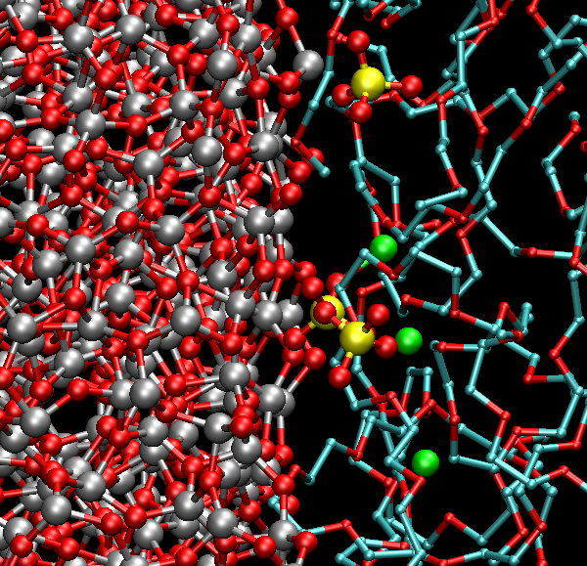
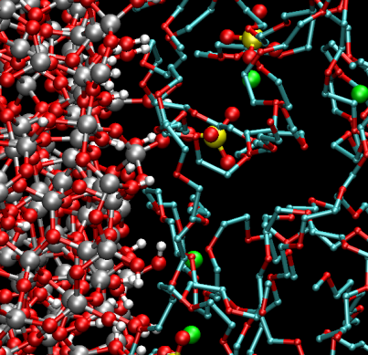
New Focus: Lithium Ion Batteries
Basic
Real-time tomography (Butler; LSU) provides images of electrode changes during charge/discharge cycles of lithium ion batteries.
MD studies of ion transport and the role of acidic and basic electrode surfaces under way (Wick; LA Tech).
Experimental and computational studies of metal oxide cathode reactions in early stages. [Funded by non-LA-SiGMA source: Meda –Xavier; Wick, Ramachandran – LA Tech)
Novel aspects:
Potential to develop detailed models of transition metal oxide cathode reactions.
Greater understanding of lithium ion intercalation and chemical damage.
Acidic

Slide 53
SD3: Biomolecular Materials
Henry Ashbaugh
Multi-scale simulation and synthesis of self-assembled and supramolecular drug delivery vehicles.
FOCUS 1
FOCUS 2
Unimolecular Delivery Vehicles
Self-Assembled Delivery Vehicles

Slide 54
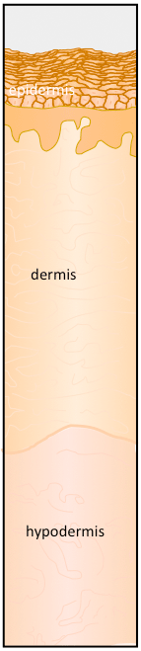
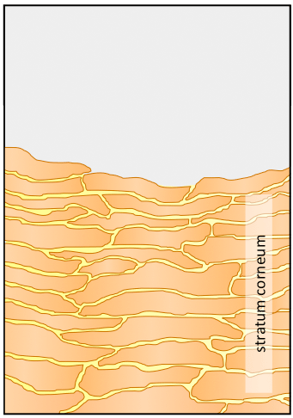
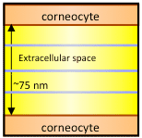
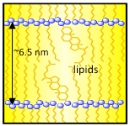
The Problem: Skin Physiology
extracellular
lipids
The outermost layer of the skin, the stratum corneum, represents the most significant barrier to the transdermal delivery of therapeutics.
corneocytes
2) The primary transport pathway through the stratum corneum involves diffusion through the lipids of the extracellular matrix.
3) The extracellular lipids are organized as multilamellar sheets inhibiting the transdermal diffusion of polar compounds.

Slide 55


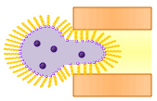


The Problem: Delivery Vehicles
Self- Assembled Drug Delivery Vehicles (Focus 2)
- Use self-assembled liposomes to transport polar drugs through lipid channels
- Amphiphiles selected to enable the liposomes to readily deform: transfersomes, ultradeformable liposomes, ethosomes.
Drugs
200nm
75nm
Pros: - Tunable assembled structures
- Inexpensive
Cons: - Assembly size dictated by thermodynamics
- Assemblies disaggregate below CMC
Unimolecular Drug Delivery Vehicles (Focus 1)
Pros: - Robust covalent assembly
- Vehicle size tunable from
5 nm to 50 nm
75nm
Cons: - Complex synthesis
- Expensive
Explore Synthesis and Delivery with Both Classes of Vehicles to Optimize Design

Slide 56





SD3 Goals
Goal:
Develop novel biomolecular materials guided by computational/experimental collaboration for the encapsulation, delivery, and release of therapeutics to targeted tissues.
Simulation challenges:
Carrier sizes (1 to 100nm), time scales for assembly/delivery (milliseconds or more), accurate free energy evaluation, efficient use of computational resources
Polymeric Unimolecular
Drug Delivery Vehicles
Self-Assembled
Drug Delivery Vehicles
linear
coarse-grained star
t = 18 ns
Surfactant micelles
star/dendrimer
lipid bilayer

Slide 57
SD3 Research Themes
Simulated
Carrier Design
Tulane, LA Tech, Grambling, LSU
Experimental
Carrier Design
Tulane, LSU, LSU-Ag, LA Tech
Drug Delivery Materials
Force Fields
Tulane, LSU, UNO
Large Scale Free Energy Simulations
UNO, LA Tech

Slide 58






Focus 1
Synthesize modular core molecules and amphiphilic side chains
Grayson (TU)
3-arm core
3-arm
Janus star
+
6-arm core
or
or
6-arm
Janus star
bifunctional monomer
 | M.W. | PDI
3-arms | 26.0k | 1.41
6-arms | 45.7k | 1.72
3x10⁴
CMC = 0.07mg/mL
2x10⁴
Fluorescence intensity
1x10⁴
On track to synthesize first Janus polymer unimolecular drug delivery vehicles.
0x10⁴
0.0
0.1
0.2
0.3
Rose Bengal concentration (mg/mL)

Slide 59



Focus 1 and 2
Develop new force-fields for simulating assembly
Ashbaugh (TU), Moldovan (LSU)
Neopentane Solubility in Water
Span80 Intramolecular Potential
ab initio
Amber
energy (kcal/mol)
First simulation model to quantitatively predict how “Oil and Water Don’t Mix”!
D1 dihedral angle

Slide 60


Focus 2
Molecular dynamics simulation of Span80 self-assembly in micelles
Moldovan (LSU), Nikitopoulos (LSU)
Self-assembly of Span 80 into a single micelle
Kinetics of Span80 aggregation
(a)
(b)
t = 100 ps
N_{Span80} = 125
t = 18 ns
MD simulations performed with GROMACS 4.0 on LONI supercomputers.
Force field parameters for Span 80 were generated using Gaussian, Amber and PRODRG2.5 server.
MD simulations show that at concentrations of 0.25 M Span 80 self-assemble spontaneously into micelles. The self-assembly process occurs in three stages: (i) aggregation in small clusters (~100ps); (ii) ripening stage, larger clusters grow at the expense of small ones; (iii) diffusion and coalescence of larger clusters.
Time evolution of the number of Span 80 clusters supports the three stage self assembly mechanism.
Span80 model applicable to modeling oil spill clean up with dispersants in the Gulf of Mexico

Slide 61

Focus 1 and 2
Develop hybrid MD/continuum techniques for accelerating time
Moldovan (LSU), Nikitopoulos (LSU)
Developed a general hybrid MD/continuum code for simulating non-equilibrium flows using LAMMPS (MD) and ANSYS/Fluent (continuum)
Extensively tested code for impulsively started Couette flow for Lennard-Jones Fluid
Established collaboration with Dr. Steve Plimpton (Sandia) to distribute through LAMMPS
Hybrid MD
Hybrid CFD
Pure CFD
(no-slip)
Moving Wall (impulsively started)

Slide 62
SD3 Milestones
Milestones | Y1 | Y2 | Y3 | Y4 | Y5
Synthesize modular library of core monomers to explore novel encapsulation/delivery chemistries | X | X | X
Develop new atomic and coarse-grained force fields | X | X
Develop new hybrid MD/continuum, coarse-grained, and accelerated strategies to link length/time scales | X | X | X
Use multi-scale simulation methods to optimize supramolecular delivery vehicles |  |  | X | X | X
Synthesize, characterize, and assess new self-assembled transmembrane drug delivery vehicles | X | X | X
Validate computational models for self-assembled drug carriers for bio-membrane translocation |  |  | X | X | X
Use MD and CG methods to study the mechanisms of cellular absorption of drugs |  |  |  | X | X
On Track
On Track
On Track
On Track

Slide 63





Traveling the STEM Pipeline
Programs
LINK
Planning Grants
Pfund
SBIR/STTR
TGEF
OPT-IN
Tenured Faculty
Tenure-Track Faculty
SURE
REU
LINK
Undergrad / Graduates /Post Docs
K-12
SoS
Notes:
63

Slide 64
Workforce Development
Juana Moreno
LA-SiGMA will address all levels of the educational ladder, contributing to a well-trained and diverse professional workforce.

Slide 65
Workforce Development Strategies
Grades 6 – 12 Students
2-Year College Students
Post Docs
Workforce Strategies
2-Year College Instructors
Graduate Students
4-Year College Students
High School Teachers

Slide 66







Grades 6-12
Two graduating Louisiana School for Math, Science, and the Arts were selected to participate in the LSU REU program.
LA Tech/Grambling Open House
Tulane Open House
Notes:
66

Slide 67

Partnerships

Slide 68


High School Teachers
Leveraged LSU’s LaMSTI teacher program
SU RET teachers participated in the GPU team
29% women, 14% URM
Notes:
68

Slide 69







Undergraduates
30 LASiGMA REU students statewide
46.5% women, 53.5% URM
Notes:
69

Slide 70
Supervised Undergraduate Research Experiences (SURE)
Undergrad / Graduates /Post Docs
SURE is one of the many programs administered by Louisiana EPSCoR. The program, restricted to women & URM, provides a stipend of $4,000/term.
In Year 1, 127 applications were received
30 awards were made.
Another round is expected in December 2011.
Notes:
70

Slide 71

Graduate Students
Graduate level courses:
1 course Fall 2010, 3 courses Spring 2011, 2 courses Fall 2011
(4 of the courses in partnership with German & Swiss Universities leveraging PIRE award)
Notes:
71

Slide 72


Graduate Students and Postdocs
Density Functional Workshop, Summer 2011
(40 registrants, 5 speakers, LA Tech, LSU, SUBR, Tulane, Xavier)
Kieron Burke
UC Irvine
Weitao Yang
Duke
Indo-US joint proposal being developed.
John Perdew
Tulane
Shobhana Narasimhan
Jawaharlal Nehru Centre
Mel Levy
Tulane & N.C. A&T
Tanusri Saha-Dasgupta
S.N. Bose National Centre
Notes:
72

Slide 73

Graduate Students and Postdocs
Workshop on Computational Thinking
Computing education for the 21st century proposal with Shodor in the works
Notes:
73

Slide 74

Graduate Students and Postdocs
Workshops on GPU Algorithms and Programming Tools
Notes:
74

Slide 75


Graduate Students
Materials Science PhD Programs
LSU-SU-UNO joint PhD in Materials Science & Engineering:
Proposal approved by SU and LSU systems, being considered by the Louisiana Board of Regents.
LA Tech PhD in Molecular Science & Nanotechnology:
Letter of Intent being reviewed by University of Louisiana System, should go to Board of Regents in September. Expect to receive permission to submit proposal for the degree.
Notes:
75

Slide 76




Graduate Students and Postdocs
Internships
Supada Loasooksathit from LA Tech spent one quarter at University of Hertfordshire in the UK
Marielle Soniat from UNO visited Susan Rempe at Sandia Albuquerque
Chinedu Ekuma from LSU will visit Pacific Northwest National Laboratory in August 2011
Chinedu Ekuma and Ryky Nelson from LSU will visit Brookhaven National Laboratory in September
Notes:
76

Slide 77
Links with Industry and National Laboratories (LINK)
Funding to visit and train at an industrial facility, research center, or national laboratory for a period of 2 – 12 weeks.
Tenured Faculty
10 LINK awards:
9 faculty
6 graduate students
University of Aberdeen, Scotland
Los Alamos National Laboratory
Mathematisches Forschungsinstitut, Oberwolfach, Germany
Terrestrial Microbial Ecology Lab, Kyoto University, Japan
World Vegetable Center, Taiwan
Proyecto Yacare, Argentina
Smithsonian Tropical Research Institute, Panama
Tenure-Track Faculty
Undergrad / Graduates /Post Docs
Notes:
77

Slide 78
Workforce Development Milestones
Milestones | Y1 | Y2 | Y3 | Y4 | Y5
Open House for MS/HS | X | X | X | X | X
Research Experiences for Teachers | X | X | X | X | X
Research Experiences for Undergraduates | X | X | X | X | X
Graduate Courses via Synchronous Video | X | X | X | X | X
Internships at National Labs/Industry | X | X | X | X | X
Graduate Curricula |  | X | X | X | X
Short Courses and Modules for CC | X | X | X | X | X
On Track
On Track
On Track
On Track
On Track
Ahead
On Track

Slide 79
Workforce Development Milestones
Milestones | Y1 | Y2 | Y3 | Y4 | Y5
Summer Workshops for HS/MS | X | X | X | X | X
Beowulf Boot Camp for CC | X | X | X | X | X
Effective Teaching Workshops for GS/PD | X | X | X | X | X
Behind
Behind
Behind
Challenge/Barrier:
Logistical issues (e.g., housing minors on campus) hindered HS/MS summer workshops.
BRCC volunteers instructors for Boot Camp unable to participate.
Logistical issues prevented Effective Teaching Workshop.
Year 1 experience with running RET will allow summer workshops in Year 2.
Meet BRCC Science Dean this August and new instructors on Boot Camp.
Effective Teaching Workshop to be presented in Year 2.
Mitigation Plan:

Slide 80
External Engagement
Ramu Ramachandran
[LA-SiGMA] will provide for efficient collection and dissemination of information between participants, the K-12 community, two-year colleges, and the general public.

Slide 81
External Engagement Strategies
Public media
International partnerships
Science museums
External Engagement Strategies
Interaction with NSF
Public lectures
Internal communications
Local industry

Slide 82


Public Media
Louisiana Public Broadcasting, public lectures, news media, EPSCoR newsletters.
Interview on Public Radio with RET teachers.
Print media stories about LA-SiGMA in North and South Louisiana.
LA-SiGMA featured in EPSCoR newsletters.
Working with LPB to be featured on “Louisiana: The State We Are In.”
Notes:
82

Slide 83




Science Museums & Public Lectures
Multiple events in museums at Baton Rouge, and Shreveport
SciPort Museum in Shreveport, South Arkansas Community College.
Balloon Nanotube at the 2011 NanoDays hosted at the Louisiana Art & Science Museum, Baton Rouge.
Girls Learning About Math and Science (GLAMS) at South Arkansas Community College (event targeting local middle & high school girls).
Public lectures and hands-on activities at SciPort Discovery Center, Shreveport.
Notes:
83

Slide 84
Public Lectures: Speaking of Science (SoS)
60 presentations in Year 1
to over 2,200 students
52% females
38% URM
13,000 students reached in the last 5 years.
K-12
Undergrad / Graduates /Post Docs
SoS is one of the many programs administered by Louisiana EPSCoR.
The program provides faculty speakers
to K-12 schools free of charge.
Notes:
84

Slide 85



Target: Internal Communications
Leverage cyberinfrastructure, video-conferencing, collaboration tools, web portal, all-hands meetings.
Monthly seminars over Acess Grid and IOCOMM network held all through Year 1.
HD video conferencing equipment being purchased to take advantage of LONI bandwidth.
Web portal operational
http://lasigma.loni.org
Notes:
85

Slide 86



Target: Internal Communications
Leverage cyberinfrastructure, video-conferencing, collaboration tools, web portal, all-hands meetings.
30 contributed papers (posters)
18 multi-campus contributions
90 participants
ERB
DAC
Three meetings held in Year 1, including the 2011 EPSCoR RII LA-SiGMA Symposium.
LA-SiGMA Facebook page.
Winners of the poster competition will attend national EPSCoR meeting in Idaho.
Notes:
86

Slide 87

Target: National and International Partnerships
Indo-US joint proposal being developed.
NSF-G8 Research Councils proposal being developed (LA-SiGMA, Japan, Germany).
Notes:
87

Slide 88


Partnership with Pacific Northwest National Lab
Environmental Molecular Sciences Laboratory (EMSL)
  Home of NWChem!
DOE INCITE request for 200,000,000 SUs over 3 years on Jaguar and Titan supercomputers (20+ PFLOPs, Kepler GPUs)
Internship program for LA-SiGMA students
  3-6 month visits
  Working with EMSL Open Source Code Developers
  Opportunities for students, undergraduate to PhD
Partners in Indo-US SCES Centre
EMSL Associate Lab Director Bill Shelton participating in an LA-SiGMA REU panel

Slide 89

Target: NSF
Formal mechanisms for interaction with NSF
Strategic Planning meeting attended by EPSCoR program director.
Strategic Plan revised with NSF feedback and resubmitted.
NSF invited to RII LA-SiGMA Symposium in August, 2011.
Nine highlights on LA-SiGMA activities submitted in Year 1.
LA-SiGMA RET story featured on NSF website.
Notes:
89

Slide 90
External Engagement Milestones
Strategies | Y1 | Y2 | Y3 | Y4 | Y5
Leverage multiple avenues to engage the general public. | X | X | X | X | X
Create a web portal for distribution of project deliverables. | X | X | X | X | X
Create a repository and version control system for code development and distribution. | X | X | X | X | X
Leverage cyberinfrastructure to facilitate communication. | X | X | X | X | X
Use Newsletter/Brochures/Highlights to publicize Alliance activities. | X | X | X | X | X
Create formal mechanisms for engagement with NSF. | X | X | X | X | X
Establish new national and international collaborations. | X | X | X | X | X
Create mechanisms for internal communications. | X | X | X | X | X
On Track*
On Track
On Track
On Track*
On Track
On Track
On Track
On Track
*Mostly on track; pending LPB appearance and HD video conferencing equipment purchase.
Mitigation plan: Working with LPB for feature, HD standards being finalized.

Slide 91
Diversity
Randall Hall
Increase the number of URM and women in the Alliance.

Slide 92
Diversity Strategies
Diversity Advisory Council
Financial Incentives
Diversity Strategies
Create pipelines to graduate school
Develop faculty role models

Slide 93


Diversity Advisory Council
DAC and LA-SiGMA EEWD Committee members in attendance at the August 2011 RII LA-SiGMA Symposium
LA-SiGMA is acting on the Fall 2011 DAC suggestions.
Notes:
#1. Diversity Advisory Council has been established. They meet at the second All Hands Meeting on August 6, 2011
The LA-SiGMA External Engagement and Workforce Development Committee completed a document for the Diversity Advisory Council with existing and planned strategies at each school.
#2. LA-SiGMA announced supplemental research assistantships for women and URM graduate students to all faculty LA-SiGMA members. Since LA-SiGMA funds became available only after October 2011, our Year 1 recruiting efforts were targeted for students who will join us in Year 2.
#3. LA-SiGMA has announced the availability for funds to supplement department start-up packages to LA-SiGMA institutions to recruit new URM and female faculty members with research interests in Materials Science. None hired yet.
Mentoring: None done
#4. Existing 3+2 and 4+1 programs in the state. LA-SiGMA plans to use these pipelines, as well as expand on them in the future.

Slide 94

Strategies
Graduate Assistantship Supplements
Announced, targeting Fall 2011 awards
Supplements to Startup Packages
Contributing to the startup package of Anne Robinson, Tulane.
Pipelines
Targeting recruiting efforts in all state bridge programs:
4+1 Grambling/LaTech, 3+2 Xavier/Tulane, 2+2 LSU/BRCC and 2+2 Southern/BRCC beginning Fall 2011

Slide 95
Diversity Milestones
Milestones | Y1 | Y2 | Y3 | Y4 | Y5
Diversity Advisory Council. | X | X | X | X | X
Provide financial incentives to GS. | X | X | X | X | X
Supplement Startup Packages. | X | X | X | X | X
Create/expand pipelines to graduate school. |  | X | X | X | X
On Track
On Track
On Track
On Track
Challenge/Barrier:
Small pool year 1
Focus on year 2 and beyond
Mitigation Plan:
Notes:
#1. Diversity Advisory Council has been established. They meet at the second All Hands Meeting on August 6, 2011
The LA-SiGMA External Engagement and Workforce Development Committee completed a document for the Diversity Advisory Council with existing and planned strategies at each school.
#2. LA-SiGMA announced supplemental research assistantships for women and URM graduate students to all faculty LA-SiGMA members. Since LA-SiGMA funds became available only after October 2011, our Year 1 recruiting efforts were targeted for students who will join us in Year 2.
#3. LA-SiGMA has announced the availability for funds to supplement department start-up packages to LA-SiGMA institutions to recruit new URM and female faculty members with research interests in Materials Science. None hired yet.
Mentoring: None done
#4. Existing 3+2 and 4+1 programs in the state. LA-SiGMA plans to use these pipelines, as well as expand on them in the future.

Slide 96
Evaluation and Assessment
Henry Ashbaugh
Evaluation and Assessment of (1) research milestones; (2) broader impacts; and (3) impact on the jurisdiction’s S&T enterprise.
.

Slide 97






Evaluation and Assessment Team
External Review Board
Dr. William Lester
UC Berkeley
Dr. Vincent McKoy
Caltech
Dr. Harold Silverman
SUNY (retired)
Dr. Susan Sinnott
University of Florida
Dr. Valerie Taylor
Texas A&M
External Evaluator
Kansas State University
Office of Educational Innovation & Evaluation
Internal Review Board
Dr. Ramu Ramachandran
LA Tech
Dr. Cheryl Stevens
Xavier
Dr. Diola Bagayoko
SUBR
Dr. Scott Whittenburg
UNO
Dr. Hank Ashbaugh
Tulane
Dr. Shantenu Jha
LSU

Slide 98

Program Evaluation and Assessment
Process
• Logic Models clearly defined inputs, strategies, activities, outputs, outcomes, and metrics for overall project and team goals.
  • Goal-Based Evaluation Work Plan guides the assessment of the impact of team strategies and the broader impacts of the project overall. Each of the nine project team goal areas and strategies contain:
  • Strategy to be assessed
  • Method(s) of evaluation (quantitative and qualitative) and timeline
  • Criteria for accomplishment or outcomes desired
  • Responsibility
  • Types of data
    Data source
    (database, survey, interview, document review, focus group)
    Formative and summative metrics from logic models and proposal

Slide 99

Baseline Survey
Goal: Collect statistics for the year prior to LA-SiGMA funding.
Time window: Oct. 1, 2009 –
Oct. 31, 2010. Deliberately had a small overlap (1 month) with the current project.
The purpose of the overlap was to see how quickly we were able to pick up or transfer students to LA-SiGMA funding.
93%
Survey response rate across the state
The survey covered all aspects of the project:
Graduate students
Undergraduate students
Diversity in the G and UG populations
External Engagement
Research Productivity – papers, presentations, proposals
Research Collaboration – collaboration tools/mechanisms
Computational Science/Technology utilization
Intellectual Property Development

Slide 100
Evaluation Plan
OEIE has developed an evaluation plan to assess advancement along Louisiana EPSCoR goals
SD1
Electronic and Magnetic Materials: Model larger lengths scales than currently feasible
DIV
Diversity: Dramatically increase minority and women representation
SD2
Energy Materials: Computationally model/design next gen energy materials for generation/storage/conversion
EE
External Engagement: Outreach to K-12, community colleges, industry, & public
SD3
Biomolecular Materials: Model/design novel drug delivery vehicles
S/RI
Sustainability – Research Infrastructure: Initiate programs to propel LA researchers to national competitiveness
CTCI
Computational Teams and Cyber-infrastructure: Develop formalisms, algorithms, codes for leadership class machines
S/FD
Sustainability – Faculty Development: Effectively compete for federally funded materials center

Slide 101
Sustainability, Management & Impact
Michael Khonsari
By the end of the RII project, Louisiana will succeed in establishing a federally funded center of excellence such as a MRSEC, ERC, or STC.

Slide 102
Traveling the STEM Pipeline
Programs
LINK
Planning Grants
Pfund
SBIR/STTR
TGEF
OPT-IN
Tenured Faculty
Tenure-Track Faculty
SURE
REU
LINK
Undergrad / Graduates /Post Docs
K-12
SoS
Notes:
102

Slide 103





Pilot Funding for New Research (Pfund)
Awards of up to $10,000 to:
Explore new ideas
Keep pace with
cutting-edge techniques
Enhance
research focus
47 Pfund awards were made this year.
Tenure-Track
Faculty
Tenured
Faculty
Notes:
103

Slide 104






Pfund Results: Impact From Previous RII
2008 – 2010 and counting…
189
Proposals Submitted
41
Proposals Awarded
251
Presentations
205
Publications
2
Patents
$16 Million
External Funding
Notes:
104

Slide 105


Opportunities for Partnership in Technology with Industry (OPT-IN)
Build sustainable relationships between academia and industry
Facilitate the commercialization
of research
Enhance research competitiveness
Promote the economic development of Louisiana
Category I
Research Focus
$10,000 – 50,000
Cash Match Required
100% cash match for non-LA industry/private sponsor
Category II
Commercialization Focus
8 OPT-IN Awards were made
Tenure-Track
Faculty
Tenured
Faculty
Notes:
105

Slide 106


Industry-Academia Collaborative Workshops
Materials & Energy
Held in October 2010 in Baton Rouge
Two industry panels
Panel of campus IP officers
Software Development & Digital Media
Held in June at the LITE Center in Lafayette
3 panels consisting of:
  Industry needs
  The academic perspective
  Stories of successful collaboration
Notes:
106

Slide 107

SBIR/STTR Phaze Zero Grants
Supports the development of projects with economic potential by offering “Phase Zero” awards that assist small businesses to prepare and successfully compete for Small Business Innovative Research (SBIR) or Small Business Technology Transfer (STTR) proposals.
19 SBIR/STTR awards were made in year 1.
Tenure-Track
Faculty
Tenured
Faculty
Notes:
107

Slide 108


Slide 109

RII - Track 1: Management
State EPSCoR Committee
Michael Khonsari
Project Director
LA EPSCoR Staff
External Review Board (ERB) & External Evaluator
Project Execution Team (PET)
Industry Liaison Team (ILT)
Science & CI (S&CI) Leads
Jarrell (LSU),
Pratt (Tulane)
Diversity Advisory Council (DAC)
Project Execution Team (PET)
Evaluation & Assessment (E&A) Leads
Ramachandran (LA Tech),
Stevens (Xavier)
ILT Representative
Whittenburg (UNO),
Ramachandran (LA Tech)
DAC Representative
Bagayoko (SUBR),
Derosa (LA Tech/Grambling)
External Engagement, Workforce & Diversity Development (EEWD) Leads
Hall (LSU), Derosa (LA Tech/Grambling)
Science Driver and Computational Teams
Faculty, Students, and Postdocs

Slide 110
At the end of Year 1…
Research
Multi-institutional research teams formed.
Collaboration tools being used to strengthen ties between team members.
Joint papers and proposals already being submitted.
Diversity
Diversity Advisory Council formed.
Financial incentives for women and URM graduate students being offered.
Programs are ongoing to recruit women & URM at all levels.
SURE Grants awarded.
Workforce Development
First year REU and RET programs highly successful.
Plans already in place to involve middle and high school students in research.
New PhD programs in Materials Science and Engineering proposed.
Programs for 2-year colleges about to be launched.
Strong Multidisciplinary and Multi-Institutional Research Teams
Transformative Research and Education in Materials Science
Notes:
110

Slide 111
On target to meet expected outcomes …
Computational Teams & Cyberinfrastructure
GPU team established.
New hybrid hardware being purchased at LSU (shared resource).
HD synchronous video equipment being purchased.
On track to leverage emerging paradigms in computing.
External Engagement
Multiple avenues and events for public outreach successfully utilized.
Additional public engagements being planned and pursued.
International partnerships established and being formalized through joint proposals.
Evaluation and Assessment
External evaluator and External Review Board.
Comprehensive evaluation plan established.
Strategic plan prepared, revised, and submitted to NSF.
Strong Multidisciplinary and Multi-Institutional Research Teams
Transformative Research and Education in Materials Science
Multiscale Simulation Tools for 21st Century Computing Environments
National Center of Excellence in Multiscale Materials Simulation

Slide 112

LA-SiGMA Present and Future
Collectively we are on track to make transformative
advances in materials science research and education
Center of Excellence
Multi-scale simulation tools
Interdisciplinary research groups
Model for collaborative graduate education
Linkages to national labs and industry
Highly trained STEM workforce

