Slide 1


Using Performance and Accountability Measures to Develop a Performance Based Funding Model for GEAR UP State Grants

Slide 2
Presentation Outline
LA GEAR UP Overview
Performance-Based Budgeting (PBB)
7 Steps to Implement PBB

Slide 3
LA GEAR UP Overview

Slide 4
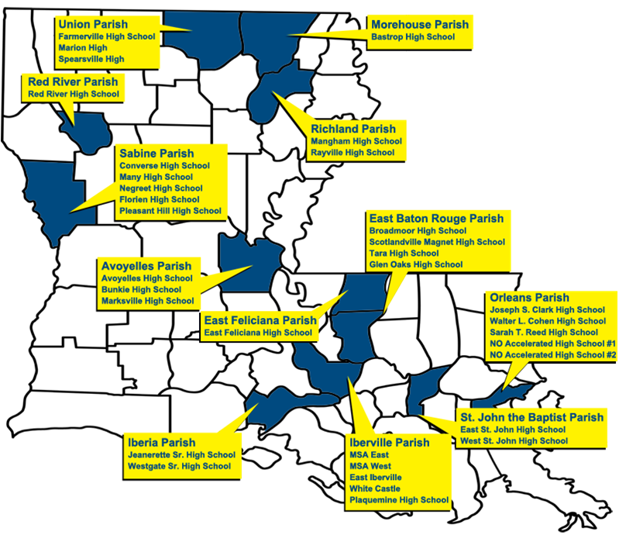
Characteristics of LA GEAR UP
State Grant
2008-14
$18 million
$3 million/year
Insert Map

Slide 5



2008-14 LA GEAR UP Cohort
Grade Level | 2008-09 | 2009-10 | 2010-11 | 2011-12 | 2012-13 | 2013-14
12
11
10
9
8
7
6
Continuing Students
Unpredictable attritions and additions

Slide 6

LA GEAR UP Initiatives
School-specific
Competitively funded
Not competitively funded
Mandatory
Program-wide
Discretionary
Standard
Make a Difference Grants
Special

Slide 7
Standard
Special
School-Based Explorers Clubs
Writing Contests
Financial Aid Workshops
Surveys
PD for Teachers
Rewards for Success Scholarships
Summer Camps on IHE Campuses
Pilot Project: ACT’s Quality Core
Parental Involvement
Positive Behavior Support
Integration of Technology
Academic Achievement
Tutoring
Educational Field Trips

Slide 8
Performance-Based Budgeting (PBB)

Slide 9
The Basics of PBB
PBB – allocation of resources in a manner to achieve measured results
Encourages and Rewards Success
Assists in Defining and Focusing on Priorities
Improves Expenditure Control and Performance
Relates Resource Allocation to Past Performance and Proposed Future Performance

Slide 10
PBB – LA GEAR UP’s Approach
Statewide ranking of schools by PPS
Standard Initiative Data
Special Initiative Data
LA GEAR UP Program Performance Score (PPS)
Apply funding tiers to ranking
LDE School Performance Data
Issue contracts
Make a Difference Score

Slide 11
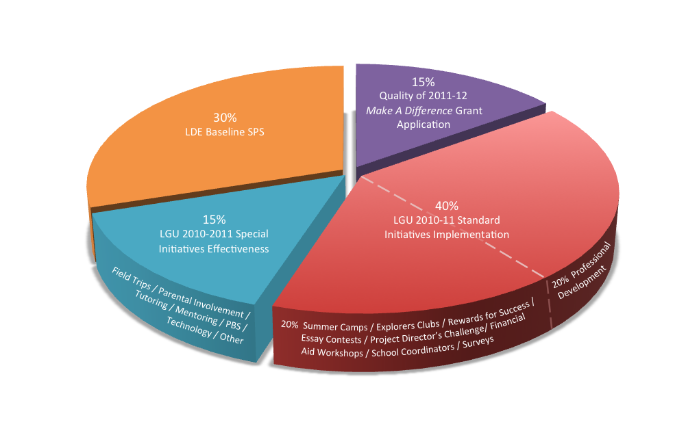
Program Performance Score Criteria & Weights

Slide 12
7 Steps to Implement PBB

Slide 13
7 Steps to Implement PBB
1
Establish Budget
2
Engage LEAs
3
Evaluate and Score Applications
4
Profile School Data and Establish PPSs
5
Rank and Fund Schools Based on PPS
6
Recognize Top 5 Scoring Schools
7
Make Awards via Contracts
Make a Difference Grant Process

Slide 14
1. Establish Discretionary Budget
$1 million

Slide 15
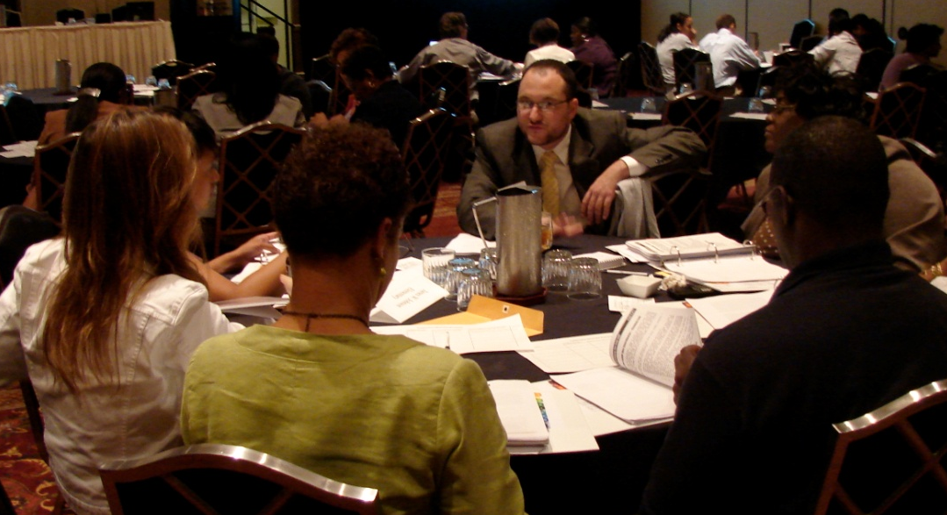
2. Engage LEAs Regarding Education Reform Priorities
Best Practices Conference Each Fall
Support Workshops
Informative Website
Online Application

Slide 16
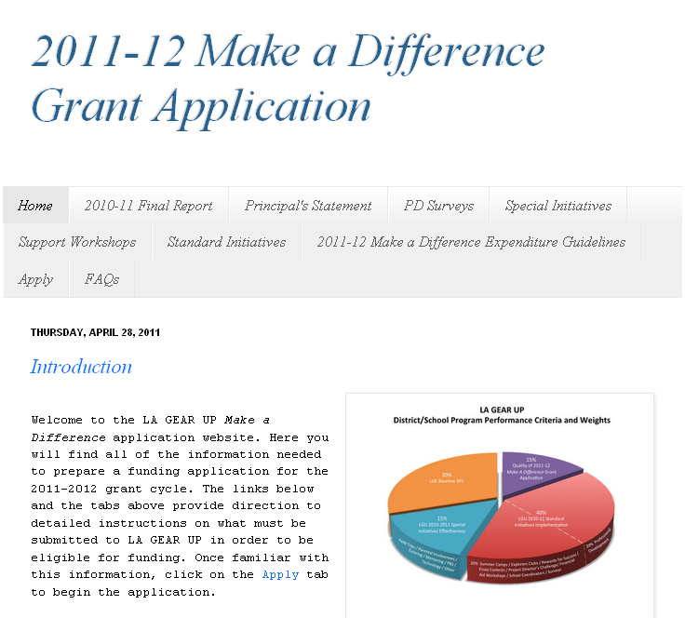
The Make a Difference Grant Application Instructional Website
www.makeadifferencelgu.blogspot.com

Slide 17
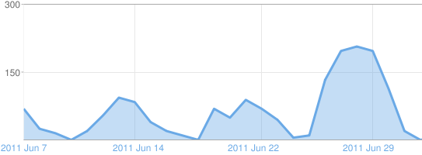
June 2011 Instructional Website Traffic
Application Deadline July 1, 2011

Slide 18
The 4 Components of the
Make a Difference Grant Application
Previous Year Final Reports
Principal’s Statement on Education Reform Priorities
Professional Development Survey
Special Initiative Proposals (3)

Slide 19
Previous Year’s Final Report
Implementation Status
The Degree to which Goals & Objectives Were Met
Number of Students Impacted
Suggested Improvements
Photo Upload

Slide 20
Principal’s Statement on
Education Reform
3 Key Priorities for the Academic Year
Current Efforts
Proposed Future Efforts
The Role of Professional Development

Slide 21
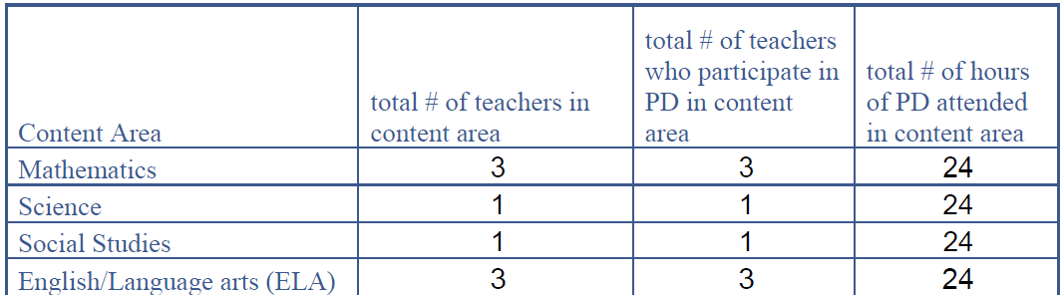
Professional Development Survey
Identifies Past and Projected PD Attendance
Core Content Areas

Slide 22

Special Initiative Proposals
Initiative Title
The Problem
Proposed Impact
Timeline
Population
Goals & Objectives
Budget Detail

Slide 23

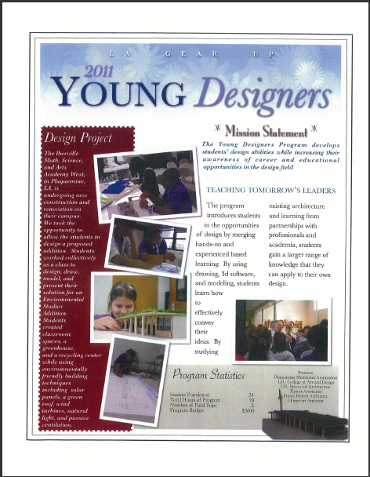
Supplemental Materials

Slide 24
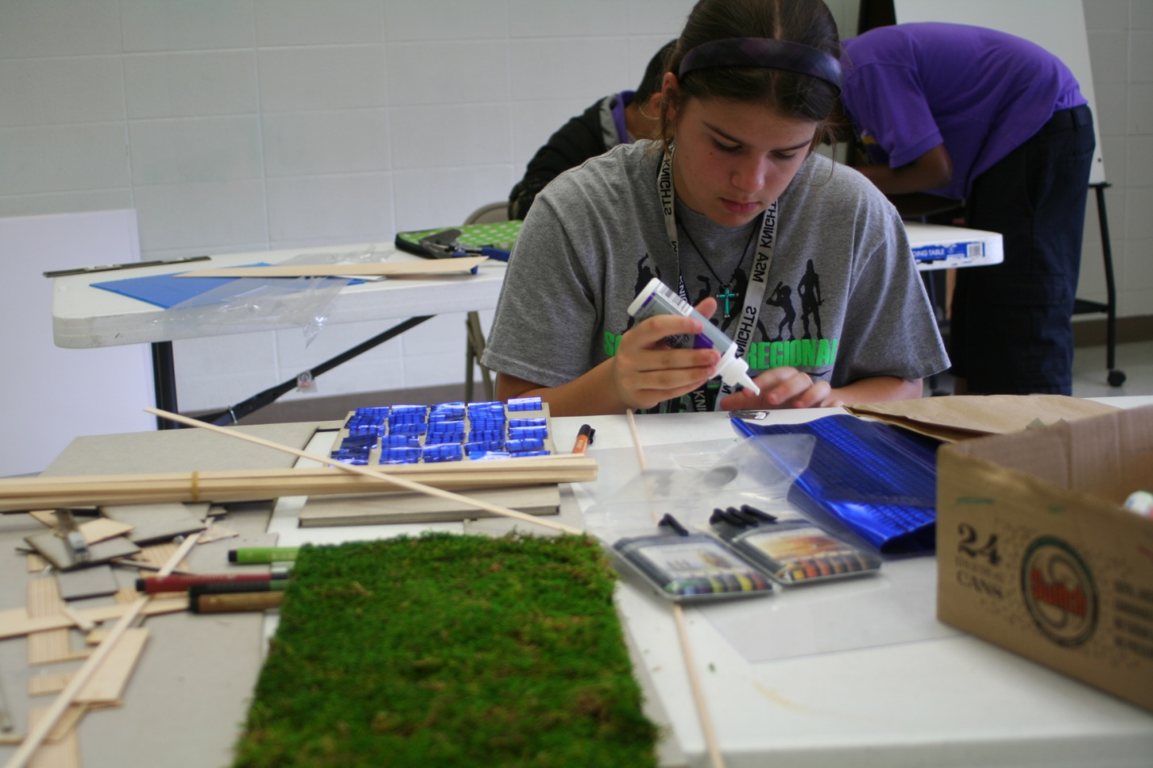
Young Designers at IMSA West

Slide 25
Components of Young Designers
Field Trip to LSU’s School of Architecture, College of Art & Design
School-Based Design Instruction
Field Trips to Area Architecture Firms
Hands On/Project-Based Activities

Slide 26
Make a Difference Grant Online Application System
Web-based Interface
Interactive Forms
File and Photo Uploads
Feeds into a Database

Slide 27
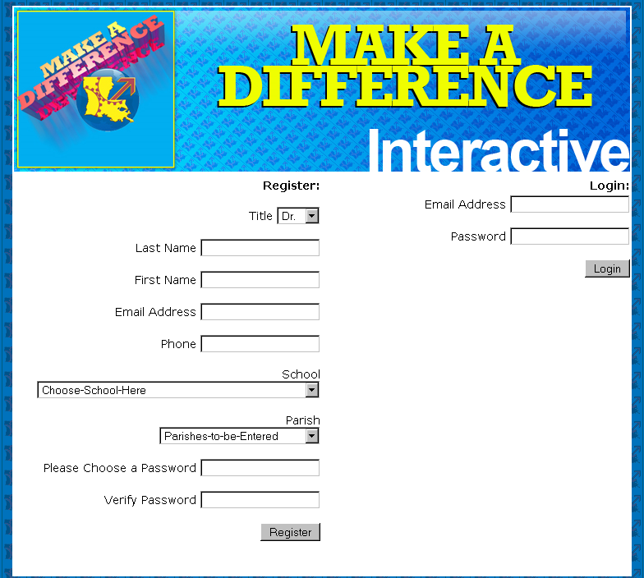
Registration and Log In

Slide 28
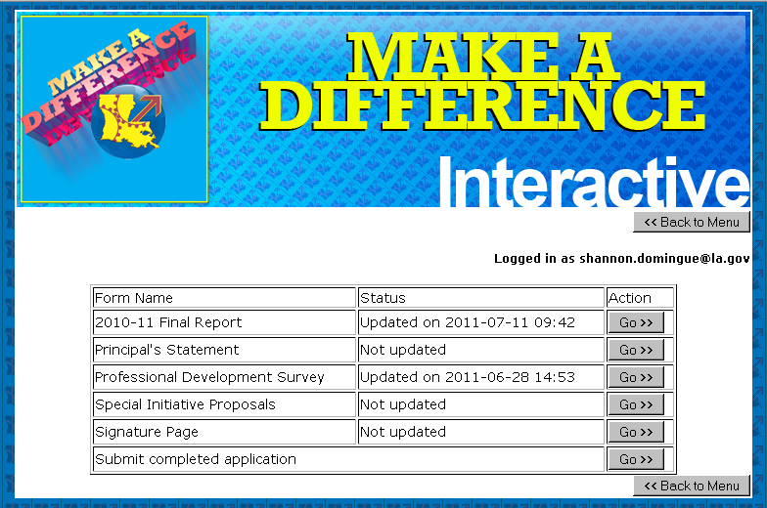
Navigation
Individually accessible components

Slide 29
3. Evaluate and Score Applications
Independent Panel of Scorers
Scored Using a Rubric Style Scoring Tool

Slide 30
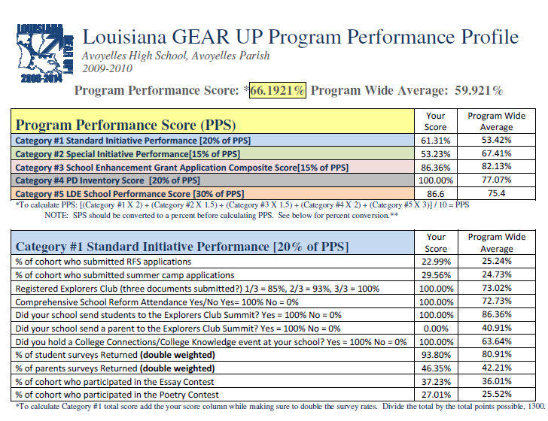
4. Establish School-Specific Data Profiles and PPSs

Slide 31
5. Rank and Fund Schools Based on PPS
Tier | Funding Level | PPS Score Range | % of schools
1 | 100% of request + $5,000 Exemplary School Award Max $25,000 | 74.36% to 79.2577% | 11
2 | 100% of request Max $20,000 | 68.32% to 72.2% | 23
3 | 2 of 3 initiatives or $12, 000 Max $12,000 | 60.34% to 66.3% | 25
4 | 2 of 3 initiatives or $10,000 Max $10,000 | 52.3788% to 59.7999% | 18
5 | 2 out of 3 initiative or $8,000 Max $8,000 | 32.566% to 49.9455% | 23

Slide 32
% LGU Schools Per Tier

Slide 33
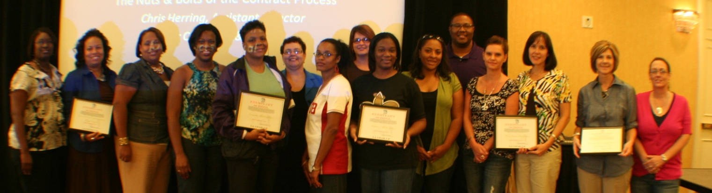
6. Recognize Top 5 Scoring Schools
2009-10 Exemplary Schools | Score | Parish
1. John L. Ory Communications Magnet School | 79.25% | St. John
2. Anderson Middle School | 75.30% | Iberia
3. Jeanerette Middle School | 74.8745% | Iberia
4. Many Jr. High School | 74.8725% | Sabine
5. Mangham Jr. High School | 74.36% | Richland

Slide 34
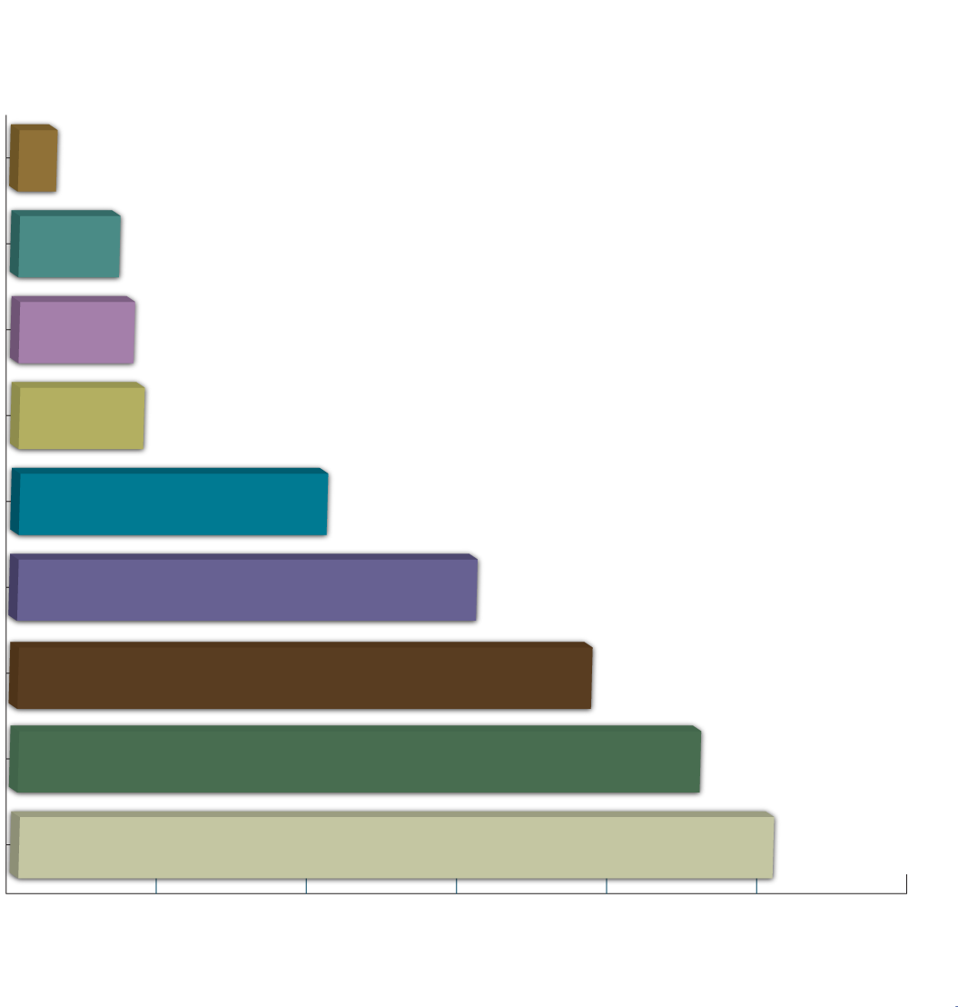
7. Award Make a Difference Grants Via Annual Contract

Slide 35



Tools Used
www.blogspot.com
Free web design tool.
My SQL Database
Management System
Dreamweaver Web Design Software by Adobe

Slide 36
For More Information Visit:
www.lagearupatnccep2011.blogspot.com

Slide 37
Shannon J. Domingue, Program Coordinator
shannon.domingue@la.gov
(225) 342-4253

